Slide 2
Weld Sensors for Robotic Welding
Intermediate Training
Jack Moore May 2018

Slide 3
Overview
Theory: sensing technologies
Seam finding
Seam Finding
AccuFast setup
Macro Job settings
Applications
Seam Tracking
Comarc tuning

Slide 4
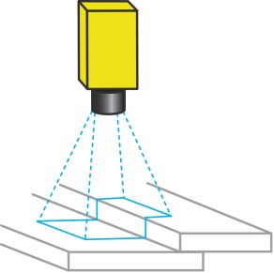
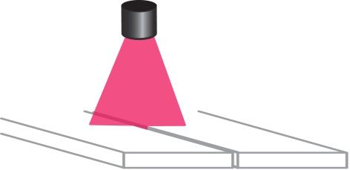
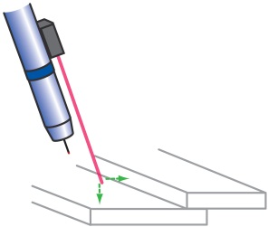
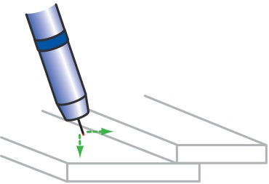
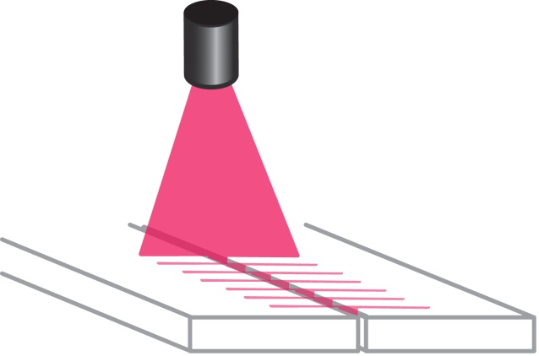
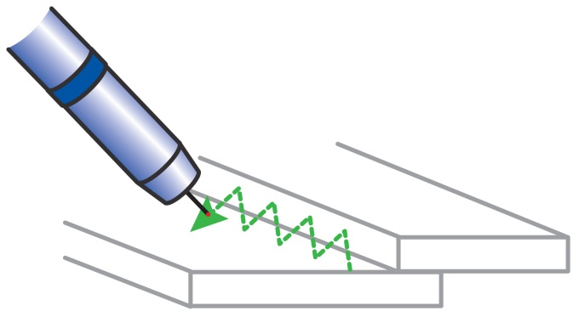
SeamFinding
Motoeye SF w/ Servo-Robot iCube
MotoSight 2D
AccuFast
Touch Sensing
Adaptive Welding
MotoEye LT w/ Servo-Robot tracking Cameras
SeamTracking
Com-Arc (thru-the-arc)
Multi-Layer Welding

Slide 5
Usage
Sensor comparison
Touch Sensing
Pro’s
Low cost
Reliable (most surfaces / metals)
Easy to program
Can be used with Toolsight
Con’s
Wire brake sometimes required (increased cost)
Slower measurement time with thin electrodes / softer metals
Wire clipping usually required (increased cycle time, increased programming complexity)
AccuFast
Pro’s
No wire clipping (simpler program logic, reduced cycle time)
Easy to program
Faster search speeds (especially for easy-to-bend electrodes) and faster search patterns
Thinner materials / butt joints
Can be used with the AccuFast Target
Con’s
Not applicable for highly reflective materials (shiny stainless steel, etc.)

Slide 6
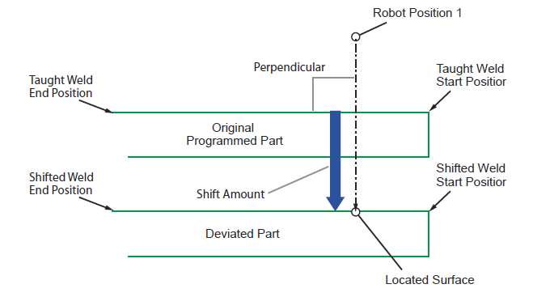
Theory – Seam Finding

Slide 7
Overview
seam finding fundamentals

Slide 8
Theory – Seam Finding

Slide 9
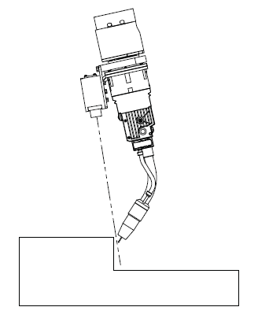
Principles
Laser Spot Sensor
Detects if the surface is “in range” based on a stand-off distance (which can be customized)
If surface is “in range” / at the stand-off distance, or closer…
“Wire touched” signal is sent to controller
Robot briefly stops its motion
Robot collects positional data
Rob continues with macro job routine

Slide 10
AccuFast - Setup
Keyence Sensor adjustments
Keyence sensor:
General Navigation
Display
Settings for AccuFast
LOW
HIGH
Averaging Filter
HI
RIN#(x)=OFF
RIN#(x)=ON
LO

Slide 11
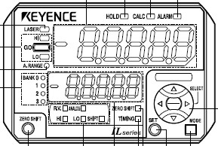
AccuFast - Setup
Keyence Sensor: Display
During normal operation…
Main display = used to show the current measured distance
Secondary display (lower display) = shows the value of the parameter currently be adjusted
The SELECT buttons are used to navigate to the various parameters (using left/right) and also to adjust the value of the given parameter (using up/down)

Slide 12
AccuFast - Setup
Keyence Sensor adjustments: LOW
The LOW setting is an application-critical setting. If you adjust this after you have programmed robot positions inside the Touch Macro Jobs, you will need to reprogram the robot positions of the Touch Macro Jobs and, thus, possibly weld path as well! Adjust this before you begin robot programming.
Press LEFT/RIGHT select buttons until the LED labeled LO is lit.
Press UP/DOWN to adjust for your application.
HI
RIN#(x)=OFF
RIN#(x)=ON
LO

Slide 13
AccuFast - Setup
Keyence Sensor adjustments: HIGH
The HIGH setting, for most settings, is a not an application-critical setting. Typically this HIGH value is set far from the LOW value. For most applications, bigger is better.
Press LEFT/RIGHT select buttons until the LED labeled HI is lit.
Press UP/DOWN to adjust for your application.
HI
RIN#(x)=OFF
RIN#(x)=ON
LO

Slide 14
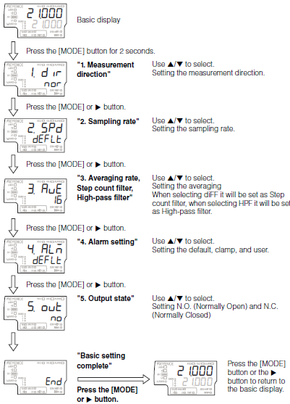
AccuFast - Setup
Keyence Sensor adjustments: Averaging Filter
The AvE setting is an application-critical setting. Set this before starting robot programming. If adjusted after robot programming began, the robot positions of the Touch Macro job (and weld path) may need to be reprogrammed. 16 is default value.
Press MODE
Press SELECT Right or MODE until “3. AvE” is displayed
Press UP/DOWN to adjust for your application.
More reflective surface … larger number (ie. 32 or 64)
Thinner lap joint / smaller “Lap Offset” (R*-TCH) / smaller “Depth” (R*-EDGE) … smaller number (ie. 16)

Slide 15
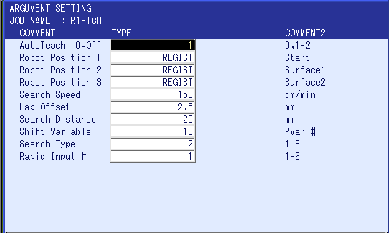
Robot Programming
OVERVIEW
Utilizes Macro Jobs
Location of Reference Positions
(covered in available videos)
Settings to adjust search path(s)
(covered in this class)
Macro Job interface
3 types of search routines
TCH (“touch”):
1D mode … for flat surfaces or edges
2D mode … for fillet or lap joints
EDGE: 6 modes
CIRCLE

Slide 16
Application Examples
Seam Finding
1 search – edge of plates
EDGE using Plane Detection mode: Video – thick plate, Video – thin plate
Video - 4D detection
2 searches – butt joint
TCH using 1D mode
Video (ok / NG), multiple searches Video
EDGE using Gap Measurement mode
Video; Video;
CIRCLE applications
Video – moving pipe (outside search)
Video – moving cut-out (inside search)
Video – custom macro for changing diameter
Video – large diameter surface
Applications
Video – Al welding app
Video – Coordinated motion

Slide 17
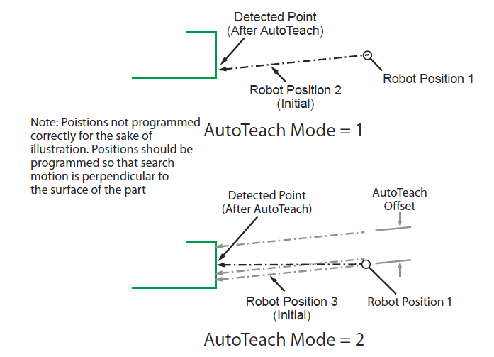
Setup
R*-TCH, 1D mode
Search Type = 1. touch sensing R1-TCH 1D
When to use AutoTeach modes: 1=small flat surface, 2=larger surface
Exercise: Adjust “AutoTeach Offset” for different plate thickness / surface area

Slide 18
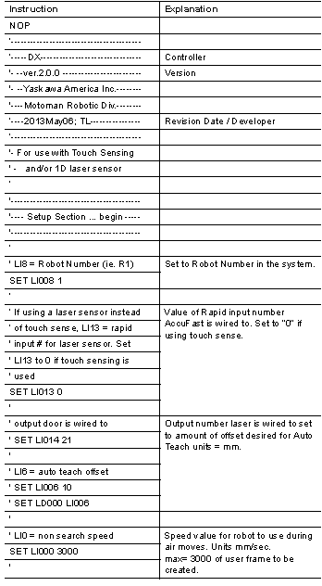
Setup
Setup Section; Overview
Configure settings in “Setup Section” at top of all related macro jobs (Rx-TCH, Rx-EDGE, RxCIRCLE, etc.
Rapid IN# for AccuFast (TCH, EDGE, CIRCLE)
Univ Output for AccuFast protective door (TCH, EDGE, CIRCLE)
AutoTeach Offset (TCH, EDGE)
Non-search speed (TCH, EDGE, CIRCLE)
User Frame # (TCH, EDGE, CIRCLE)
Bvariable # for status (TCH, EDGE, CIRCLE)
Alarm/no-alarm setting (TCH, EDGE, CIRCLE)
Retry (if first search missed detection) (TCH, EDGE, CIRCLE)
Set Focal Length for application (if necessary), or use factory configuration
Set LOW value. Possibly adjust HIGH value if necessary… typically the HIGH value is 10s of mm’s or more from the LOW value which allows for detection using the side of the beam.

Slide 19
Setup
R*-TCH / R*-EDGE / R*CIRCLE
Rapid IN# for AccuFast
Determine which Rapid Input (RIN# / DIN#) is being used by the AccuFast sensor.
After configuring the Keyence sensor’s LO and HI values, open the shutter door to the sensor and while the red laser dot is projected onto your hand, move your hand between the LO and HI distances.
You should observe the GO light turns on and, when this does turn on, look at the Rapid Input screen on the PP and determine which RIN# is being triggered.
Set the Rapid Input # into “SET LI013 (x)”; where x = RIN#

Slide 20
Setup
R*-TCH / R*-EDGE / R*CIRCLE
Output door is wired to (Univ Output for AccuFast protective door)
Consult the system prints of the robot system / Universal Input screen.
Set the Universal Output # to “SET LI014 (x)”; where x = OT#

Slide 21
Setup
R*-TCH / R*-EDGE
AutoTeach Offset (TCH, EDGE)
With the R*-TCH and R*-EDGE macro jobs, during most AutoTeach motion routines, an “offset distance” is assumed. This distance is adjustable.
Set desired distance to “SET LI006 (x)”; where x = offset dist.
Larger value … better accuracy
Smaller value … use only if flat surface area is small
Exercise: AutoTeach with TCH and EDGE, adjust parameter

Slide 22
Setup
R*-TCH / R*-EDGE / R*CIRCLE
Non-search speed
The speed used by the macro job routine for motion while searching for surface of the part is adjusted as a Macro Job Argument. The speed used for all other macro job routine motion is set by the “non search speed” parameter.
Set desired search speed to “SET LI000 (x)”; where x = speed
User Frame Number
- If you desire to have the calculated shift amount saved to a User Frame format, you specify the User Frame # here => “SET LB007 (x)”

Slide 23
'--------------------------------
'---- Setup Section ... begin ---
'--------------------------------
MSG ""
'
' Retry on/off
SET LB013 0
'
' Flag status/alarm
' 0=Alarm 1=NoAlarm w/status flag
SET LB014 0
'
' global Bvar address for status
SET LB015 99
SET B[LB015] 0
'
' Manual setting for DX200
' Max shift amount
SET LR000 25
'
*RETRY
'
'LI8 = Robot Number (ie. R1)
SET LI008 1
'
'If using a laser sensor instead
' of touch sense, LI13 = rapid
' input # for laser sensor. Set
' LI13 to 0 if touch sensing is
' used.
SET LI013 0
'
' output laser is wired to
SET LI014 5
'
'LI6 = auto teach offset
SET LI006 10
SET LD000 LI006
'
'LI0 = non search speed
SET LI000 3000
'
'LB7 = userframe number
SET LB007 0
'
'--------------------------------
'-- Setup Section ... complete --
'--------------------------------
Setup
R*-TCH / R*-EDGE / R*CIRCLE
Bvariable # for status
At the end of execution of each macro instruction, a value is set to a B variable. The value written to this B variable is either 1 (successful search) or 0 (unsuccessful search). In INFORM you can handle, programmatically, what the robot will do in the event of either situation (success or bad search).
This parameter allows adjustment of which B variable # the status is written to => SET LB015 (x)

Slide 24
'--------------------------------
'---- Setup Section ... begin ---
'--------------------------------
MSG ""
'
' Retry on/off
SET LB013 0
'
' Flag status/alarm
' 0=Alarm 1=NoAlarm w/status flag
SET LB014 0
'
' global Bvar address for status
SET LB015 99
SET B[LB015] 0
'
' Manual setting for DX200
' Max shift amount
SET LR000 25
'
*RETRY
'
'LI8 = Robot Number (ie. R1)
SET LI008 1
'
'If using a laser sensor instead
' of touch sense, LI13 = rapid
' input # for laser sensor. Set
' LI13 to 0 if touch sensing is
' used.
SET LI013 0
'
' output laser is wired to
SET LI014 5
'
'LI6 = auto teach offset
SET LI006 10
SET LD000 LI006
'
'LI0 = non search speed
SET LI000 3000
'
'LB7 = userframe number
SET LB007 0
'
'--------------------------------
'-- Setup Section ... complete --
'--------------------------------
Setup
R*-TCH / R*-EDGE / R*CIRCLE
Flag status/alarm (Alarm/no-alarm setting)
If a Maximum Shift Amount Exceeded event occurs, an Alarm can be triggered. You can adjust if the alarm is triggered or ignored by the following parameter => “SET LB014 (x) where 0=alarm, 1=no alarm
Caution!! If ‘no alarm’ is set (SET LB014 1), make sure to collect the value of the Status B Variable and handle (ie. skip a weld job, etc.) in the event of unsuccessful search.

Slide 25
'--------------------------------
'---- Setup Section ... begin ---
'--------------------------------
MSG ""
'
' Retry on/off
SET LB013 0
'
' Flag status/alarm
' 0=Alarm 1=NoAlarm w/status flag
SET LB014 0
'
' global Bvar address for status
SET LB015 99
SET B[LB015] 0
'
' Manual setting for DX200
' Max shift amount
SET LR000 25
'
*RETRY
'
'LI8 = Robot Number (ie. R1)
SET LI008 1
'
'If using a laser sensor instead
' of touch sense, LI13 = rapid
' input # for laser sensor. Set
' LI13 to 0 if touch sensing is
' used.
SET LI013 0
'
' output laser is wired to
SET LI014 5
'
'LI6 = auto teach offset
SET LI006 10
SET LD000 LI006
'
'LI0 = non search speed
SET LI000 3000
'
'LB7 = userframe number
SET LB007 0
'
'--------------------------------
'-- Setup Section ... complete --
'--------------------------------
Setup
R*-TCH / R*-EDGE / R*CIRCLE
Retry on/off (if first search missed detection)
For those applications where occasional missed searches occur, a RETRY of the search motion may be desired. One retry is possible.
To enable a single Retry => “SET LB013 (x)”; where x=1 (up to two search routines / one retry) or x=0 (one search routine / no retry)

Slide 26
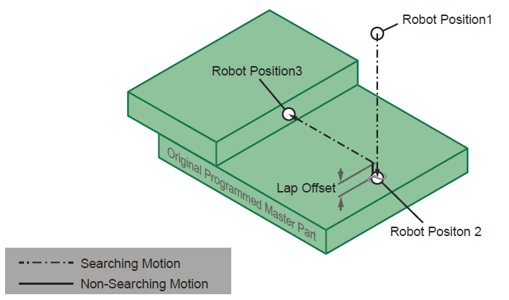
Programming
R*-TCH; 2D mode
TCH macro with 2D mode. touch sensing R1-TCH 2D
“Robot Positon 1” defines start position for searching motion
“Robot Positions 2 and 3” define location of Master Part
Seam Finding technology locates surfaces of deviated part and, comparing to Robot Positions 2 and 3, measures Shift Amount
Recommended programming sequence:
1st: Robot Position 2
2nd: Robot Position 1
3rd: Robot Position

Slide 27
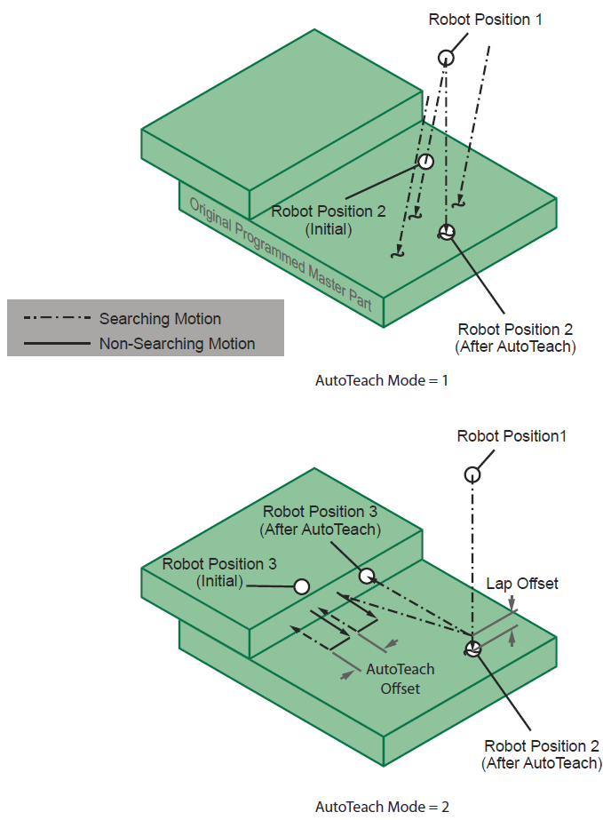
Programming
R*-TCH; 2D mode
TCH macro with 2D mode
2touch: AutoTeach
2touch: Playback

Slide 28
Setup
R*-TCH; 2D mode
Search Type = 2
Exercise 1: Adjust “Lap Offset” for different plate thickness
Exercise 2: Adjust “AutoTeach Offset” for different lap joint sizes

Slide 29
Setup
R*-TCH; 2D mode
Search Distance [argument of R*-TCH]: used to define maximum amount of the calculated shift amount, which is based on the distance between “Robot Position 3” and the Detected Location of the seam.
If the distance between RP3 and the Detected Location is greater than the value of “Search Distance,” the Maximum Shift Amount Exceeded is set. An alarm may be generated, or can be disabled (see value of parameters in SETUP section of macro).
Exercise: adjust and verify that Search Distance can be reduced to tolerate a maximum of +/- 6mm (1/4”) weld seam variation.

Slide 30
Setup
R*-TCH; 2D mode
Overall search window is defined by:
Maximum vertical search = (Distance between Robot Position 1 and Robot Position 2) + Search Distance
Maximum lateral search = (Lateral distance between Robot Position 1 and Robot Position 3) + Search Distance
Exercise 1: move weld seam location until Max Shift Amount Exceeded is set, then adjust Search Distance so the alarm goes away.
Exercise 2: use INFORM to skip a weld if Max Shift Exceeded is set. Use the status flag B variable (referenced in the SETUP section)

Slide 31
Programming; Application
R*-TCH; 2D mode
Touch Sensing examples: touch sensing R1-TCH 2D w/ weld path
Flat surface – R1-TCH (1TCH mode)
T Joint – R1-TCH (2TCH mode).
6mm Lap – R1-TCH
2mm Lap, galvanized – R1-TCH
AccuFast examples: accufast R1-TCH
Edge of thin plate (AutoTeach=1) and Edge of thick plate (AutoTeach=2) – R1-TCH
Thin Lap – R1-TCH
Go/no-go, hole in plate – R1-TCH
Tube-to-tube, using side of laser beam – R1-TCH

Slide 32
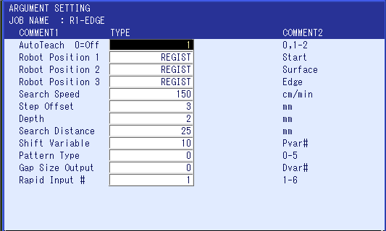
Programming
R*-EDGE

Slide 33
Programming
R*-EDGE

Slide 34
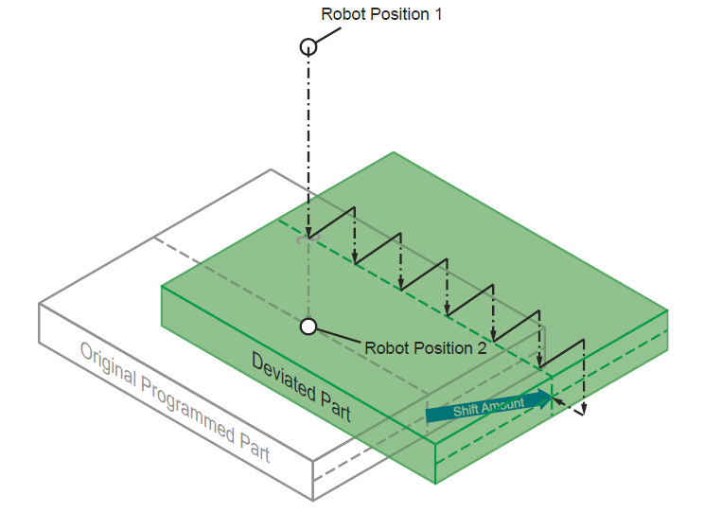
Programming
R*-EDGE
EDGE routine
Mode 0
Touch sensing
2D detection

Slide 35
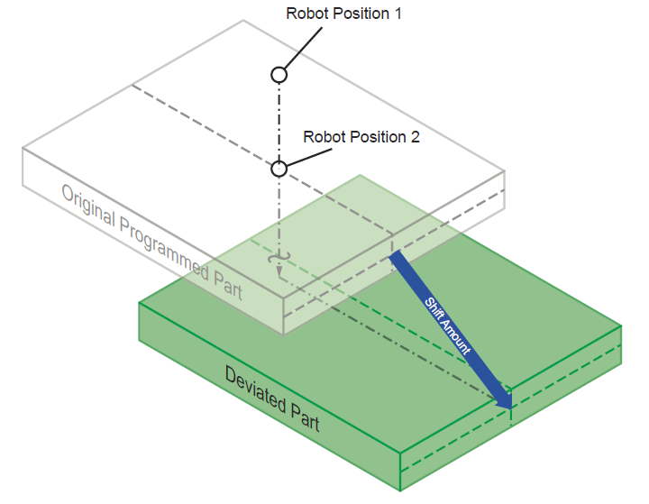
Programming
R*-EDGE
EDGE routine
Mode 1
AccuFast
2D detection

Slide 36
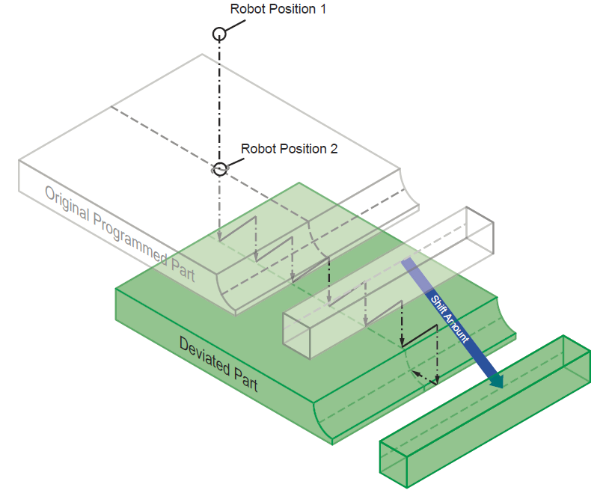
Programming
R*-EDGE
EDGE routine
Mode 2 (Mode 3 = AccuFast)
Touch sensing
Gap measurement mode
2D detection
Adaptive Welding
WVADJ instruction

Slide 37
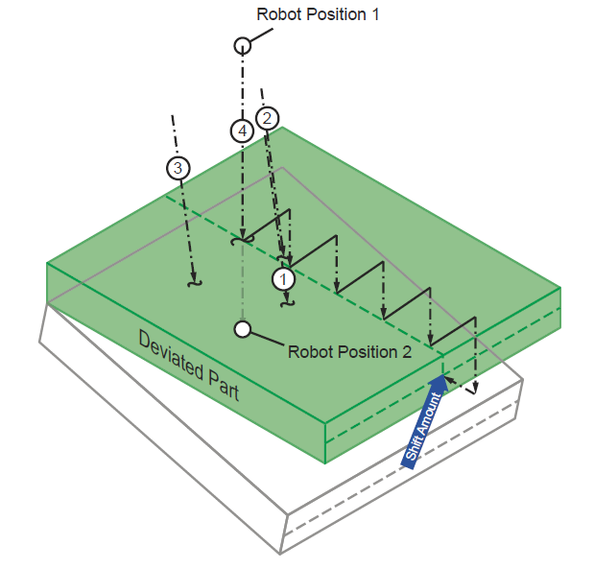
Programming
R*-EDGE
EDGE routine
Mode 4 (Mode 5 = AccuFast)
Touch sensing
2D w/ Plane-detection mode

Slide 38
Setup
R*-EDGE
Step Offset [argument of R*-EDGE]:
Used for Pattern Types 0, 2, and 4
Defines step size (vertical and horizontal)
Larger steps = faster cycle time
Smaller steps = use smaller values if a small gap is to be detected (Pattern Type=2)
Exercise: adjust Step Offset value to detect a 6mm butt joint

Slide 39
Setup
R*-EDGE
Depth [argument of R*-EDGE]:
For Pattern Types 0, 2, and 4 …
Defines distance to move past horizontal surface before moving back to find edge of plate
For Pattern Types 1, 3, and 5 …
Defines distance the laser sensor moves into surface before searching for edge of surface
Larger depth = typically better accuracy for AccuFast
Smaller depth = use smaller values for thinner plate
Exercise: with AccuFast sensor, adjust Depth value to detect the edge of 6mm sandblasted steel. See how small of a value that can be used before false readings occur

Slide 40
Setup
R*-EDGE
Search Distance [argument of R*-EDGE]: used to define maximum amount of the calculated shift amount, which is based on the distance between “Robot Position 3” and the Detected Location of the seam.
If the distance between RP3 and the Detected Location is greater than the value of “Search Distance,” the Maximum Shift Amount Exceeded is set. An alarm may be generated, or can be disabled (see value of parameters in SETUP section of macro).
Exercise: allow for part variation of +/- 6mm. Move the weld seam 8mm and note Maximum Shift Amount Exceeded state.

Slide 41
Setup
R*-EDGE
Gap Size Output [argument of R*-EDGE]: sets the D variable # that receives the detected Gap amount
Exercise 1: using AccuFast on a 6mm steel butt joint, note the gap distance (placed into a D variable you choose) as the actual gap amount is varied from 2mm to 6mm.
Exercise 2: Call two different Arc Start Files; one if gap is less than 2mm, the other if gap is greater than 2mm.

Slide 42
Programming; Applications
R*-EDGE
Touch Sensing examples: touch sensing R1-EDGE
Edge, thick plate; Pattern Type 0 – R1-EDGE
Edge, variable gap on thick plate; Pattern Type 2 – R1-EDGE
T-joint, oblique angle, variable angle; Pattern Type 4 – R1-EDGE
AccuFast examples: accufast R1-EDGE
Narrow Butt Joint; Pattern Type 3 – R1-EDGE
Edge, outside corner; Pattern Type 1 – R1-EDGE
NSRCH

Slide 43
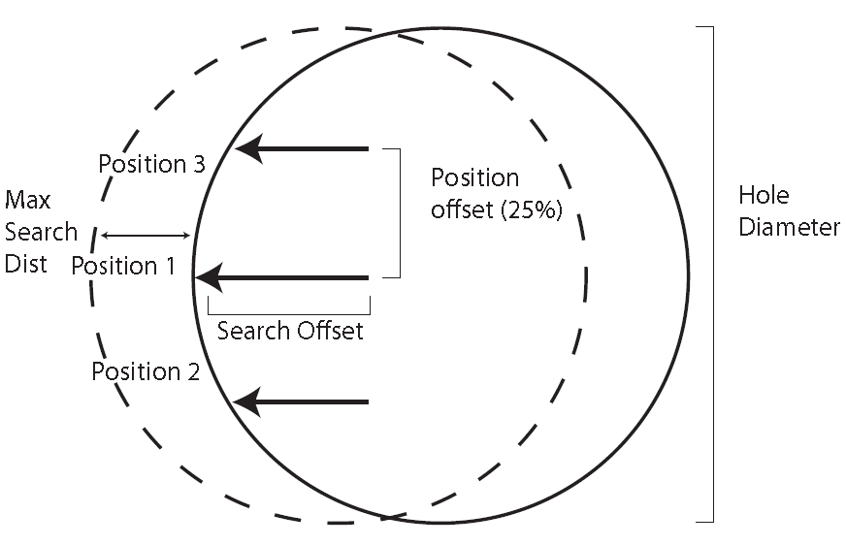
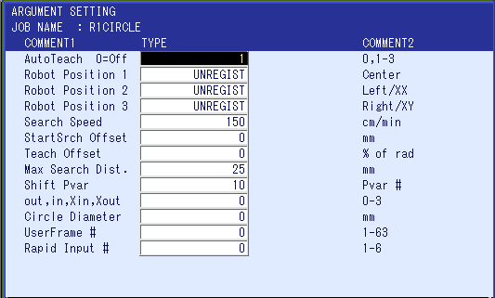
Programming
R*CIRCLE
RxCIRCLE
3 positions: where RIN turns ON
3 positions: same Z height (see arguments)
Circle diameter → D099
For curved surfaces with ~2” and larger diameters

Slide 44
Setup
R*CIRCLE
StartSrch Offset [argument of R*CIRCLE]
Robot Position 1, 2, and 3 represent locations on (location that are touching) the part surface. Approach positions – location used to begin search motion towards Robot Position – are calculated by the macro job…
This parameter sets the distance between each Robot Position and its approach position
Exercise: With Touch Sensing, attempt AutoTeach twice, once with “StartSrch Offset” = 5, and again with = 25.

Slide 45
Setup
R*CIRCLE
Teach Offset [argument of R*CIRCLE]
During initial teaching of Robot Position 1, 2, and 3, these locations are roughed in by the user. The exact, proper location of these positions are detected by the macro job via AutoTeach.
The distance between Robot Position 1 and Robot Positions 2/3 – this distance AutoTeach uses – is defined by this parameter.
Specified in a percentage of the radius of the curved surface. A larger value = better accuracy
Typical values are in the 25% to 50% range
Small diameter curved surface => smaller % value
Larger diameter curved surface => larger % value
Exercise: Attempt AutoTeach twice, with “Teach Offset” values 10 and 50

Slide 46
Setup
R*CIRCLE
Max Search Dist. [argument of R*CIRCLE]
This parameter determines maximum allowable shift amount.
An alarm can be registered (depending on a SETUP section parameter) when Maximum Shift Amount Exceeded is reached
Exercise: Adjust parameter to allow +/-6mm part variation. Adjust weld seam 8mm and observe Maximum Shift Amount Exceeded state.

Slide 47
Setup
R*CIRCLE
out,in,Xin,Xout [argument of R*CIRCLE]
This parameter determines the search pattern to be used for this instance of R*CIRCLE. Two patterns are available
0 or 1: 3 point detection. Search pattern as shown in drawing to the right
2 or 3: 4 point detection. Search pattern with searches at 3, 6, 9, and 12 o’clock.
Exercise: observe all 4 modes

Slide 48
Setup
R*CIRCLE
Circle Diameter [argument of R*CIRCLE]
For search patterns of 0 or 1 (‘out,in,Xin,Xout’ = 0 or 1), the macro job makes a calculation to alert the user if a bad search is made.
To determine if a bad search is made, the diameter of the detected part location is compared to the diameter of the taught part location.
If the difference in diameter is greater than a threshold value (which is defined in SETUP section), the user is alerted

Slide 49
Setup
'--------------------------------
'---- Setup Section ... begin ---
'--------------------------------
MSG ""
'
' Retry on/off
SET LB012 0
'
' Flag status/alarm
' 0=Alarm 1=NoAlarm w/status flag
SET LB013 0
'
' global Bvar address for status
SET LB014 99
SET B[LB014] 0
'
*RETRY
'
'LI8 = Robot Number (ie. R1)
SET LI008 1
'
'If using a laser sensor instead
' of touch sense, LI13 = rapid
' input # for laser sensor. Set
' LI13 to 0 if touch sensing is
' used.
SET LI013 0
'
' output laser is wired to
SET LI014 5
'
'LI6 = auto teach offset
SET LI006 10
SET LD000 LI006
'
'LI0 = non search speed
SET LI000 3000
'
'LR4=AllowShiftAmnt as a
' % of Taught circle dia.
SET LR004 10
IFTHENEXP LR004<1 OREXP LR004>20
MSG "Check Allowable Percent Offset"
SETUALM 8001 "R1 INVALID PARAM
PAUSE
ENDIF
DIV LR004 100
'
' Dvar Output for Diameter
' Measurement
SET LB003 99
'
'--------------------------------
R*CIRCLE
Dvar Output for Diameter
An accurate diameter must be entered into the ‘Circle Diameter’ argument
Upon successful execution of the R*CIRCLE macro instruction while in AutoTeach mode, the diameter of the taught diameter is written to a D Variable
The value written into the D Variable should be used for the ‘Circle Diameter’ argument
This parameter defines which D variable # is used
Exercise: After AutoTeach is complete, collect the measurement of the circle’s diameter from the referenced D variable and input this data to the argument “Circle Diameter”

Slide 50
'--------------------------------
'---- Setup Section ... begin ---
'--------------------------------
MSG ""
'
' Retry on/off
SET LB012 0
'
' Flag status/alarm
' 0=Alarm 1=NoAlarm w/status flag
SET LB013 0
'
' global Bvar address for status
SET LB014 99
SET B[LB014] 0
'
*RETRY
'
'LI8 = Robot Number (ie. R1)
SET LI008 1
'
'If using a laser sensor instead
' of touch sense, LI13 = rapid
' input # for laser sensor. Set
' LI13 to 0 if touch sensing is
' used.
SET LI013 0
'
' output laser is wired to
SET LI014 5
'
'LI6 = auto teach offset
SET LI006 10
SET LD000 LI006
'
'LI0 = non search speed
SET LI000 3000
'
'LR4=AllowShiftAmnt as a
' % of Taught circle dia.
SET LR004 10
IFTHENEXP LR004<1 OREXP LR004>20
MSG "Check Allowable Percent Offset"
SETUALM 8001 "R1 INVALID PARAMETERS" 0 SMODE=0
PAUSE
ENDIF
DIV LR004 100
'
' Dvar Output for Diameter
' Measurement
SET LB003 99
'
'--------------------------------
Setup
R*CIRCLE
AllowShiftAmnt
The macro job uses the argument CIRCLE DIAMETER to determine if a bad search (one of the 3 or 4 touches/searches) has been made.
This parameter sets the allowable difference between the diameter of the detected part location and the diameter of the taught part location.
Specified in a percentage. i.e. detected diameter=56mm, taught diameter=50, diameter of detected diameter is 12% greater than taught diameter. If AllowShiftAmnt=10, alarm can occur.

Slide 51
Programming; Applications
R*CIRCLE
Touch Sensing example
Tube-to-plate -- R*CIRCLE
AccuFast example
Large diameter tube-to-plate -- R*CIRCLE

Slide 52
Usage
Path Shifting
Use Macro Instructions to utilize Touch / AccuFast
R*-TCH, R*-EDGE, R*CIRCLE, etc.
Create/Combine the shift amount(s)
Use adjacent searches where possible (ie. from other side of plate)
If 1D variation, search in direction of weld seam movement / variation
If 2D+ variation, searches must be perpendicular to each other
Do not compound (ie. X deviation used twice) shift amounts
Deploy SFTON / SFTOF in weld jobs
R1-TCH P0
MOVJ
SFTON P000
ARCON …
MOVL
ARCOF
SFTOF

Slide 53
Usage
Path Shifting examples
Combinations
T-Joint
one 1D touch on side
two 2D touches on weld seam (start and end of seam)

Slide 54
Usage
Path Shifting examples
Combinations
CRAW coupon
R1CIRCLE
one 2D touch at other end

Slide 55
Usage
Path Shifting examples
Combinations
Tube-to-tube
Multiple 1D touches

Slide 56
Usage
Path Shifting examples
Combinations
Butt joint
two EDGE touches on weld seam (start and end of seam)
WVADJ added to adjust WVON instruction data

Slide 57
Comarc
Overview
Theory in brief
Requires weaving motion
Hall Effect sensor → Sensor board → COMARC Inform commands. Regulate welding current with robot path correction.
Used for steel alloys (not possible with aluminum welding wire)
MIG welding. Most output modes are supported by Comarc function.
Function information > Comarc Manual
Equipment Configuration
Setup / Usage: comarc fundamentals
Develop seam tracking weld parameters
Measure PC Data (Comarc Measurement Mode + S1E197=1)
Measure Comarc settings for weld seam(s) (Comarc Measurement Mode + S1E197=0)
Deploy settings discovered in step 3. above. Repeat all steps above for different weaving parameter conditions (as needed for your application

Slide 58
Comarc
Considerations
Required welding conditions:
Minimize undercut
High enough travel speed (and low enough wire feed speed) to keep arc at leading edge of weld pool
Slightly wider weave is more robust than slightly narrower weave motion
Push angle is better than a drag angle
Horizonal is better than downhill
Supported modes: traditional non-pulsed, some (but not all) specialty non-pulsed modes, most pulsed modes. In general, non-adaptive modes are more robust than some adaptive modes.

Slide 59
Comarc
Tips and pointers
For setup test:
T-joint 150mm long
Program weld start location into weld seam
Deviate weld end point 10-15mm out of the joint (instead of moving the part, move the robot path!)

Slide 60
Comarc
Tips and pointers
For large variations of weld path:
Increase parameter SxE30-45 to allow for more aggressive corrections of robot’s path. A larger value produces larger correction amounts for a given amperage change.
For use on butt joints, only U/D correction is possible.
Reference a Comarc Condition File from the COMARCON instruction. In the C.C. File, set the CORRECTION SELECT setting to “U/D” (instead of U/D & L/R).
Deviation / Correction amount; monitoring
Use of the C.C. File allows for defining a maximum acceptable distance that Comarc is allowed to deploy. If the actual correction distance is greater than the VERTICAL MONTIOR or HORIZONTAL MONTIOR for the set NO. of times, a robot alarm can be generated based on the CONDITION setting.
U/D adjustment: larger value => shorter CTWD
L/R adjustment: larger value => wire placement is moved to the right

Slide 61
Comarc
Tips and pointers
Exercise 1: setup for use with Bead-on-Plate welding (ie. use U/D correction only)
Exercise 2: create a T-joint weld sequence with 3 segments. Adjust the L/R value from first segment to last segment to demonstrate control of position of welding electrode (high/low).

