Slide 2
YRC1000 Review
Sayre Jeannet

Slide 3
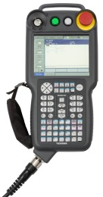
YRC1000 Review
New Features and Functionality
VMAX function
3D graphical window
Programming Pendant Interface Improvements
Simplification of multiple condition programming
Robot operating state monitoring
Job monitoring function
Robot monitoring
Pendant oscilloscope improvements

Slide 4
YRC1000 Review
VMAX Tag
Designed to allow a programmer to move in a linear motion at maximum speed.
Speed is not constant but optimized for the robot’s current posture.
What’s the difference between MOVL & MOVL VMAX?
MOVL & MOVL VMAX both travel along a linear path.
MOVL speed is specified in mm/sec while MOVL VMAX speed is specified in % of maximum speed.
How do I access the VMAX tag?
Detail edit screen
VMAX is based on %

Slide 5
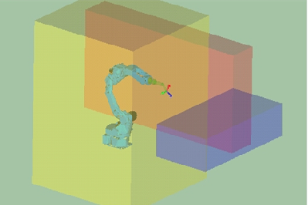
YRC1000 Review
3D Graphics Window
View the robot’s programmed path in a job
3D viewing of Safety Range Limits (Cuboid/Planar/Prism)
Viewing of Tool Interference Zone
3D View Setup
Safety Function > Robot Range Display
3D View Access
Robot > 3D Graphics

Slide 6
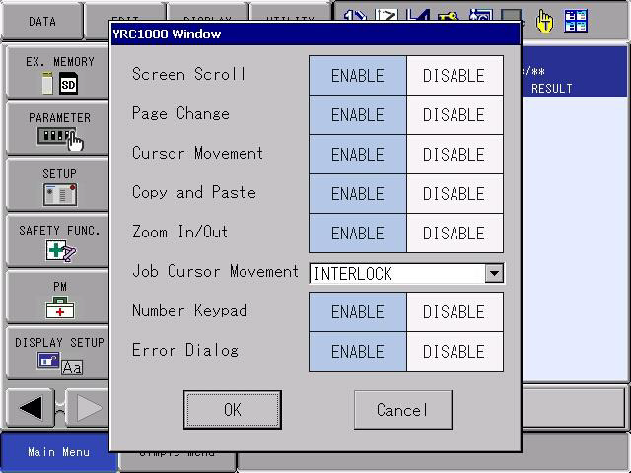
YRC1000 Review
Programming Pendant Interface Improvements
Text Copy & Paste now available
Long press the screen to allow easy access to zooming functionality
Numeric touch screen keypad available

Slide 7
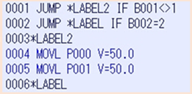
YRC1000 Review
Simplification of Multiple Condition Programming
Multiple AND/OR conditions can be applied to a single logical instruction
Conditional expressions allow up to 15 different conditions based on AND/OR operators
DX200 | YRC1000

Slide 8
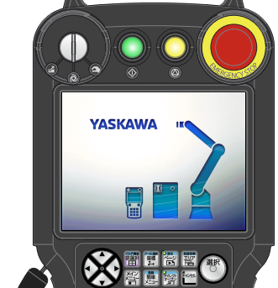
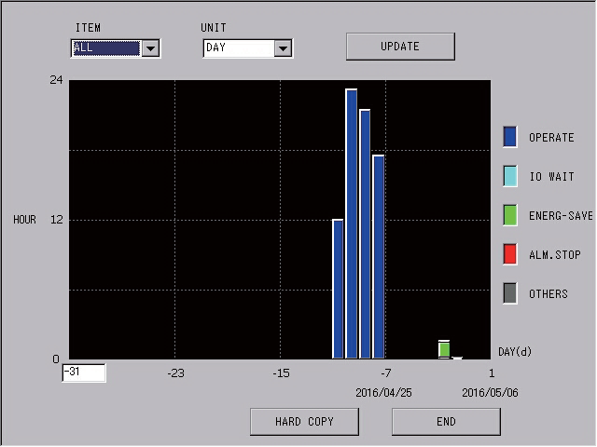
YRC1000 Review
Robot operating state monitoring
Allows for monitoring of:
Operation time
IO waiting time
Energy saving time
Alarm related stop time
Multiple Time Intervals Available
Hourly (max 5 days)
Daily (max 100 days)
Monthly (max 60 months)

Slide 9
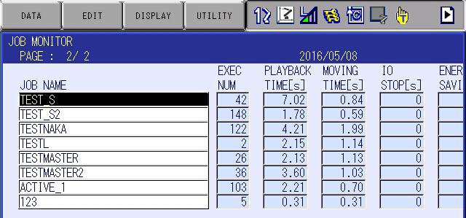
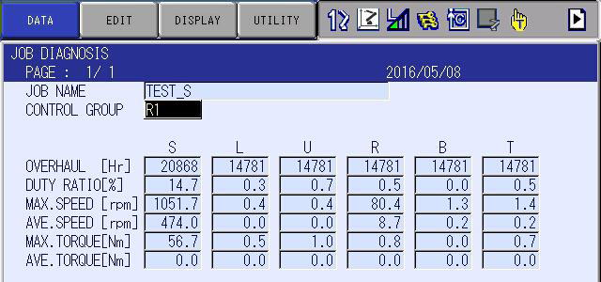
YRC1000 Review
Job Monitoring / Diagnosis
Job Monitoring allows for monitoring of:
Number of times that job has been executed
The moving/playback time per job
Stopping time related to IO
Time spent in energy saving mode
Job Diagnosis / Analysis
Duty cycle
Max speed & torque
Average speed & torque

Slide 10
YRC1000 Review
Robot Monitoring
Robot Monitoring allows for threshold monitoring of:
Torque
External Force
Axis Speed
Pulse Error
When the value of the threshold is exceeded the designated output will go high allowing for programmable responses via the robot or a connected PLC.
Set threshold and general purpose signal
Threshold
ON
Torque etc.
OFF
General purpose signal
Example: When the actual value is larger than a threshold, automatically turn ON the pre-set general purpose signal

Slide 11
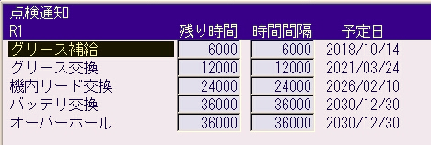
YRC1000 Review
Inspection Notification Improvements
Scheduled date
Maintenance
Notification R1
Remaining time
Time in between
Displays maintenance critical data with recommended maintenance period
When to add grease
When to replace grease
When to change the wire harness
When to change the battery
When to perform an overhaul
Simplify your preventative maintenance planning!
Supply grease
Change grease
Change wire harness
Change battery
Overhaul
Scheduled maintenance date according to current usage
Maintenance items
Maintenance
Notification R1
Notification time
Notification number
Supply grease
Change grease
Change wire harness
Change battery
Overhaul
Notification of maintenance before the actual scheduled date

Slide 12
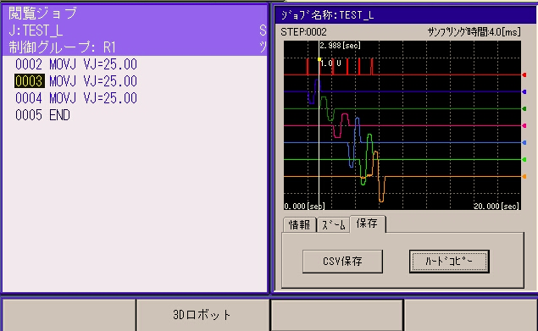
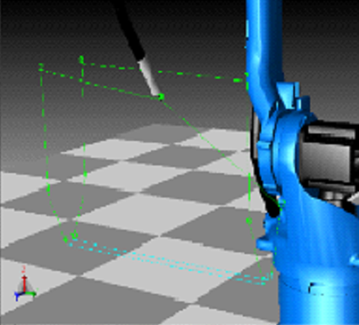
YRC1000 Review
Pendant Oscilloscope Improvements
Simultaneous display of:
Waveform
Job Content
Robot Location
Relationship between all easily viewable
Diagnostic of problem areas
Optimization
Performance prediction
Cursor in the Job is linked and moved up & down
Move the cursor left & right
3D Robot

