Slide 2
External Axis Installation and Set-up
Presenter: Rick Vaught

Slide 3
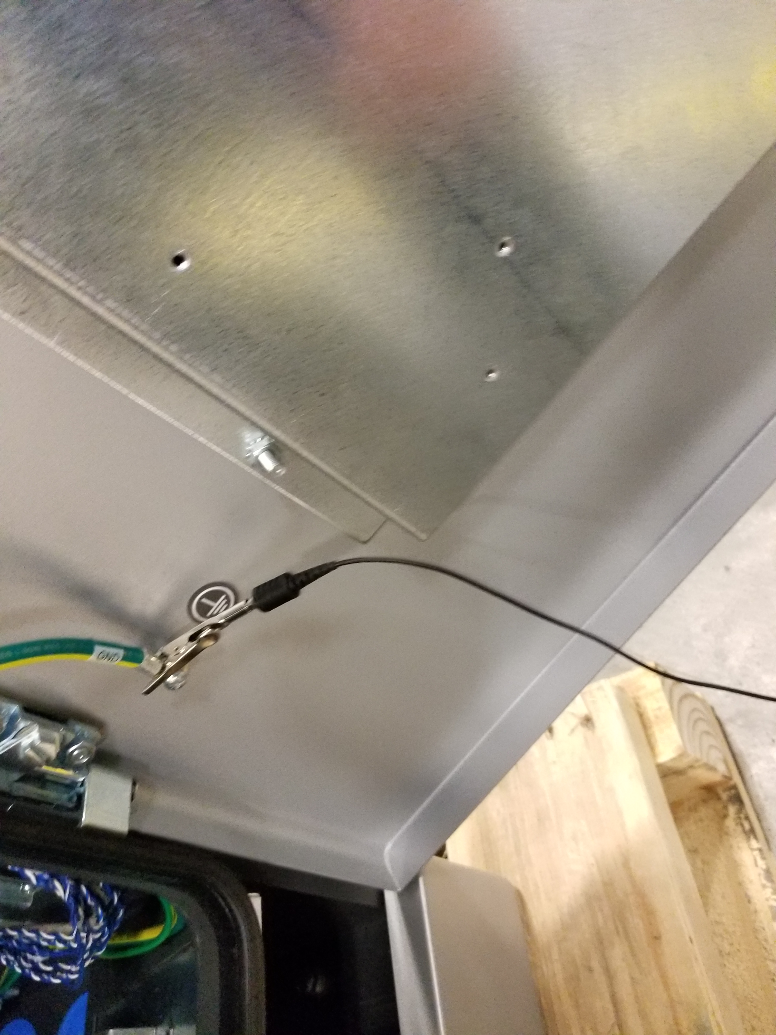
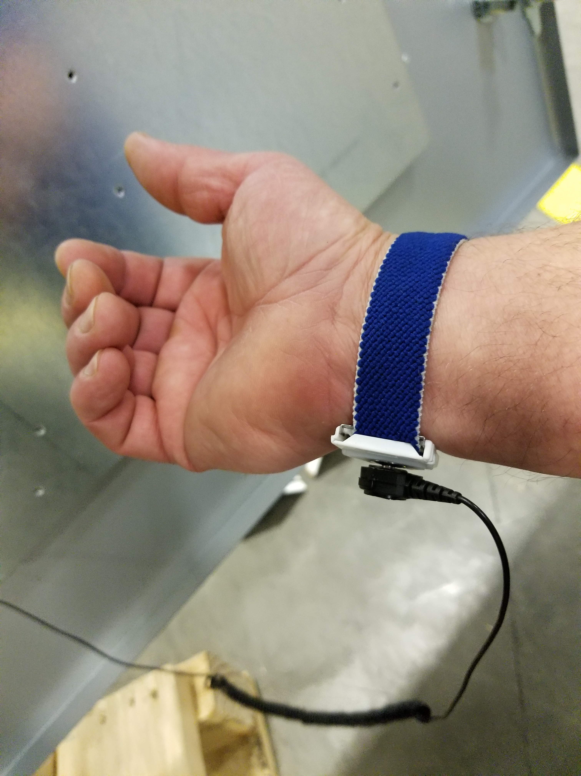
Step 1
ESD Protection
Use a static strap to protect boards from damage by ESD (Electrostatic discharge)
Put wristband on.
Connect alligator clip to a ground lug in the controller.

Slide 4
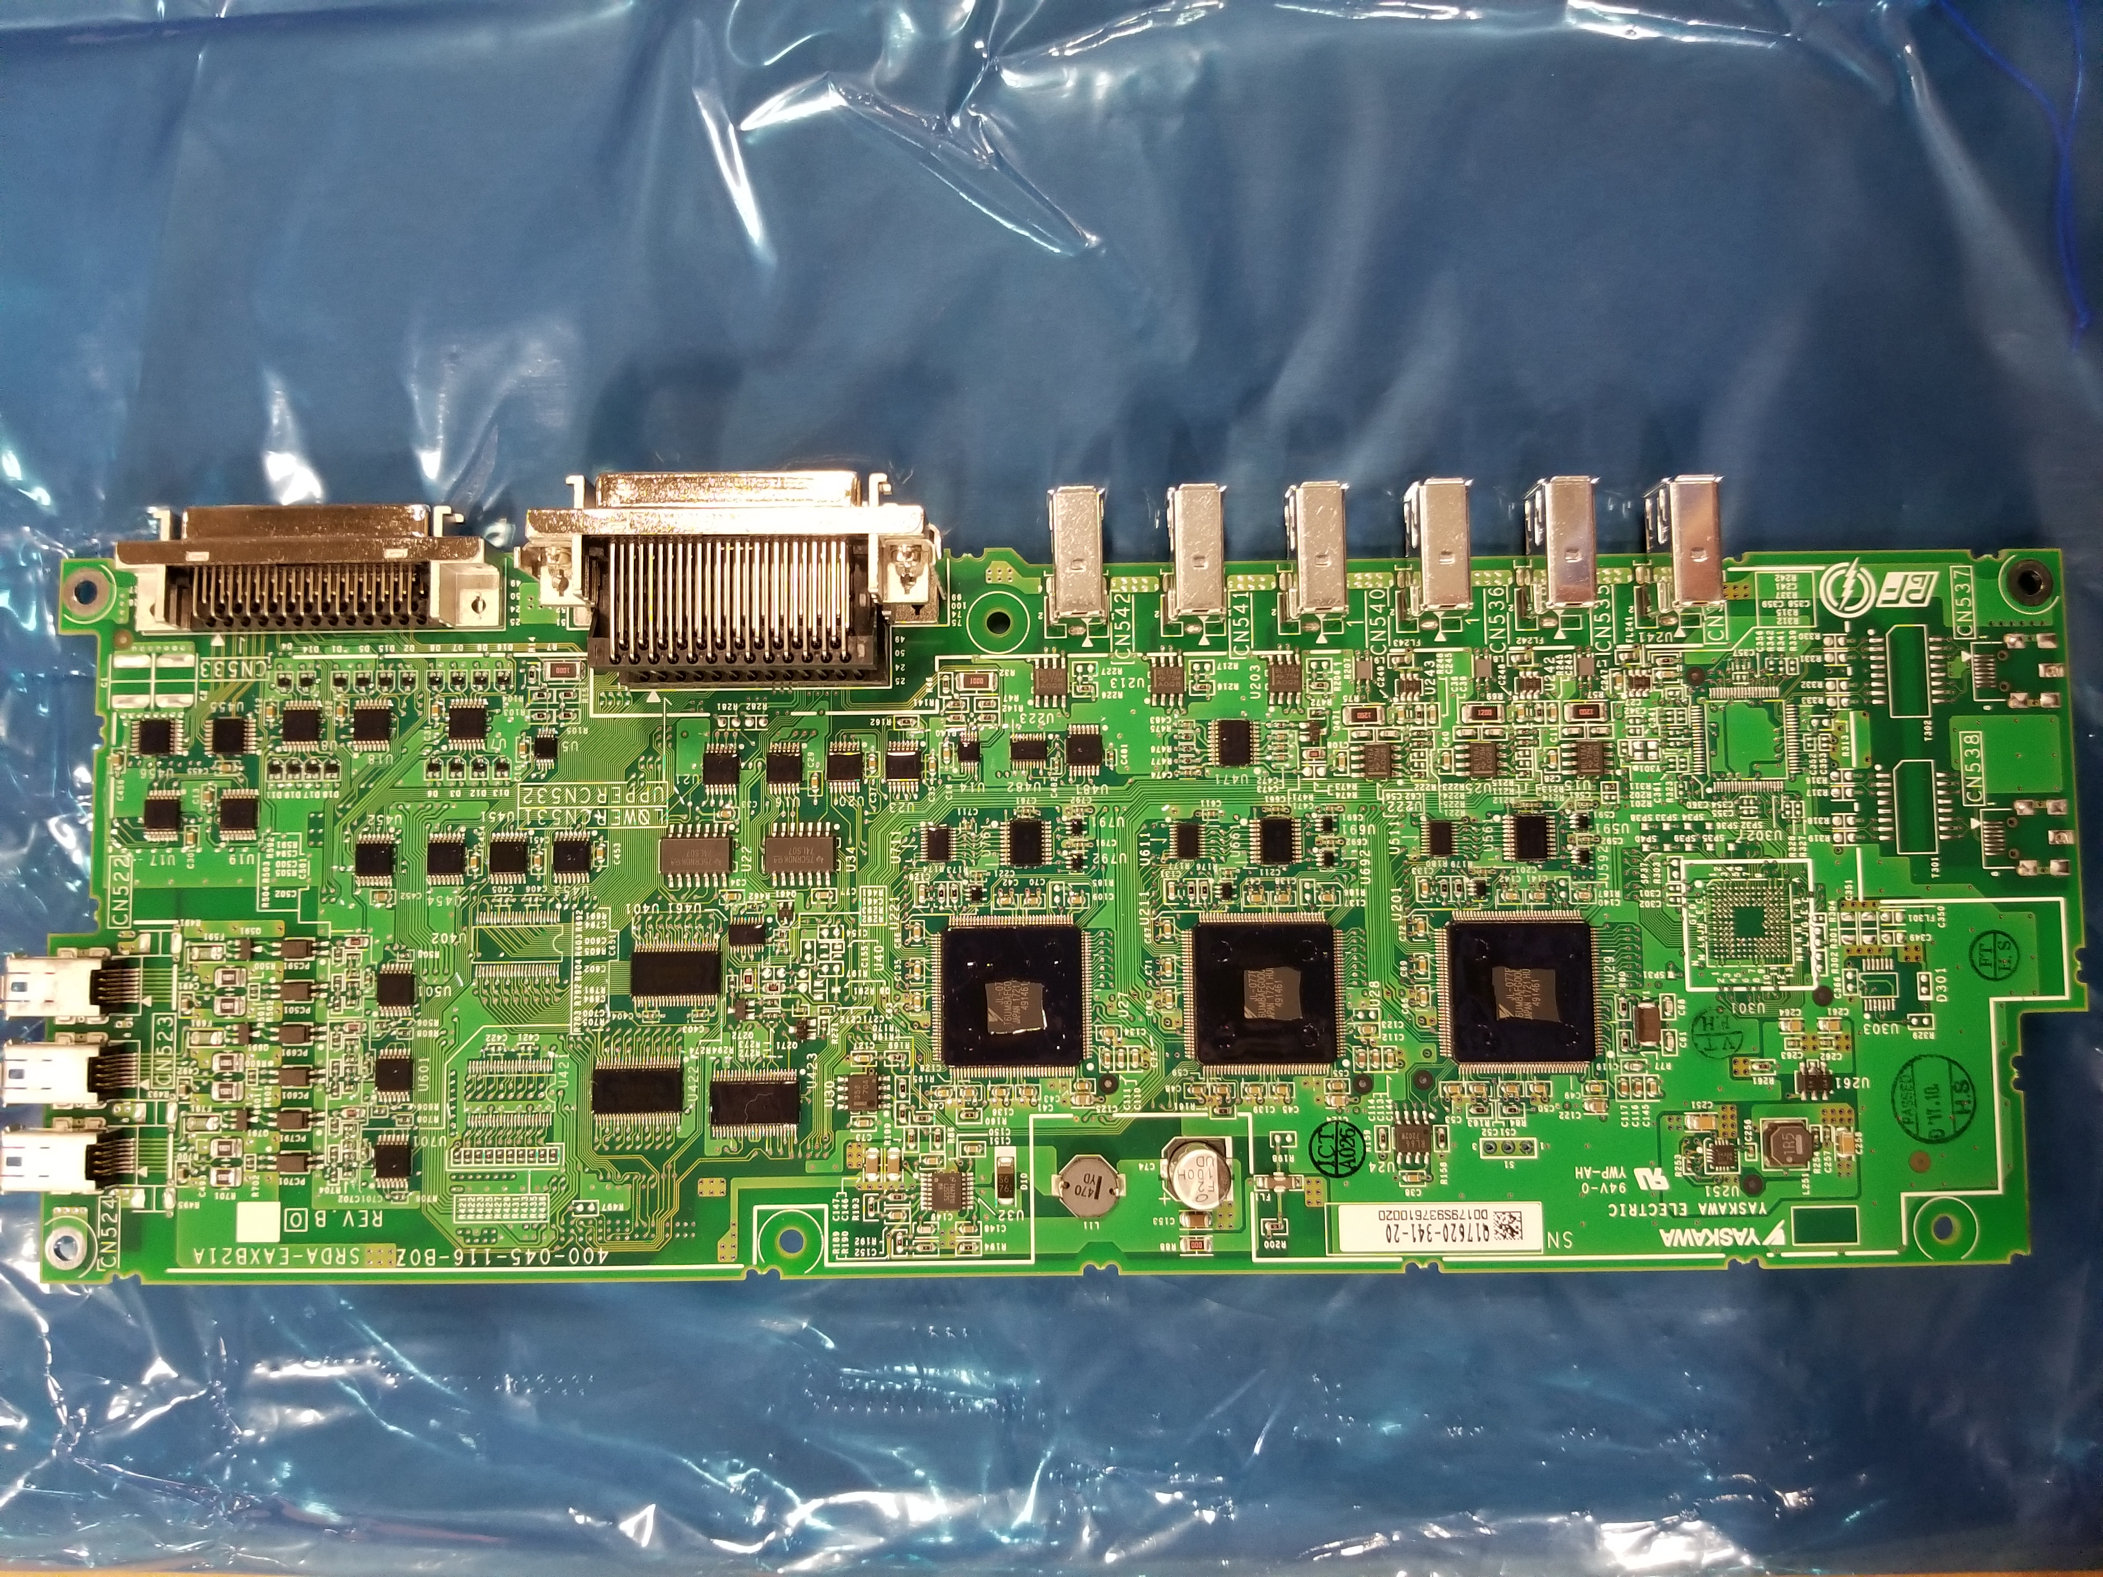
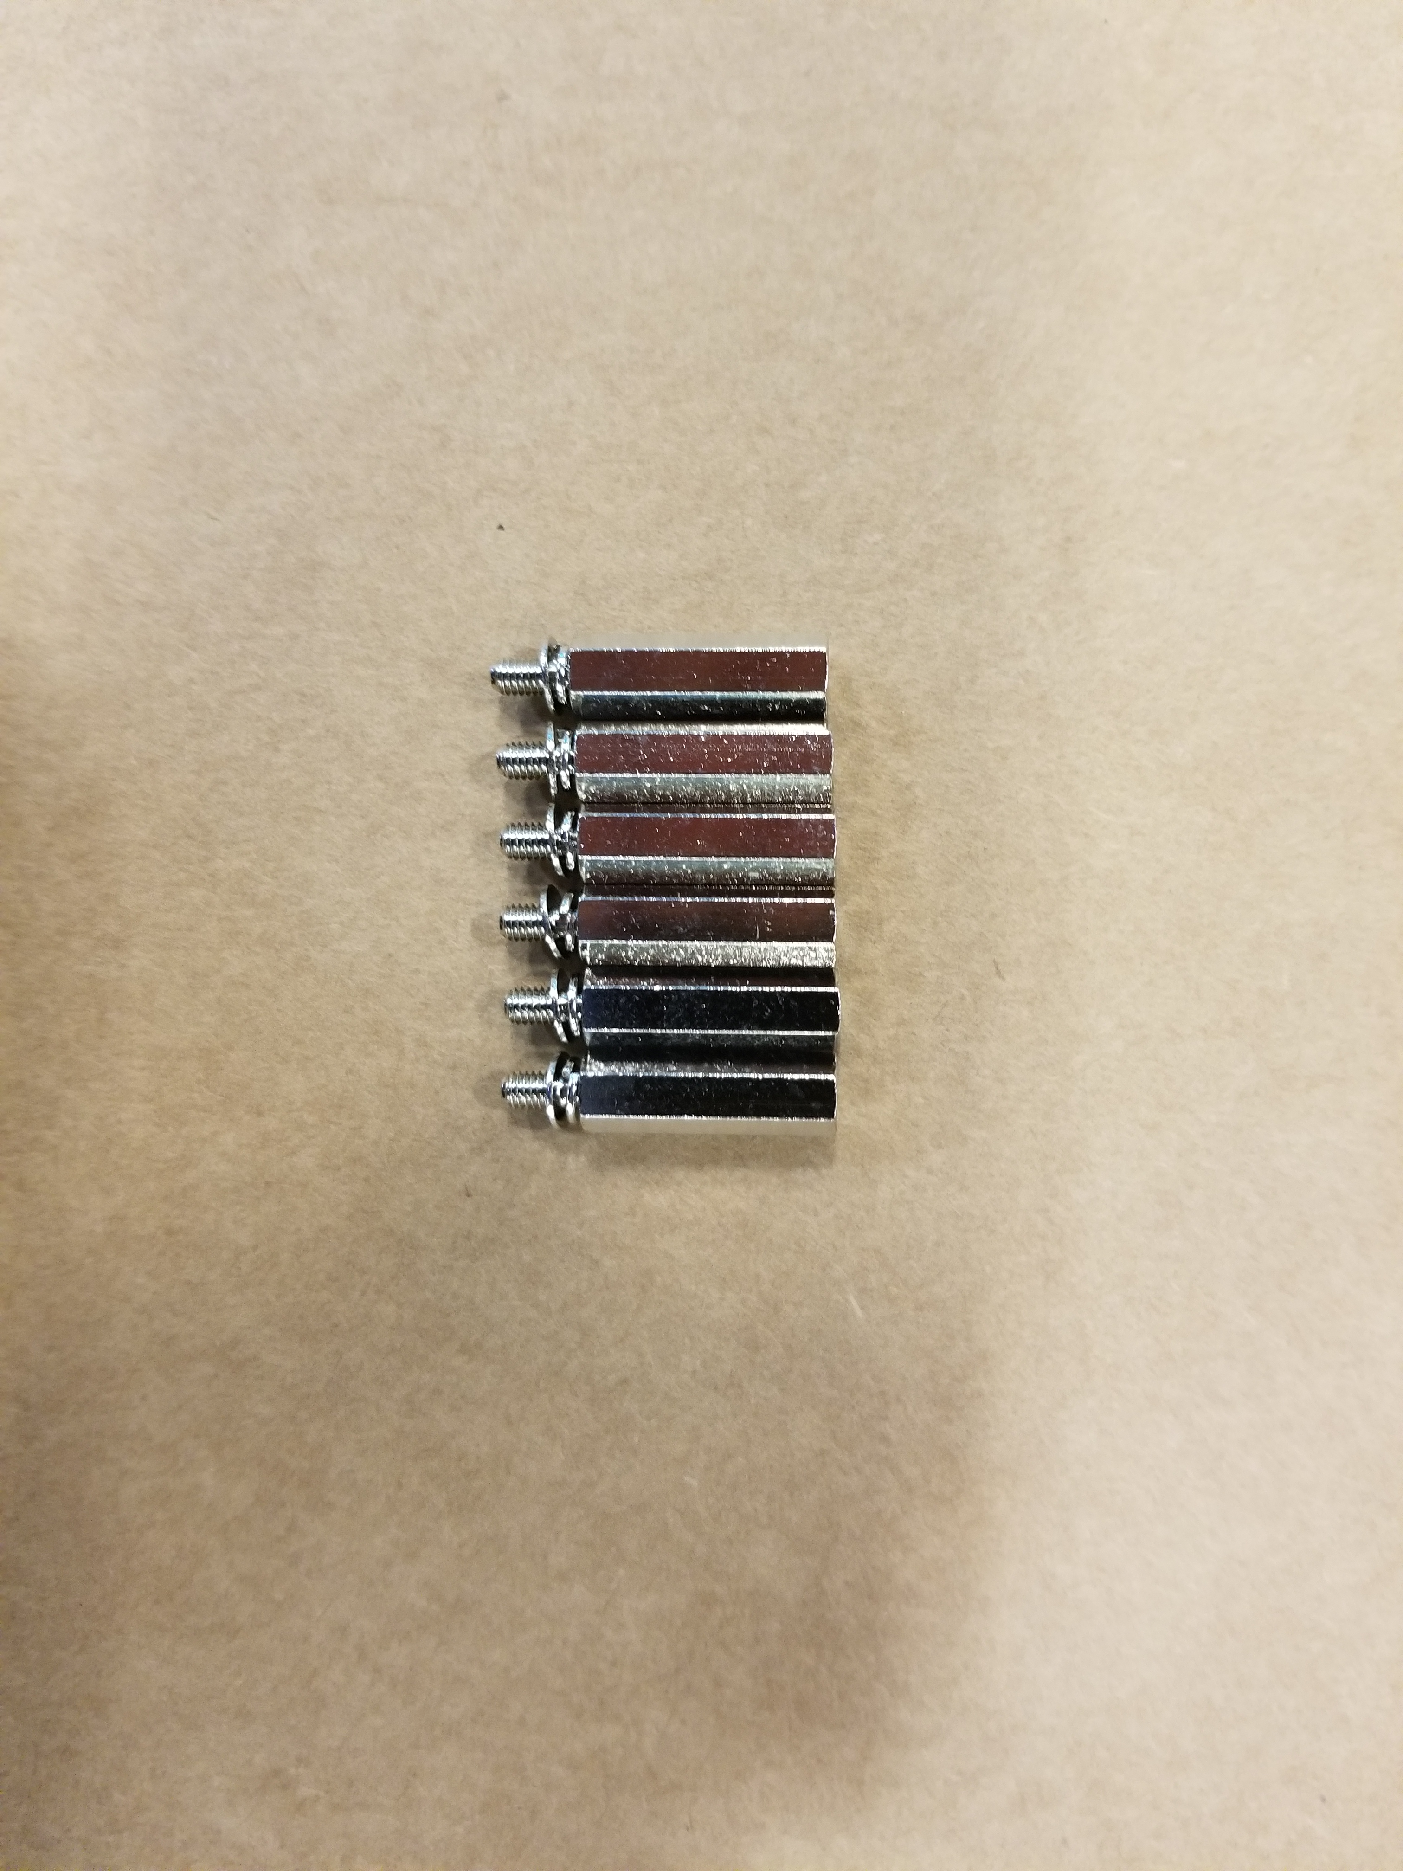
Step 2 – Installation of the Servo control board
The 164290-1 servo control board for Axis 7,8 and 9 is a daughter board that mounts to the right side of the robots servo control board.
This board comes with standoffs that screw into the EAXA21A (robot servo control board) inside the DX200 controller

Slide 5
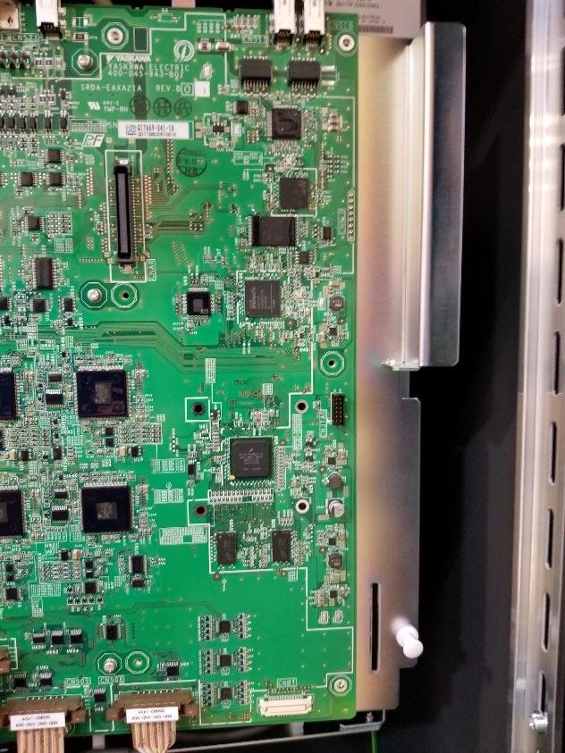
Mounting the servo control board
Remove mounting screws from the side of the EAXA21A board where the external axis servo control board will be mounted.
Note – if you are unsure as to which screws to remove, hold the external axis servo control board up to the robot control board for comparison
Removed screws.
Keep the screws that have been removed

Slide 6
Mounting the servo control board
Replace the removed screws with the standoffs that are provided.
Snug the standoffs but do not overtighten

Slide 7
Mounting the servo control board
There is a “male” connector on the back of the external axis servo control board.
Line the board up with the female connector on the DX200 EAXA21A board and plug in.
The mated connectors should support the board (temporarily) and observe that the through holes of the board line up with all of the standoffs that were installed.

Slide 8
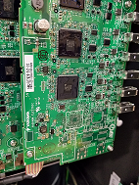
Mounting the servo control board
Using the screws that were removed from the DX200 EAXA21A board, screw down the servo control daughter board for the external axis
Replaced screws
Note : replace all removed screws. Only 3 are shown in picture as example

Slide 9
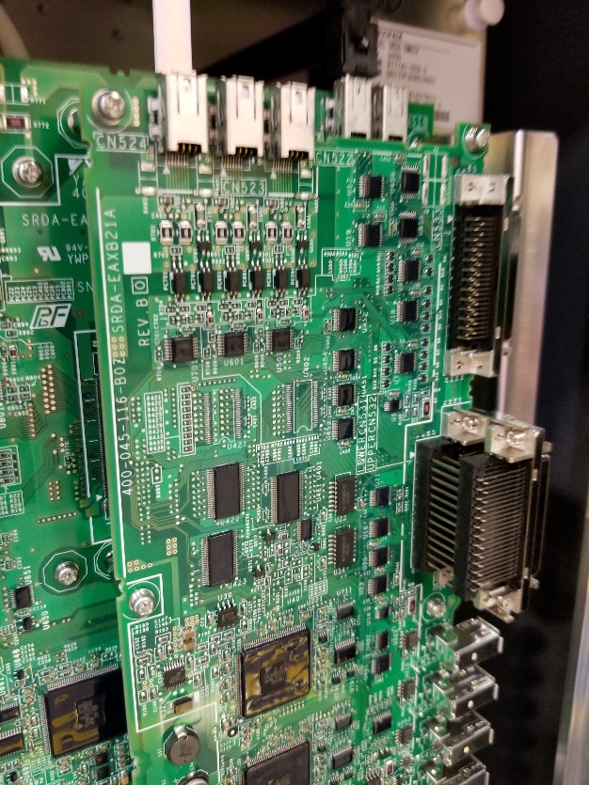
Mounted servo control board

Slide 10
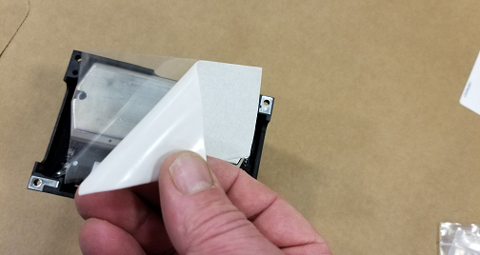
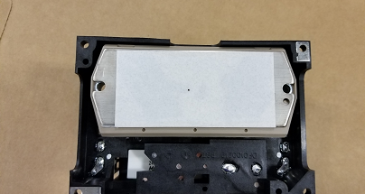
Step 3 – Preparing the Amplifier for Installation
The amplifier comes with a thermal sheet (ref. notes section of prints).
Remove the protective film from each side of the thermal sheet.
Place the thermal sheet on the metal on the back of the amplifier.
Remove film on thermal sheet
Thermal sheet placed on amplifier

Slide 11
Step 4 – Installing the amplifier
Find the release pins on the amplifier module located at the right of the module on the top and bottom and gently pull out until you feel a click.

Slide 12
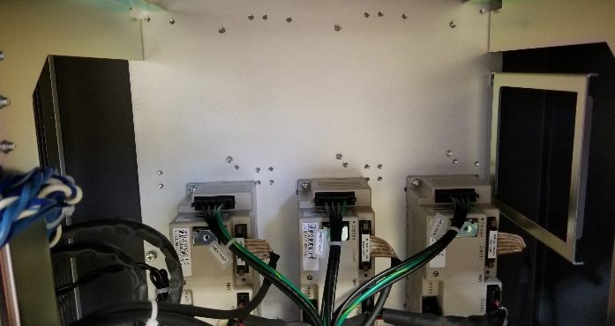
Step 4 – Installing the amplifier
After the pins on the amplifier module have been released, the front panel opens and swings on hinges to reveal the robot amplifiers and the 3 spots for additional external axis amplifiers.
Door closed
Space for additional amplifiers
Door open

Slide 13
Step 4 – Installing the amplifier
Per print, install the correct amplifier using the correct hardware as designated by the bill of material (BOM).

Slide 14
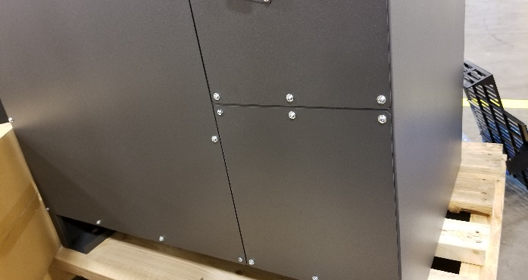
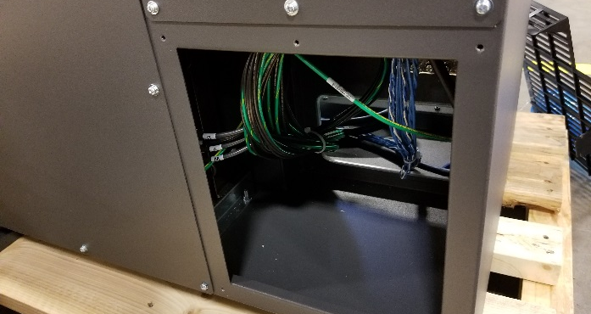
Step 5 – amplifier connections
Prepare the controller for the installation of the encoder and power pigtails.
Remove the M4 screws and remove the cover plate.
Save the screws to remount the cable entry panel.
Back of DX200 controller
Remove lower right back panel

Slide 15
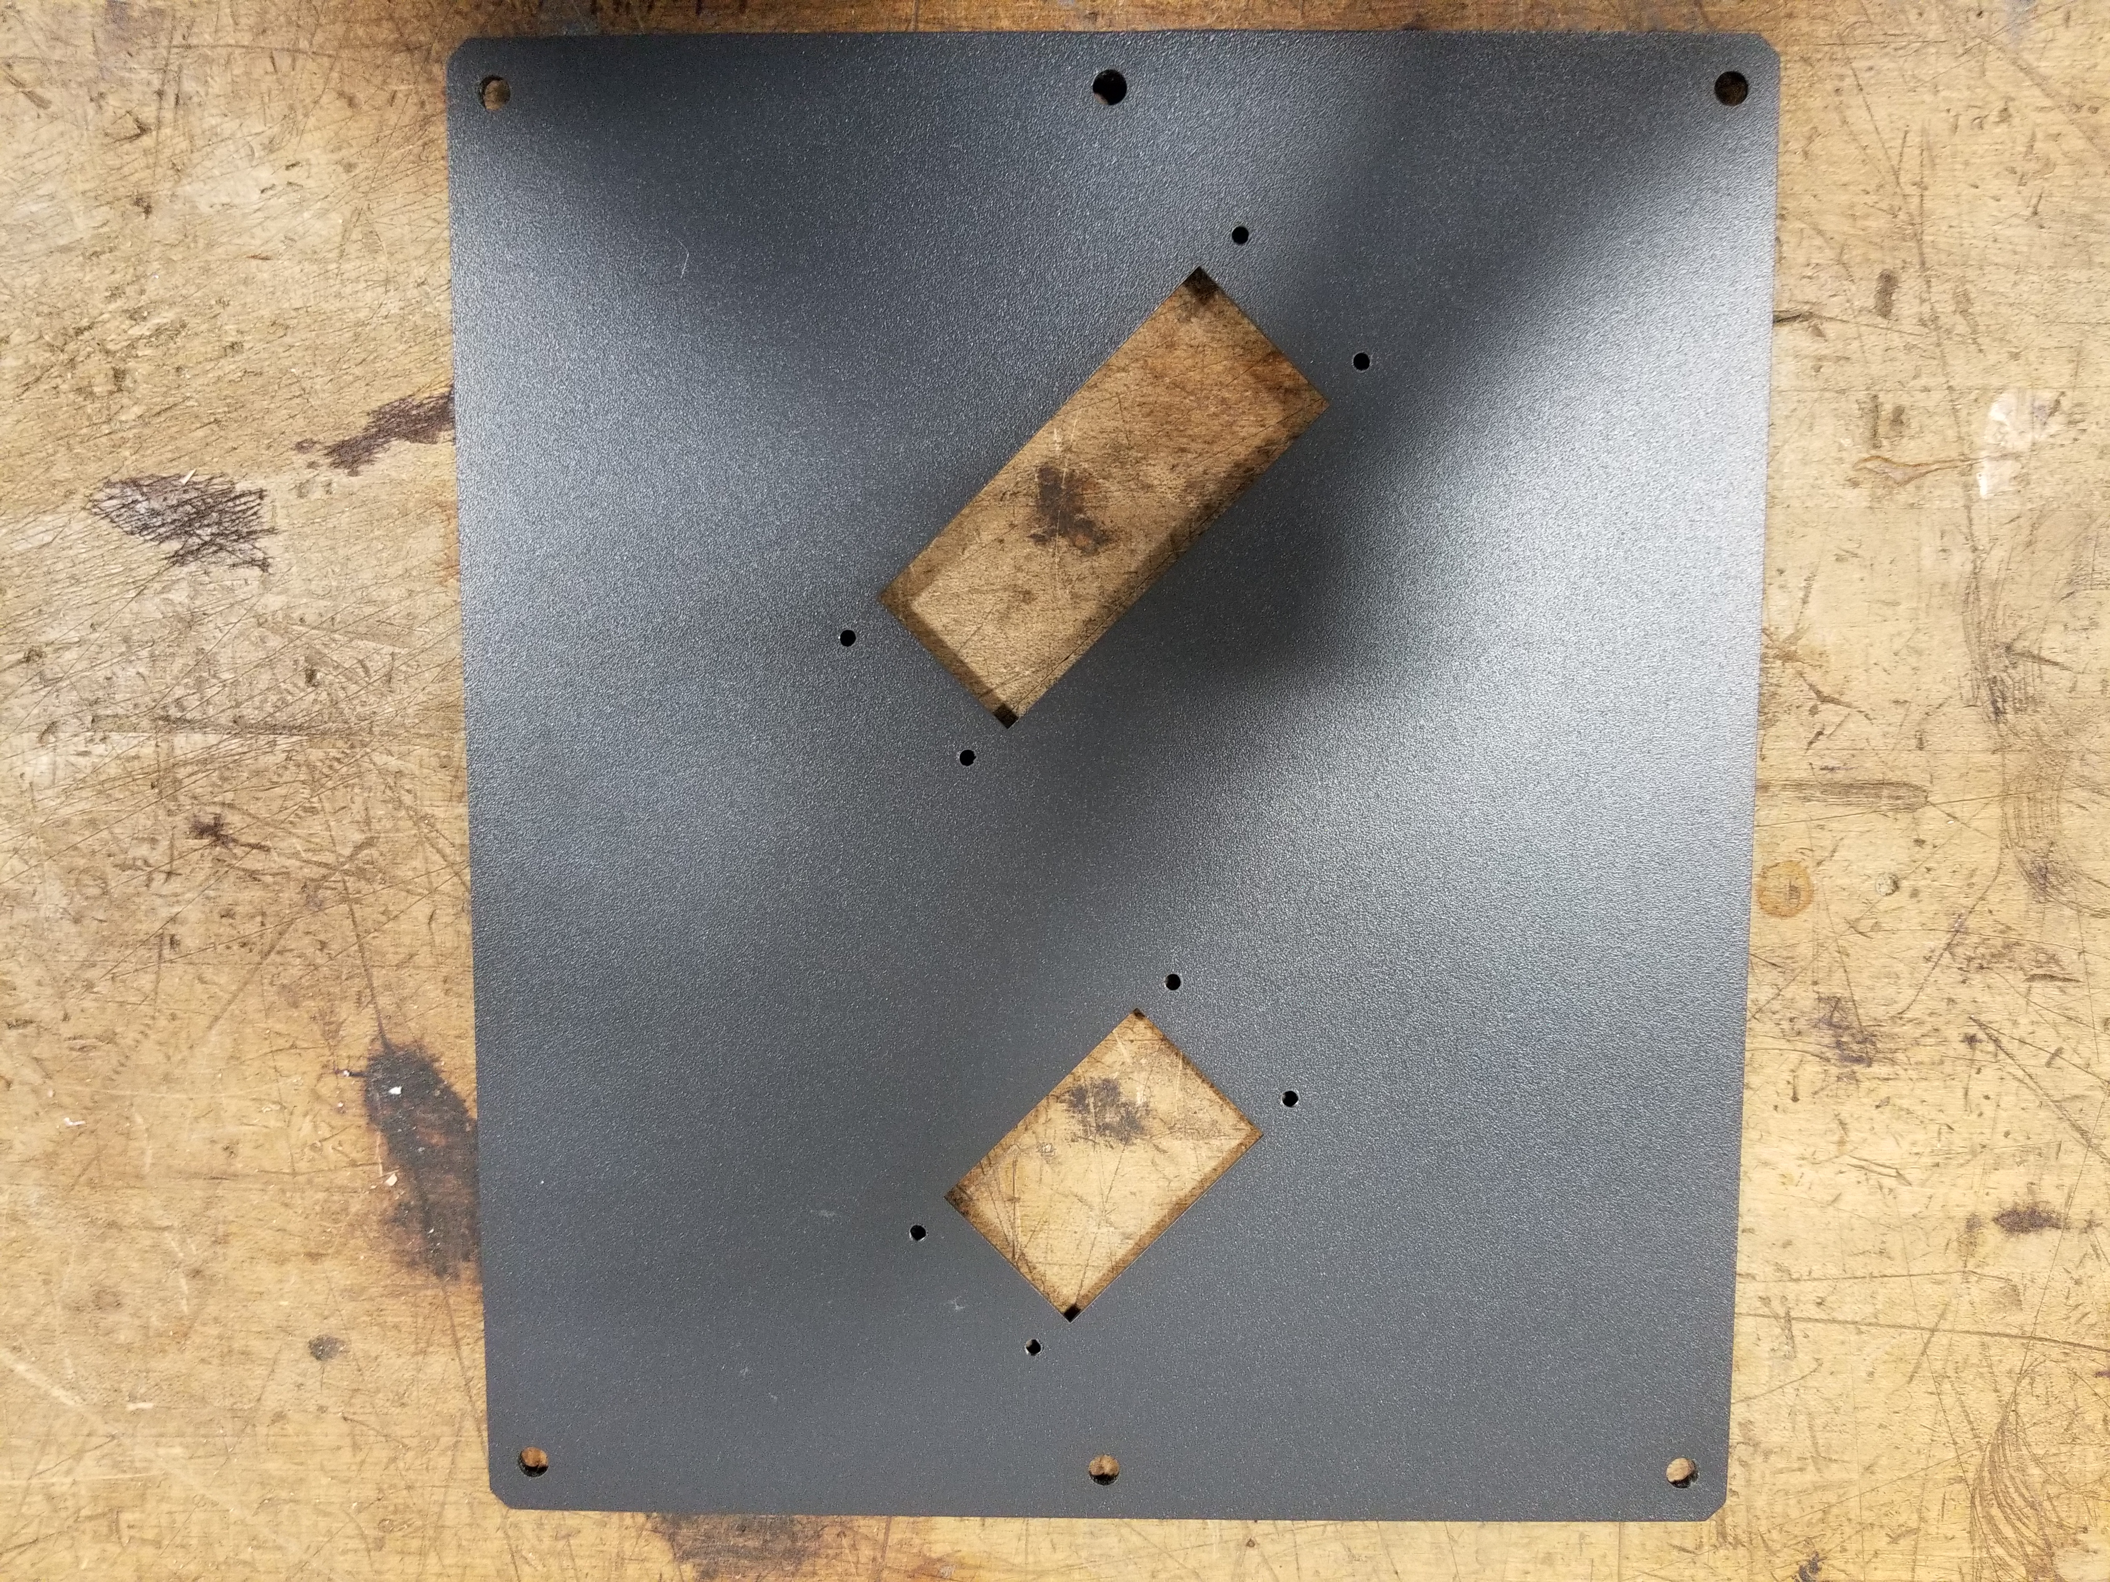
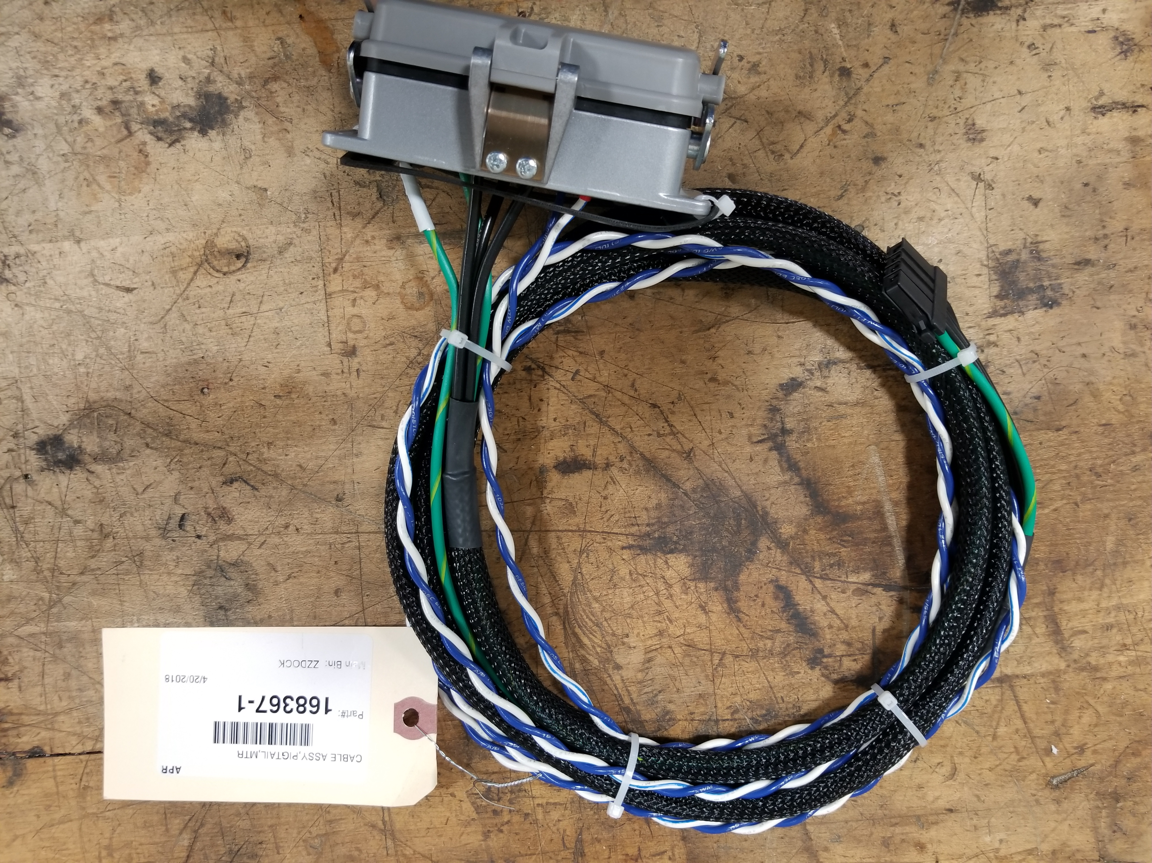
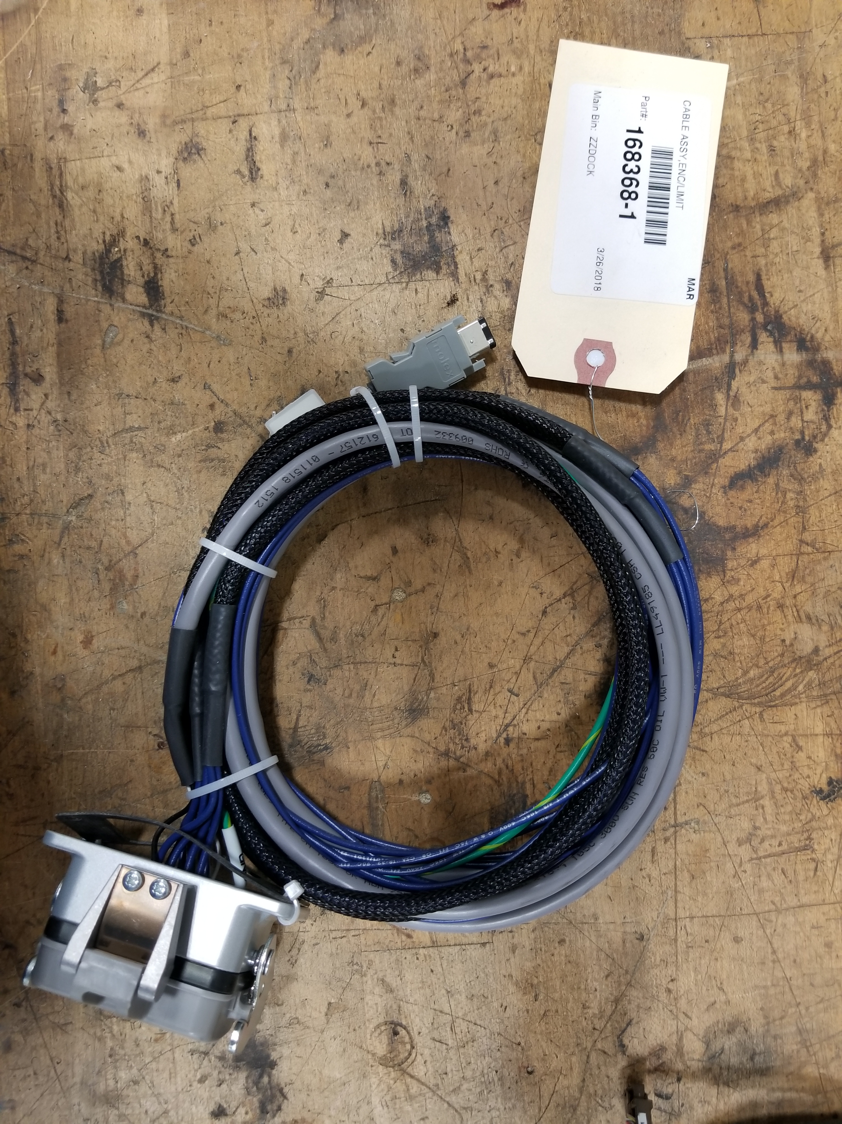
Preparing the cable entry panel
*note * The parts that are shown here are for this particular external axis kit, other kit parts will not be exact part numbers but resemble the example
Feed the cables through the appropriate openings of the panel. Using 8, M4x12 PPH screws (137146-4), attach the bulkheads of the cable assy to the cable entry panel. Make sure the orientation of the bulkheads matches the print.

Slide 16
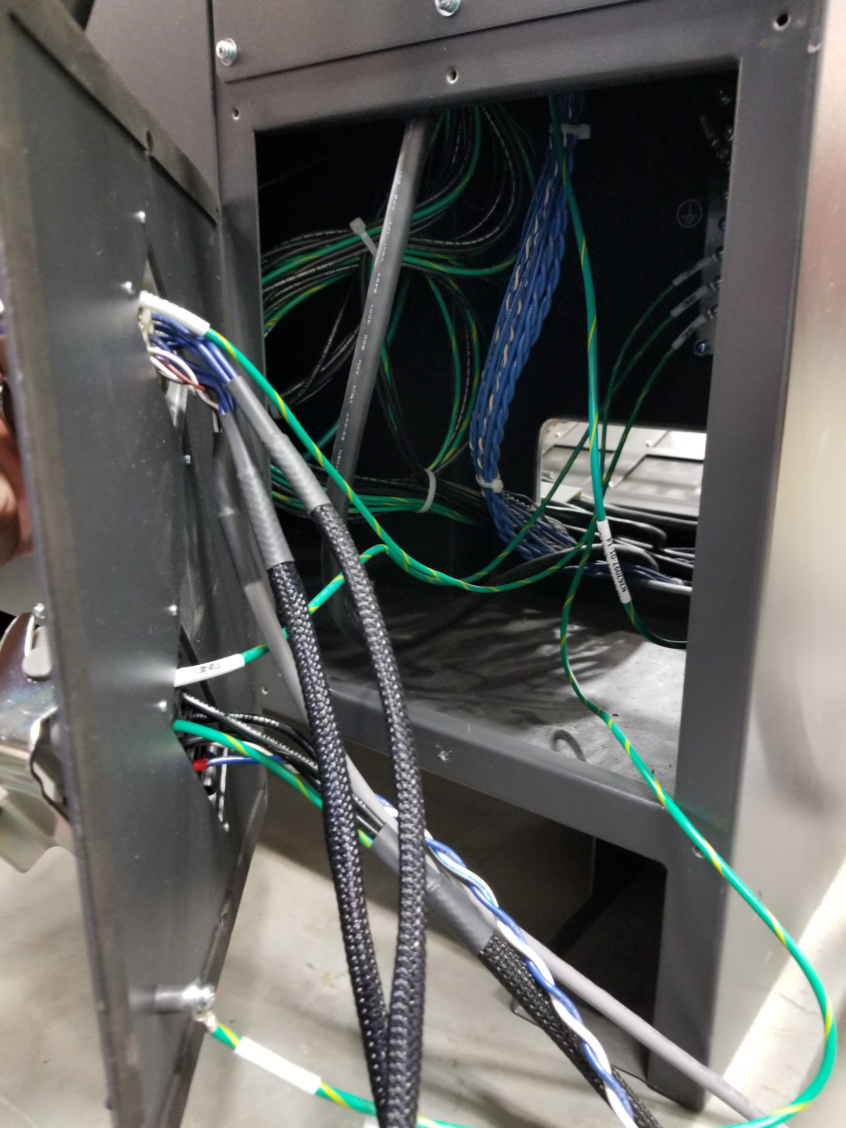
Installing the cable panel
Feed the cable ends through the opening in the DX200 controller

Slide 17
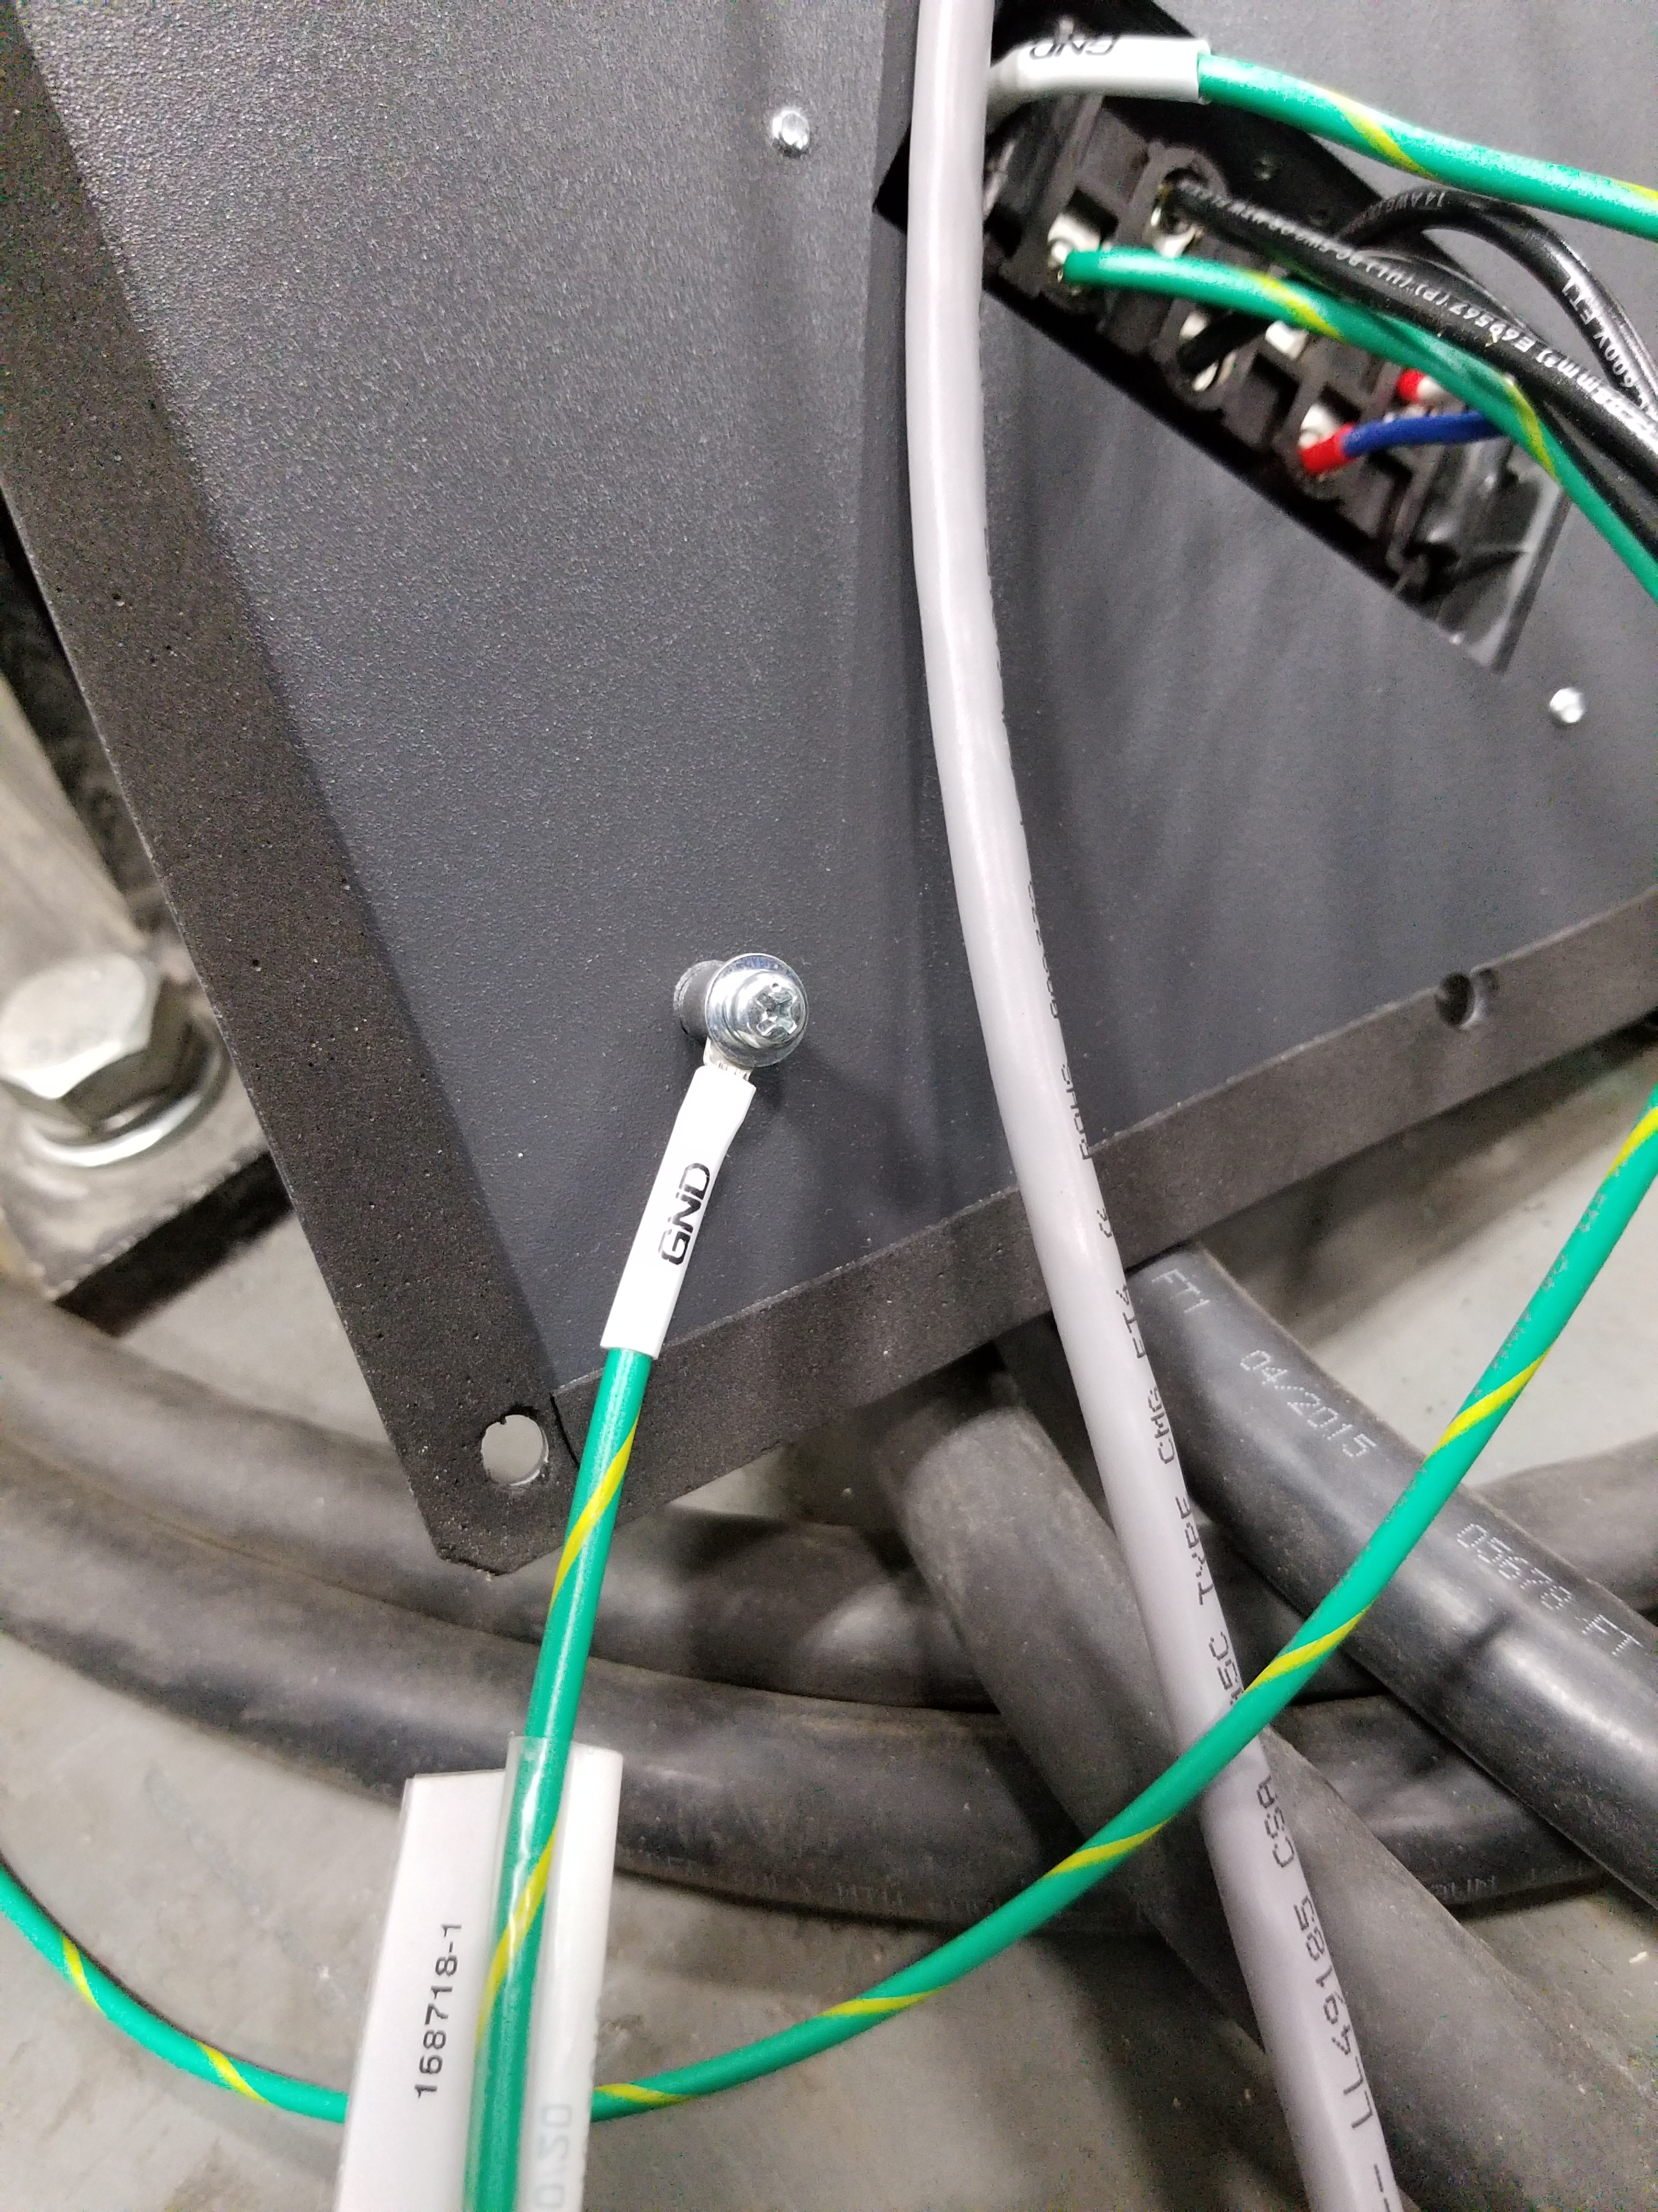
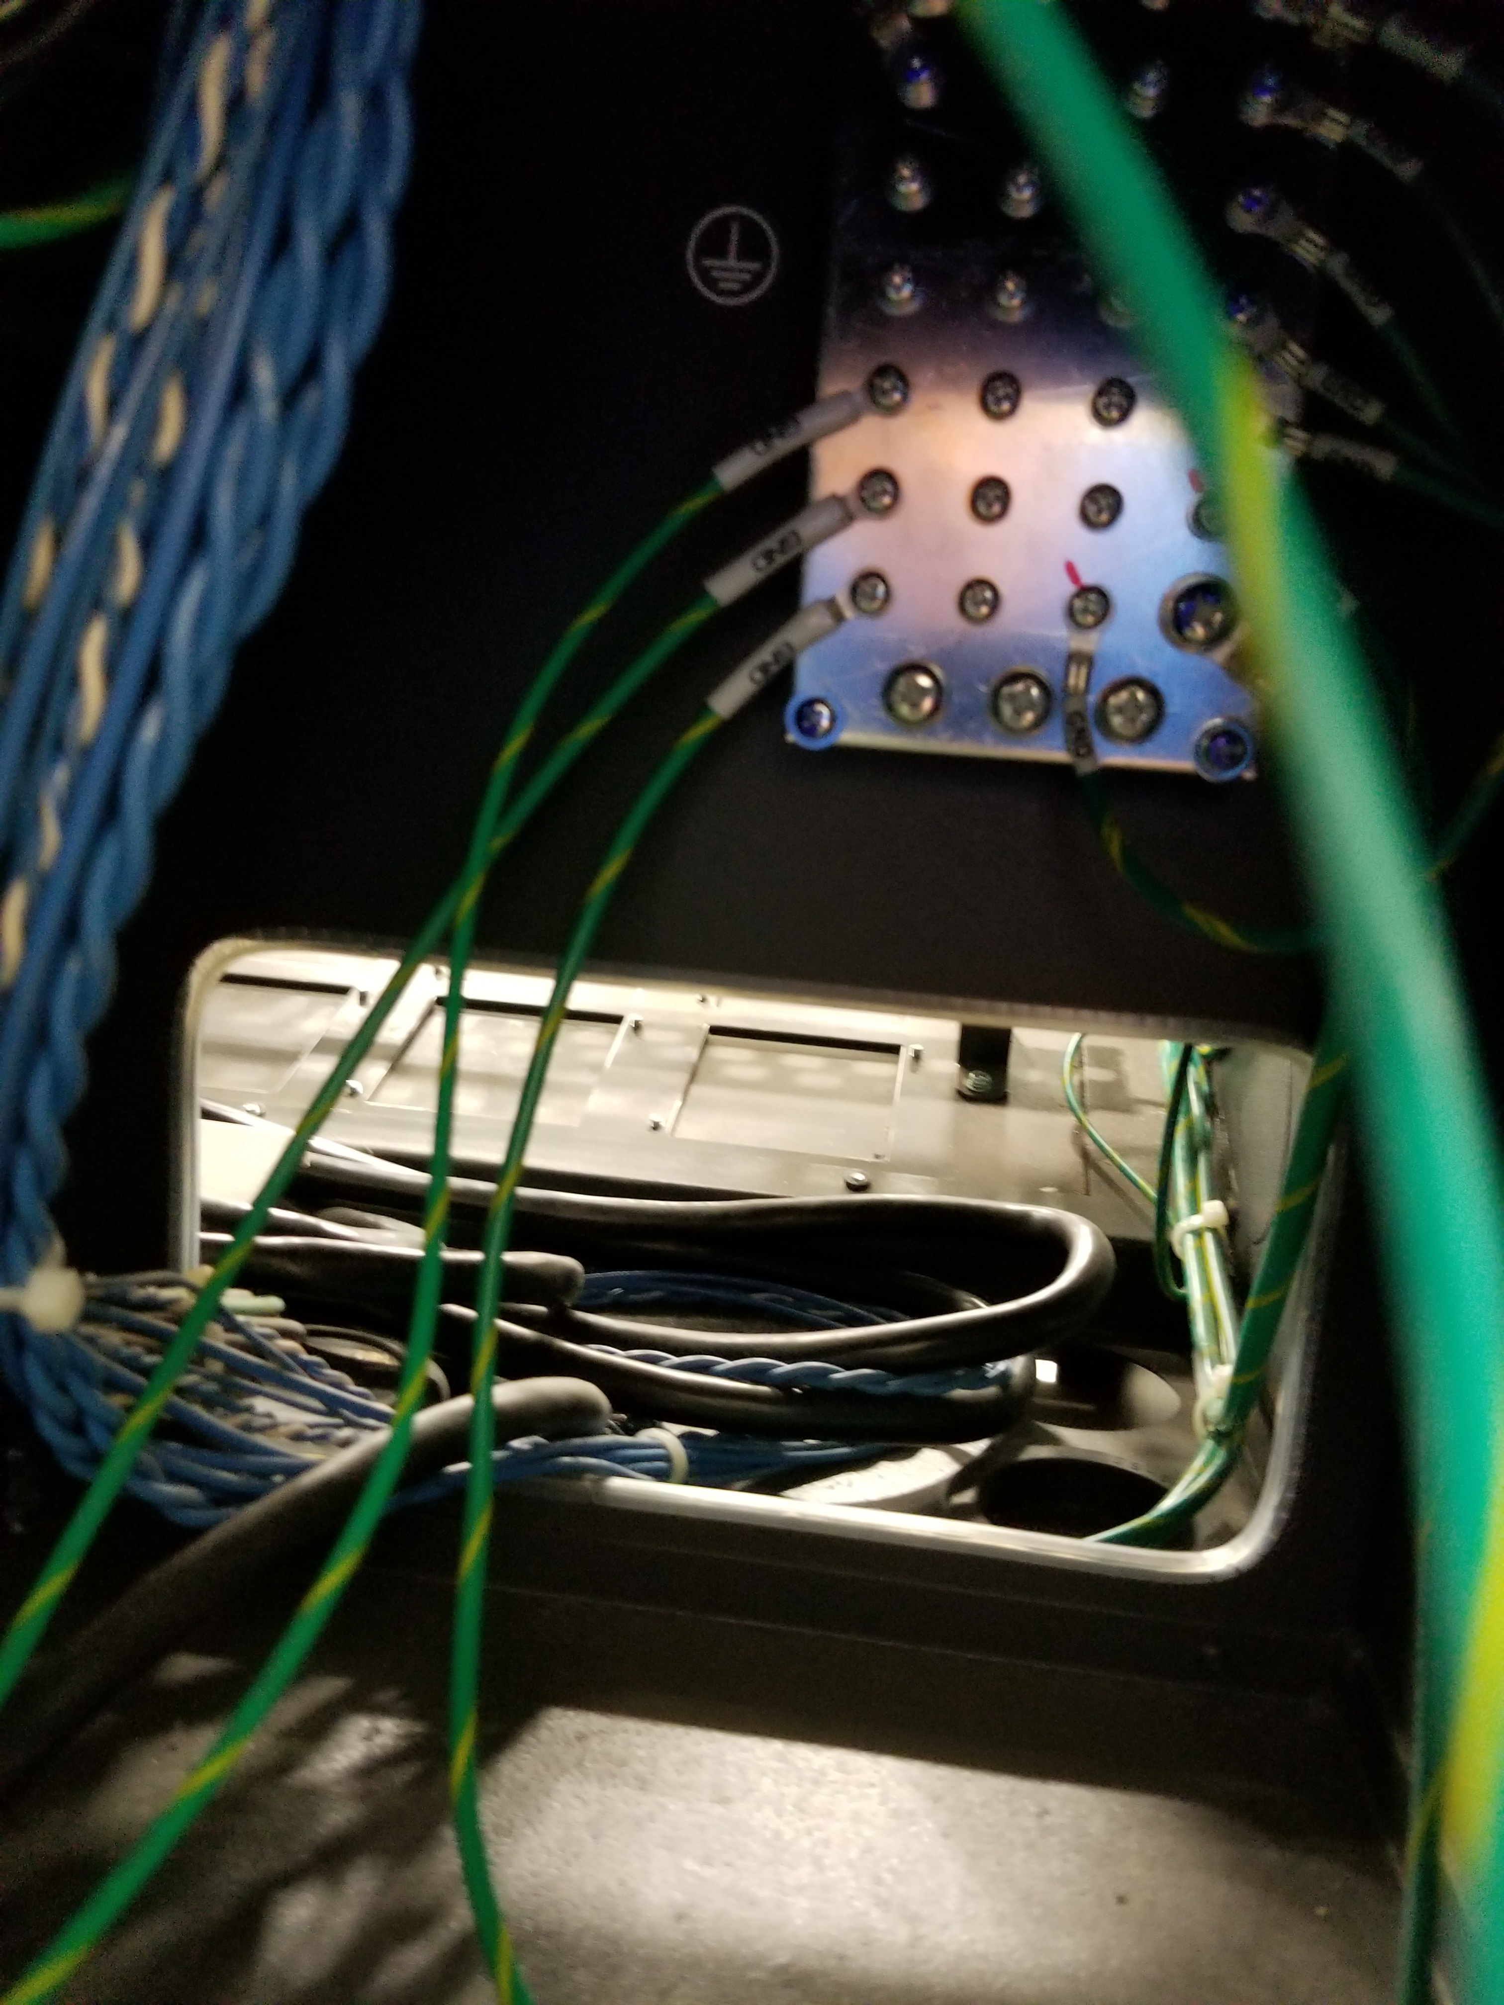
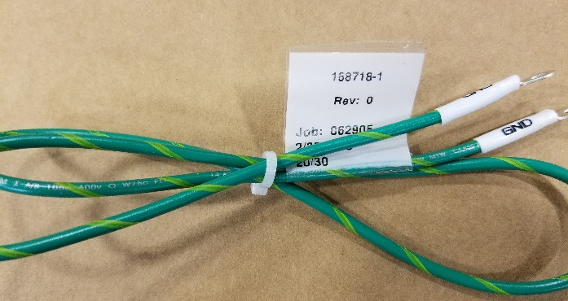
Ground wire attachment
Before securing the cable entry panel, connect the ground wires from the encoder cable assembly and the power cable assembly to the ground plate located in the back of the controller
Also, connect 168718-1, 14 awg ground jumper from the ground post on the cable entry plate to the ground plate of the controller.

Slide 18
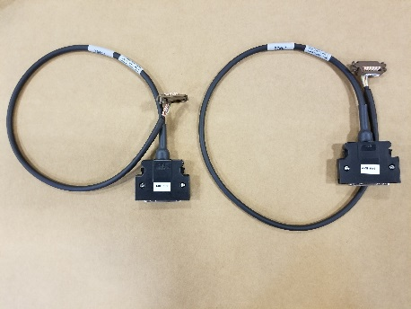
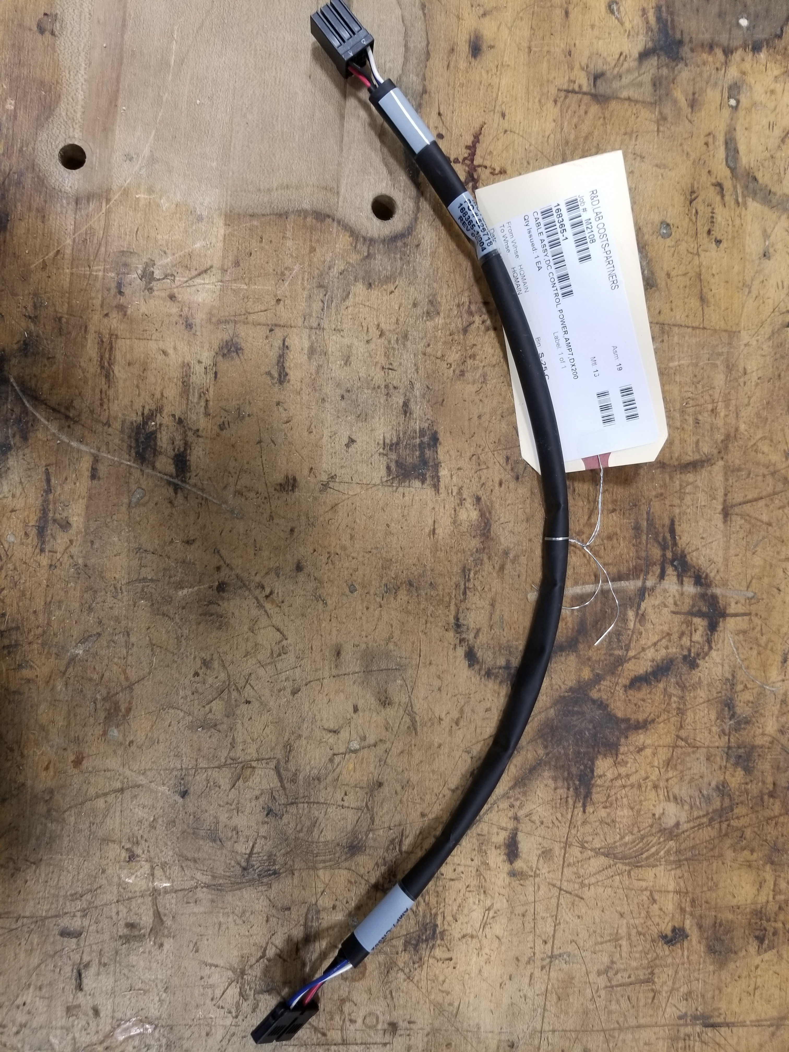
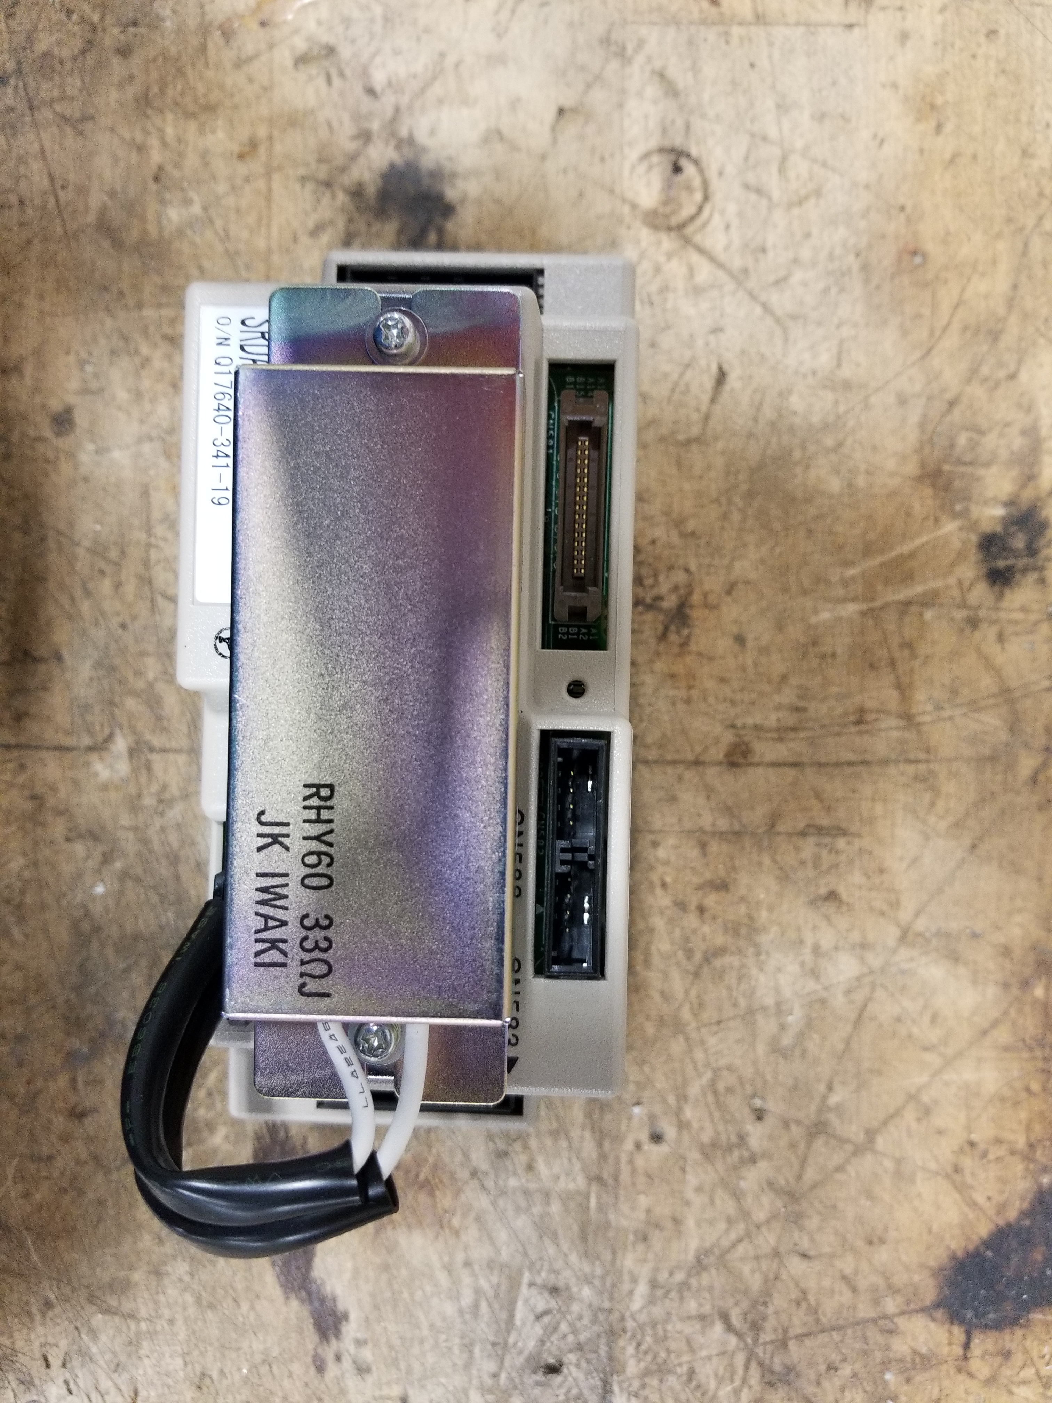
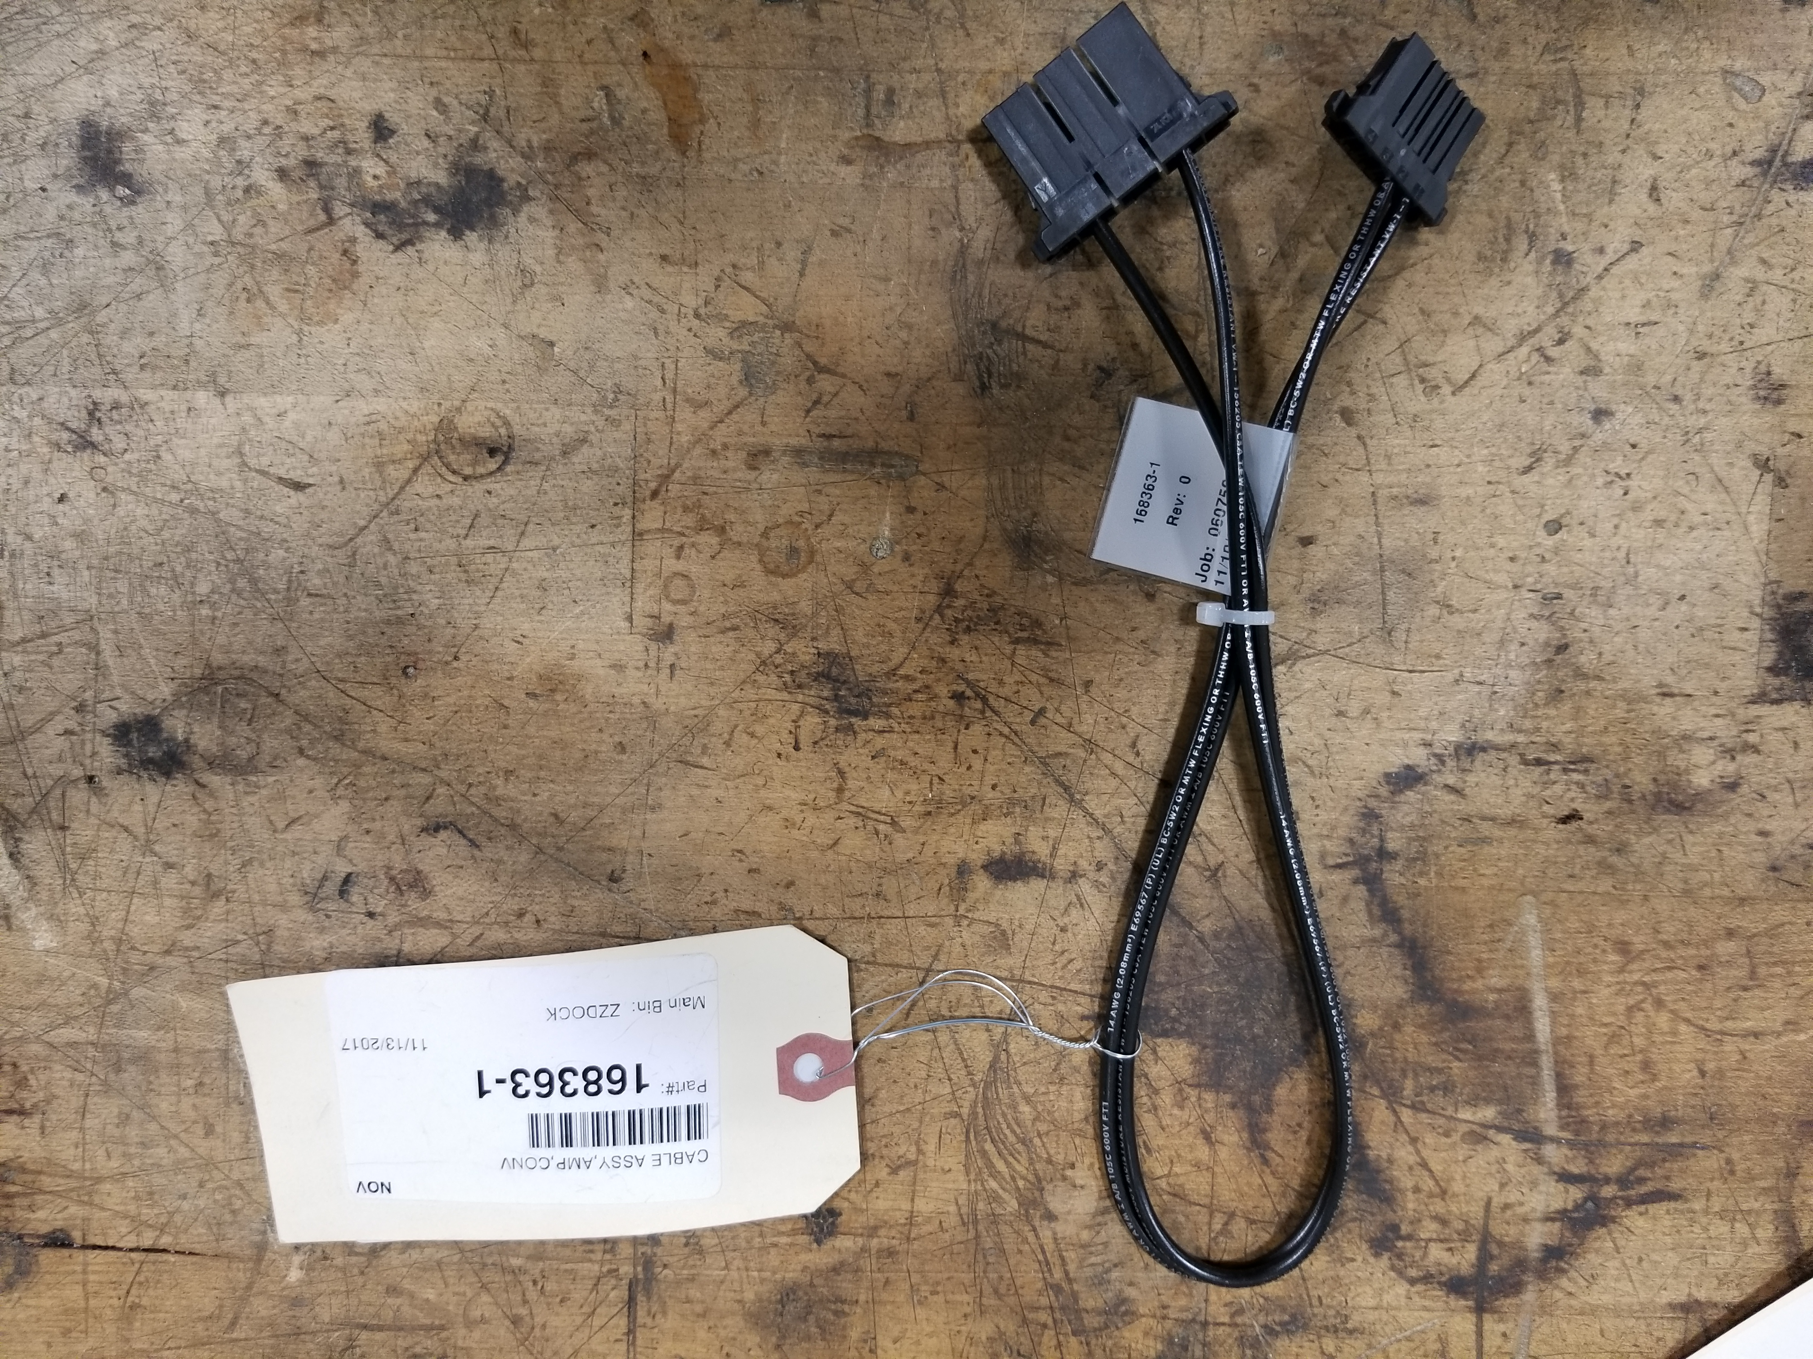
Amplifier connections

Slide 19
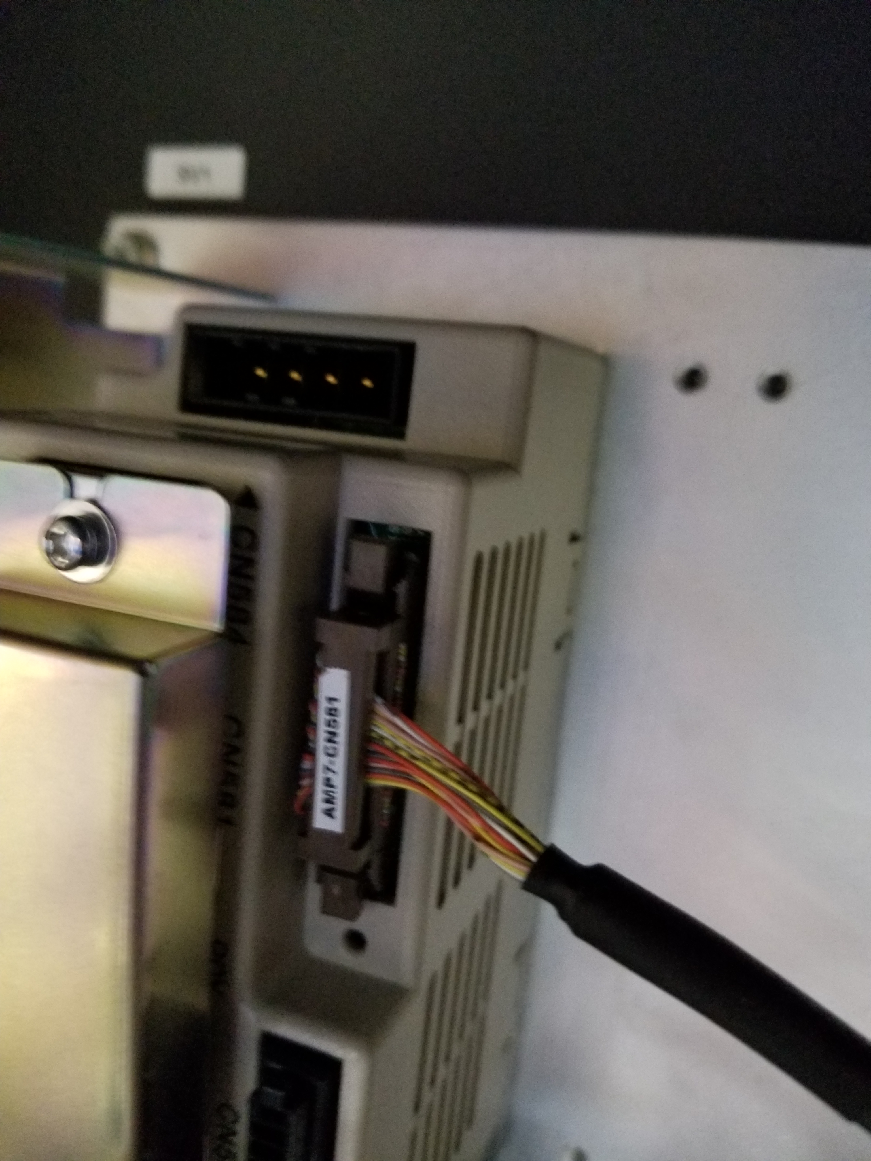
Connection of Amplifier interface cable, 168398-()
Connect amplifier interface cable to the CN581 of the amplifier.

Slide 20
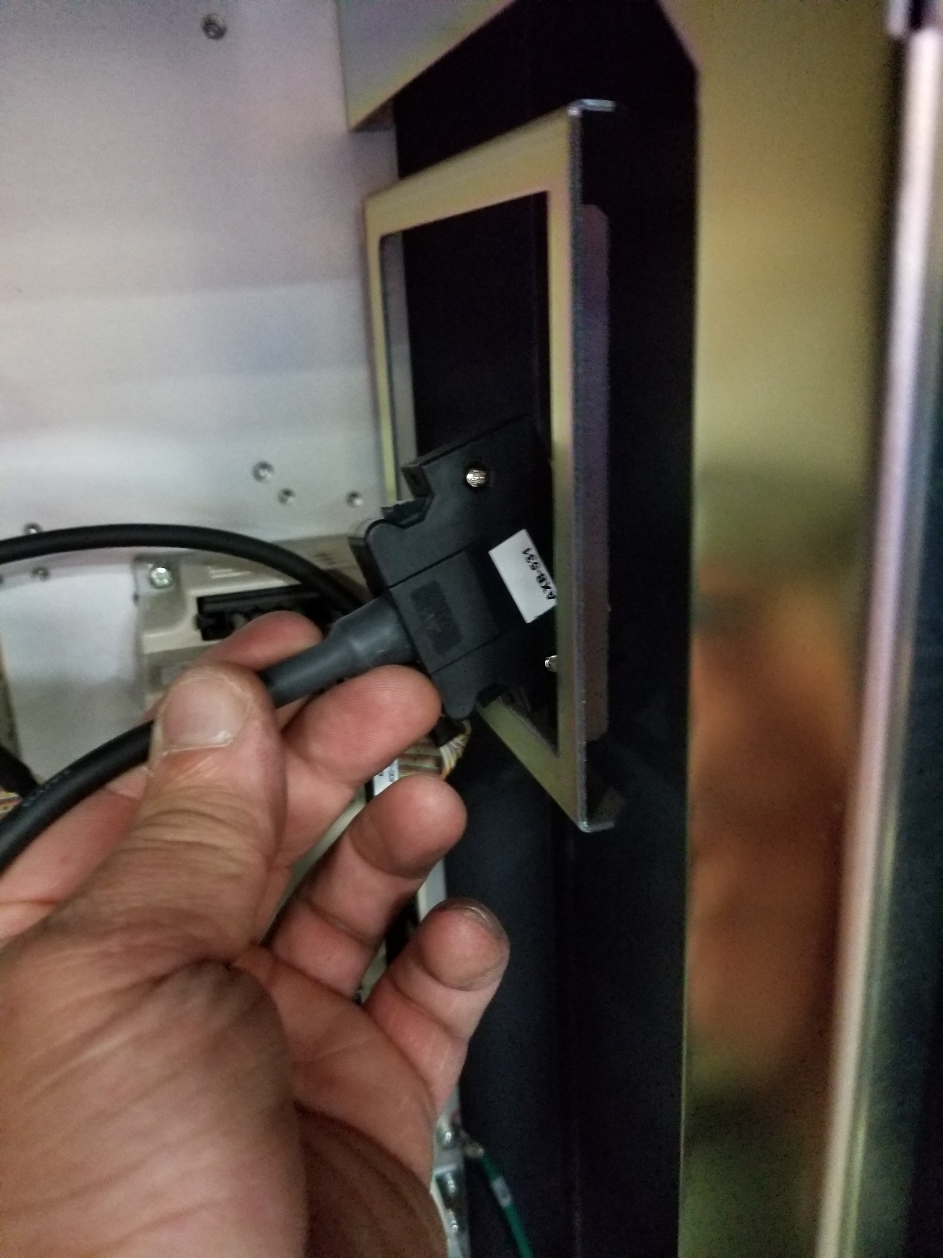
Connection of Amplifier interface cable, 168398-()
After connecting the cables to the amplifier, route the cables through the right side of the chassis of the amplifier module. And let hang free at this point.

Slide 21
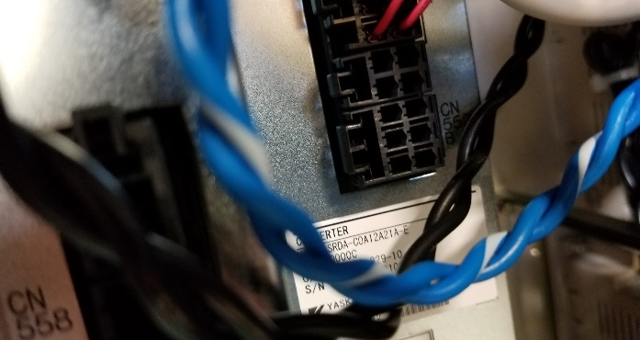
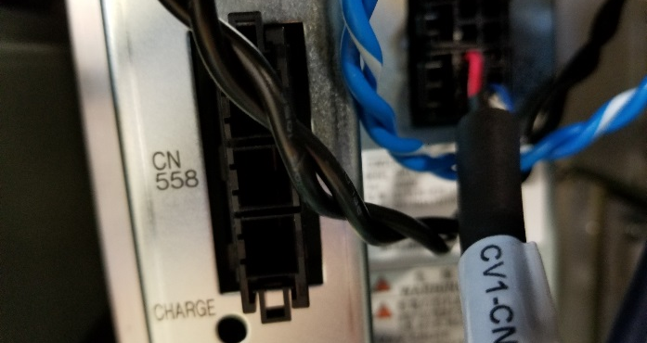
Connection of 168365, DC control power to Converter
Remove dummy plug CN552B from the converter module in the DX200 and plug in the 6 pin connector, marked CV1-CN552B of the 165365-2 cable.

Slide 22
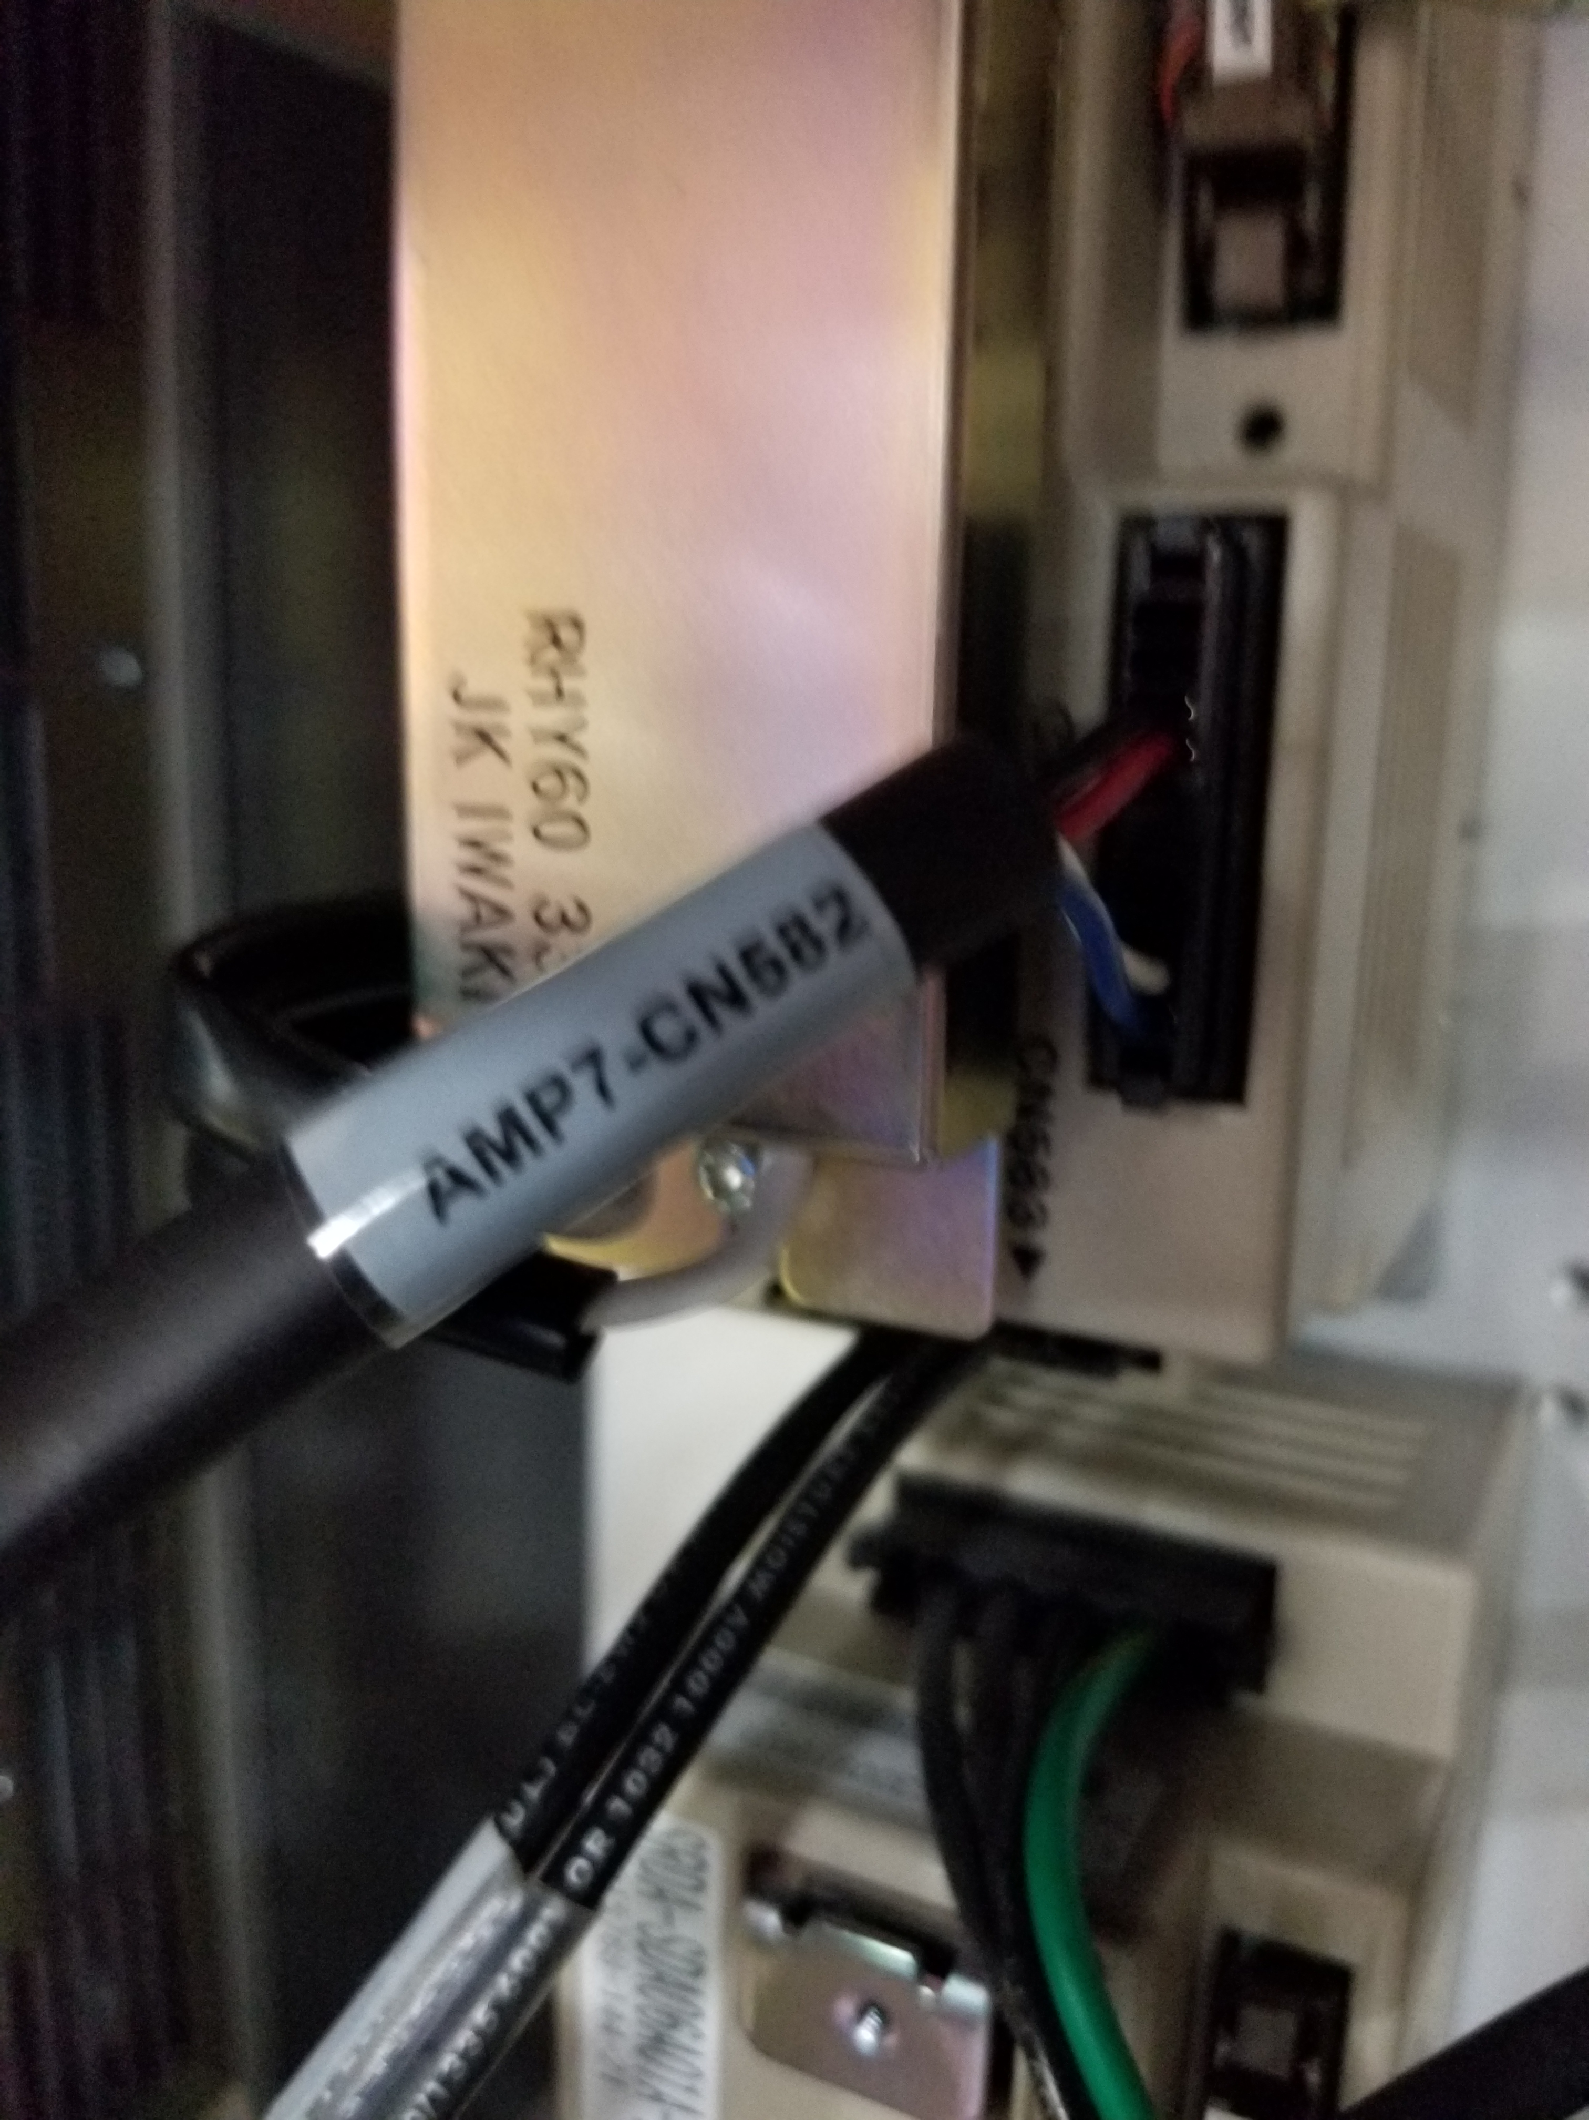
DC control power cable connection to amplifiers
Plug in connector “amp 7 CN582” to the CN582 connector on amp 7

Slide 23
Installation of Converter power cable
Remove the dummy plug from the CN558 slot on the converter unit in the DX200.

Slide 24
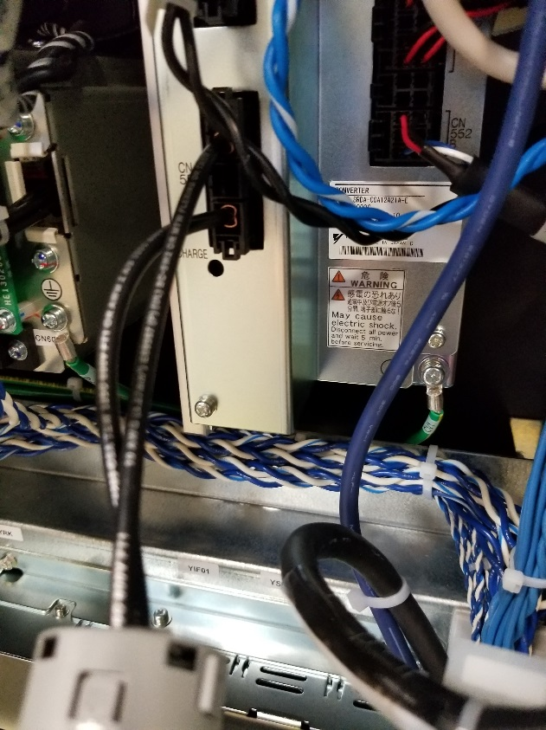
Installation of Converter power cable
Plug the connector marked with the label “CN558” into the converter, port CN558.

Slide 25
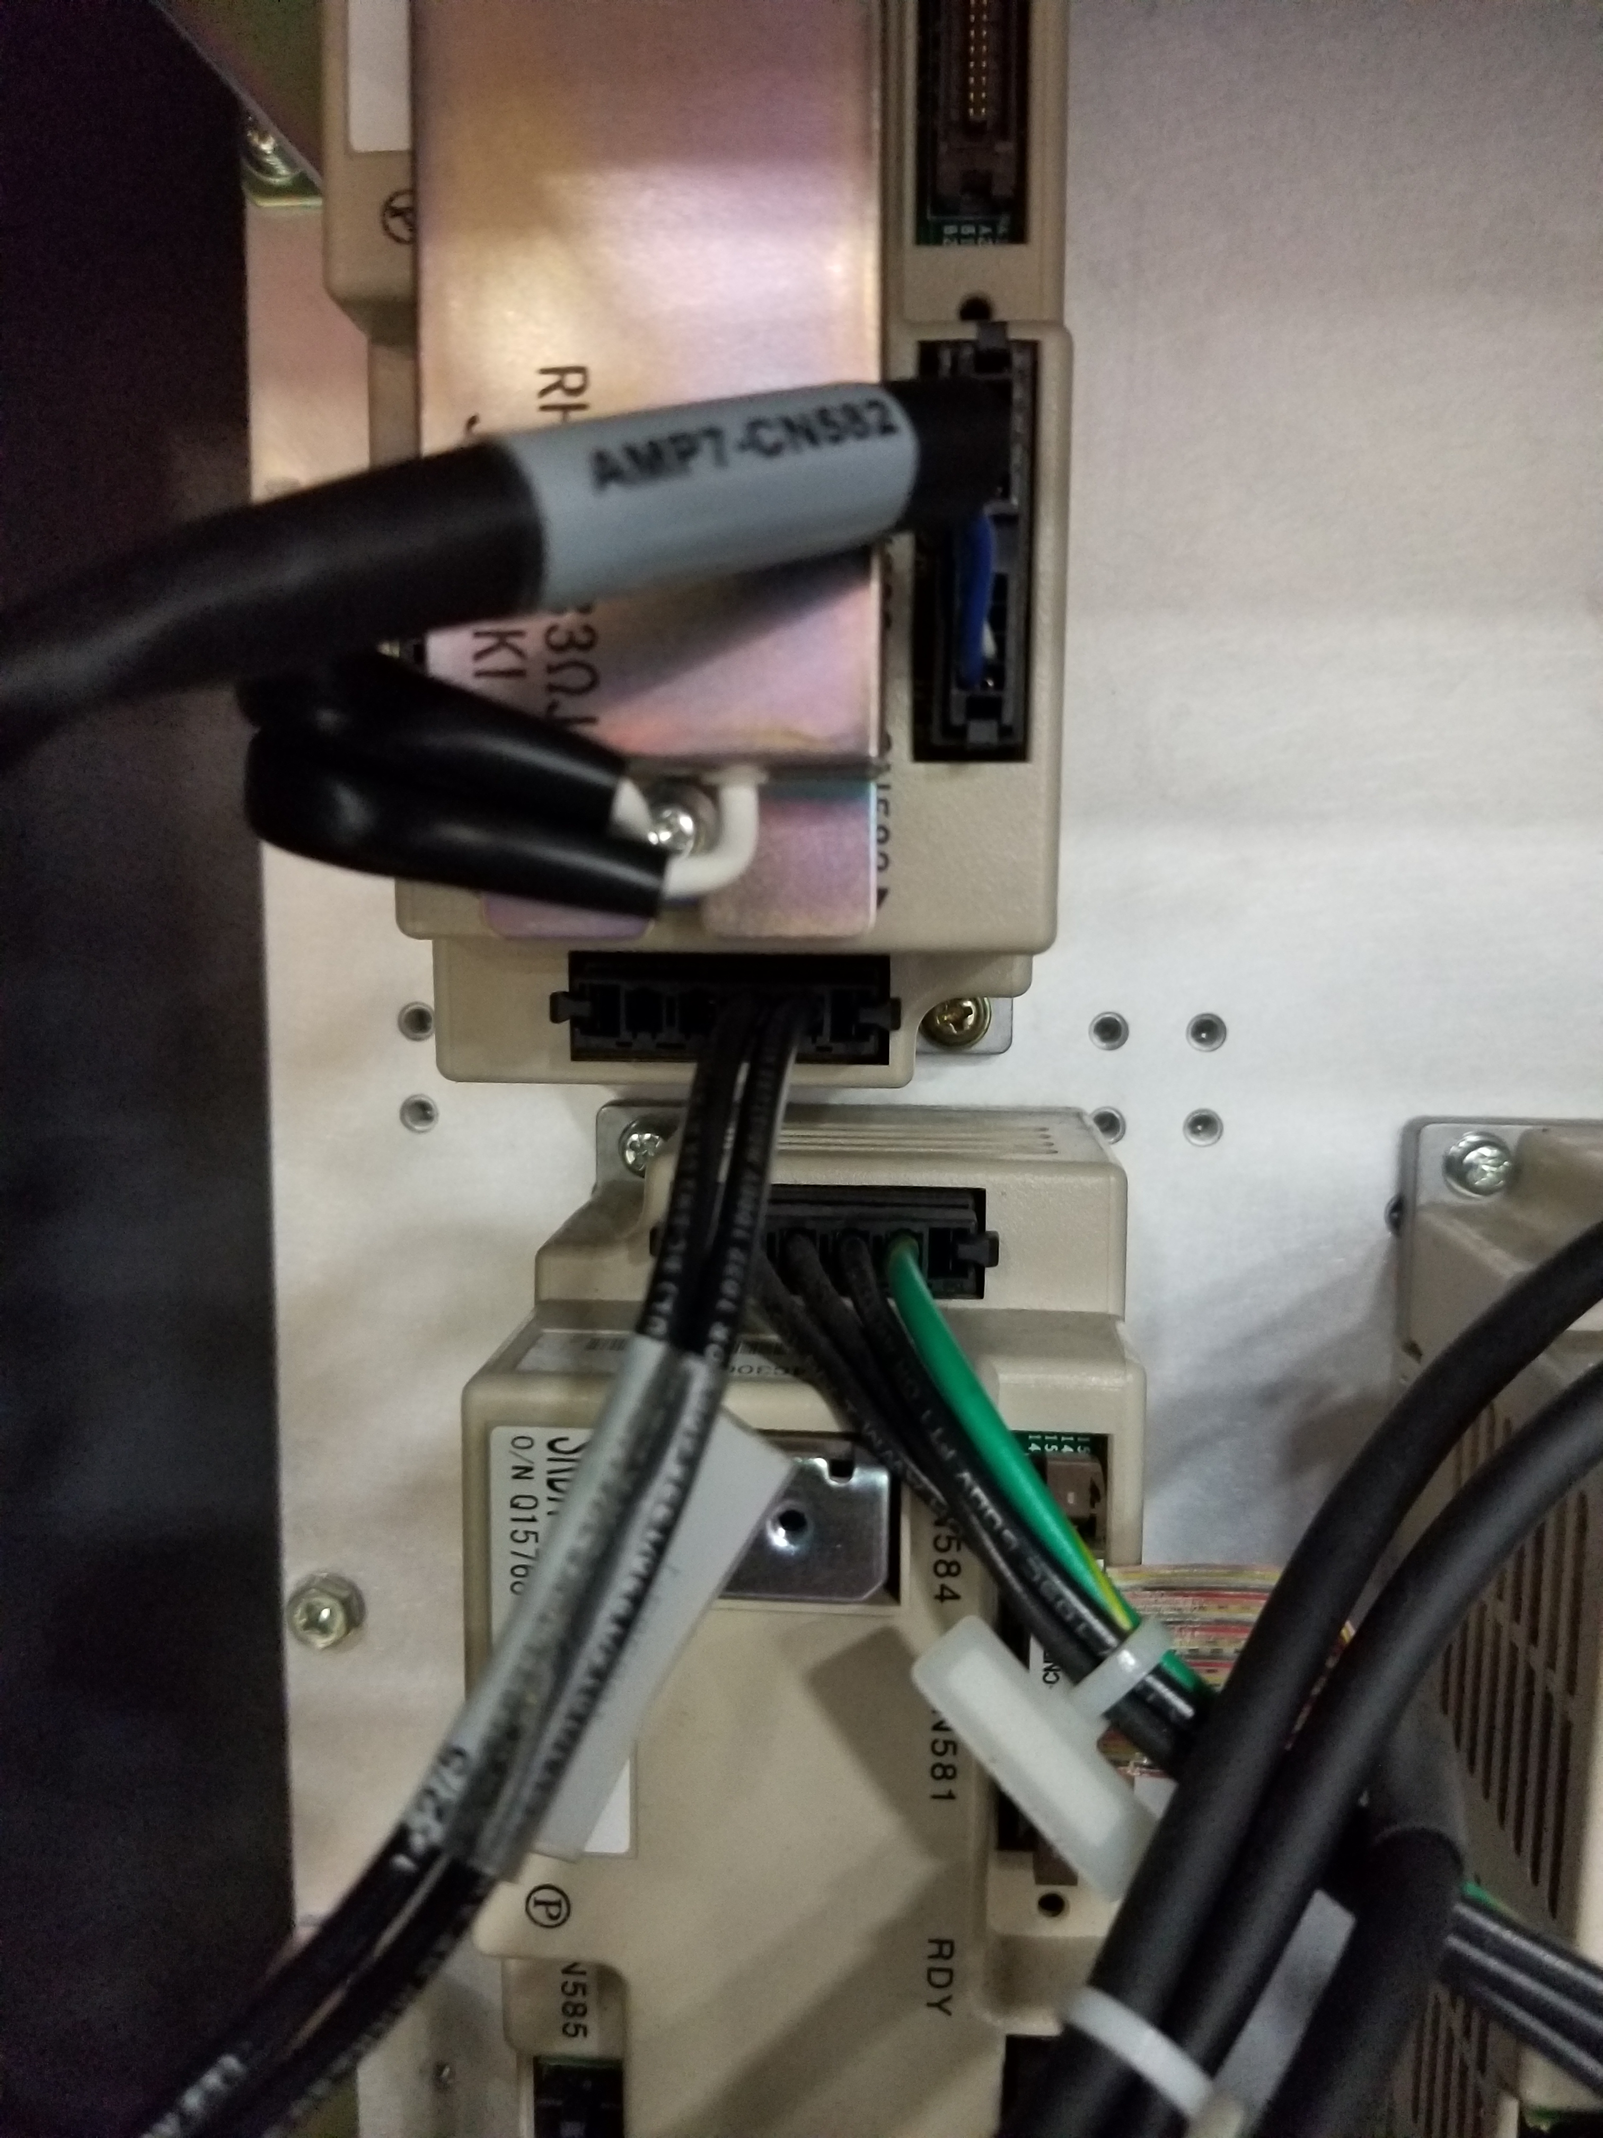
Installation of Converter power cable
Neatly route the cable to the amplifiers and connect the connector labeled “Amp 7 CN583” to amp 7

Slide 26
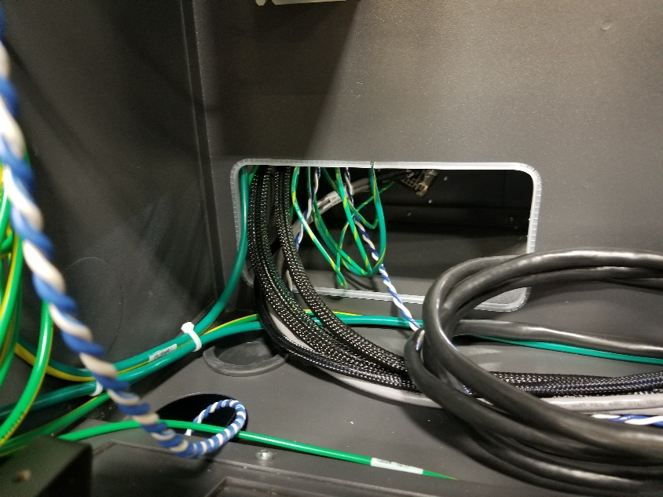
Installation and connections of power and encoder pigtail from cable entry plate
Power connection : Pull the cables from the pigtail, through the opening in the DX200 controller to the front of the controller.

Slide 27
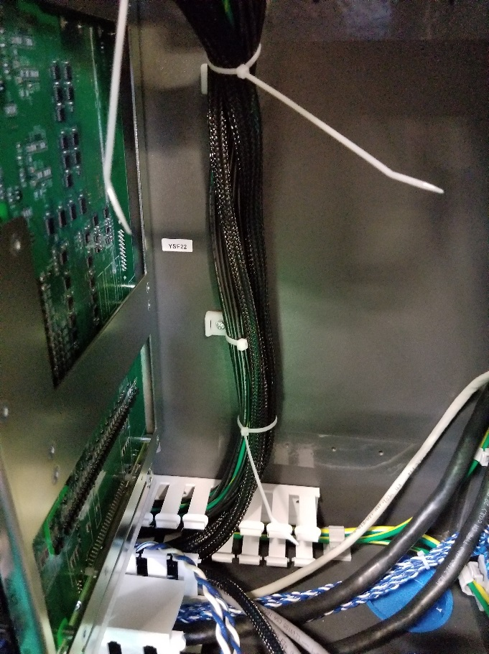
Installation and connections of power and encoder pigtail from cable entry plate
Neatly route the power cables through the Panduit channel and up to the amplifiers. Wire tie cables with the existing bundle of robot amplifier power cables.
Wire ties
Power cables
panduit
Brake wires

Slide 28
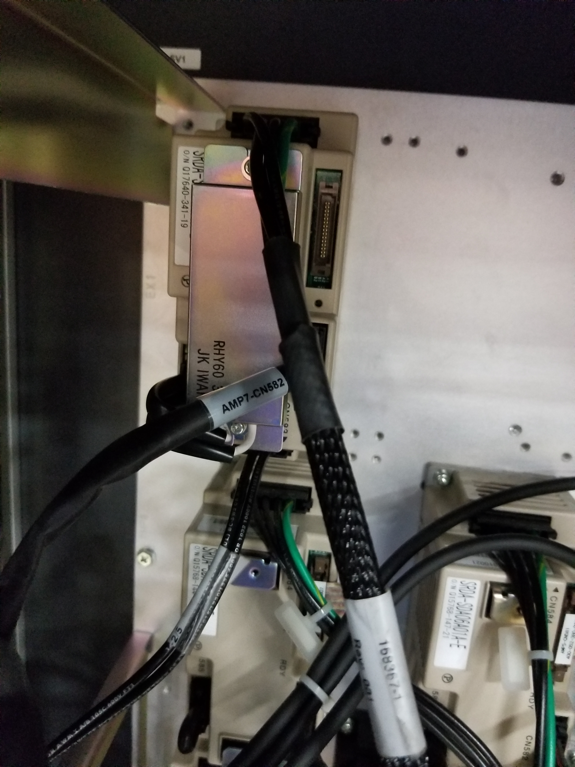
Installation and connections of power and encoder pigtail from cable entry plate
Make motor connections at amplifier.

Slide 29
Brake line connections
The brake wires for the motors are twisted pair, blue and blue/white wires. Separate the brake wires from the motor power cables and route to the YBK01, brake board.
Brake wires

Slide 30
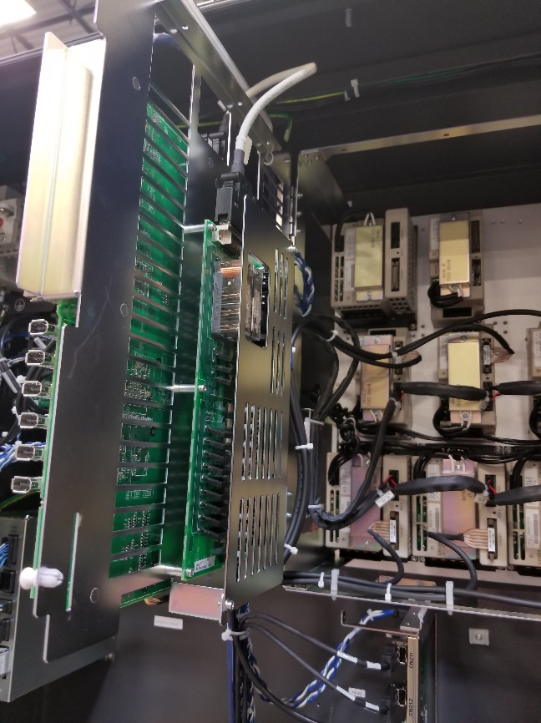
Brake Board location in DX200
The YBK brake board is located on the back side of the EAXA21A, servo control board rack. To reveal this board, pull the two release pins on the rack and open the door.
Open door
Brake board
Release pins for servo control unit. 2 locations top and bottom.

Slide 31
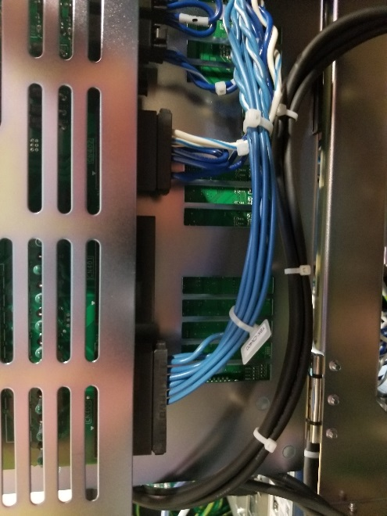
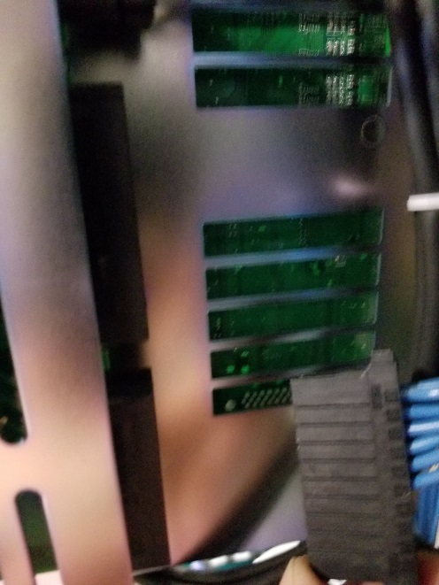
Brake wire hook up.
Locate the CN400 connector on the YBK brake board and unplug by squeezing the release tabs on the top and bottom of the connector and pull.
CN400

Slide 32
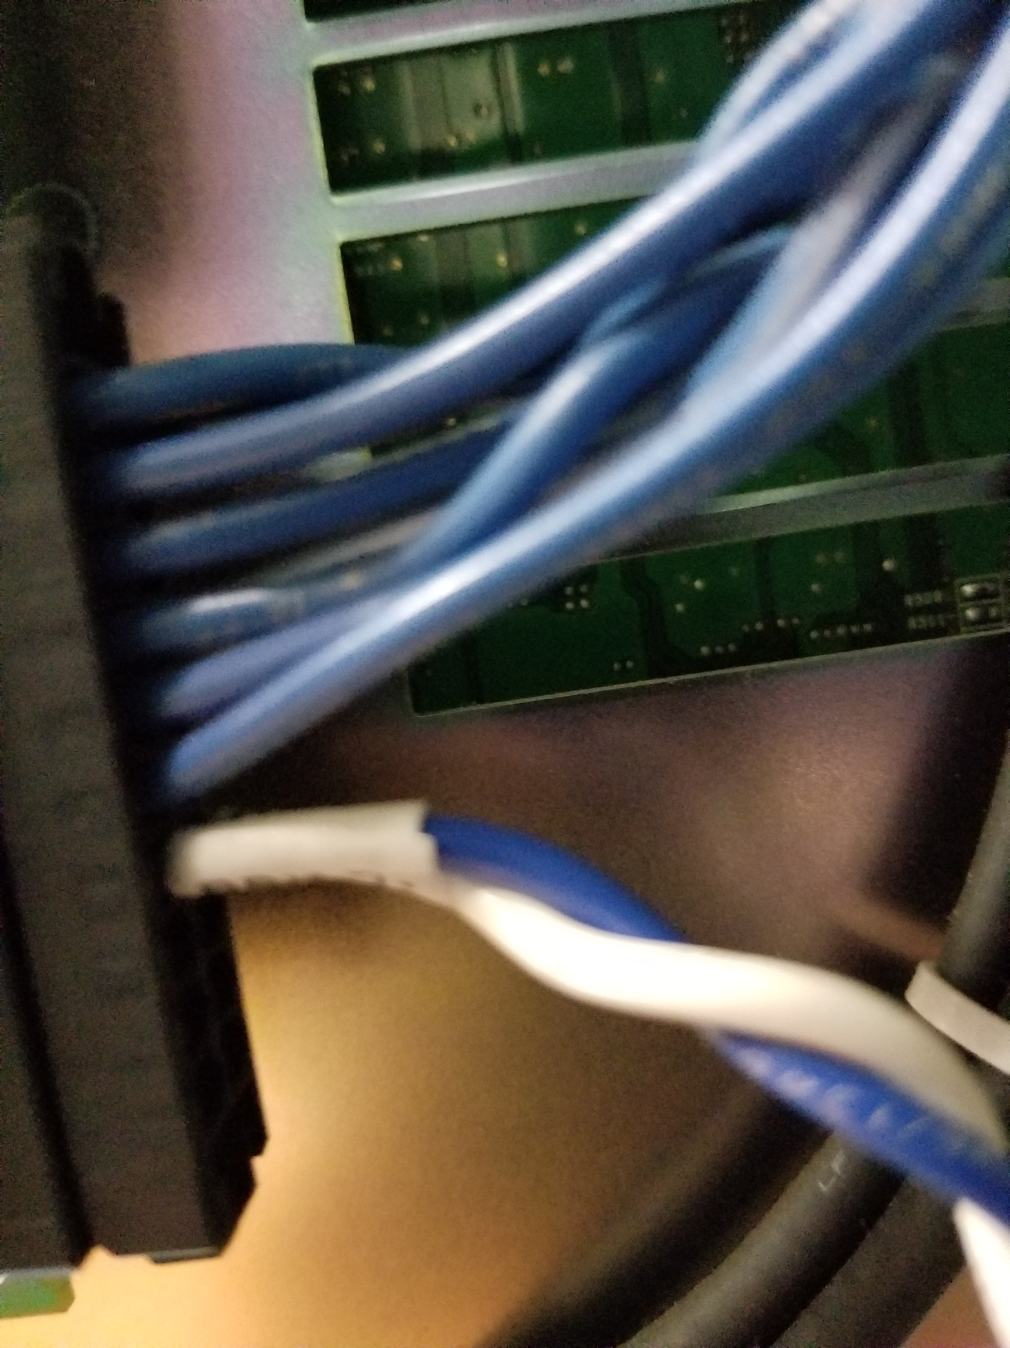
Brake wire hook up.
When the twisted pair brake wires have been neatly routed to the brake board, insert the socketed wires into the connector.
The wires are labeled BRK7+, BRK7-
BRK7+ will go into CN400-B4
BRK7- will go into CN400-A4

Slide 33
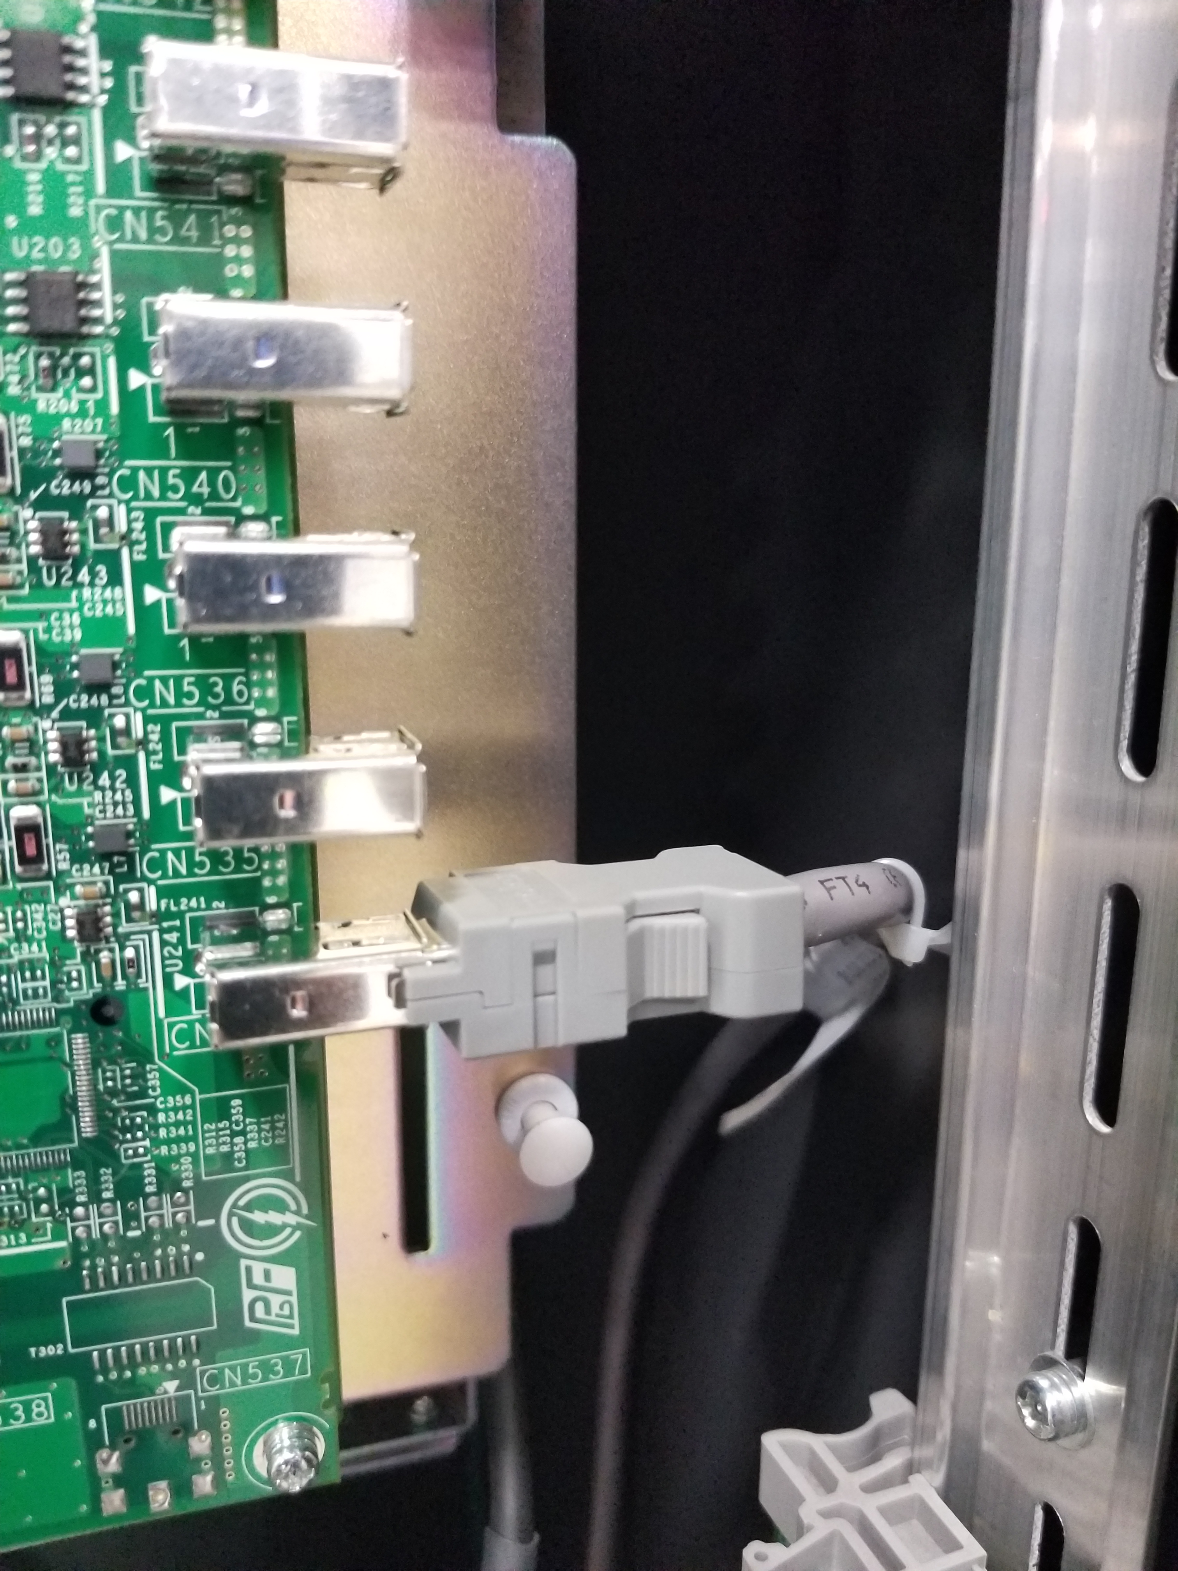
Encoder connections
From the encoder limit switch cable, attach the designated grey encoder connection to the external axis servo control board.

Slide 34
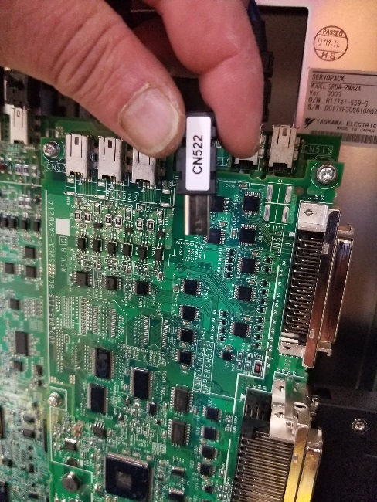
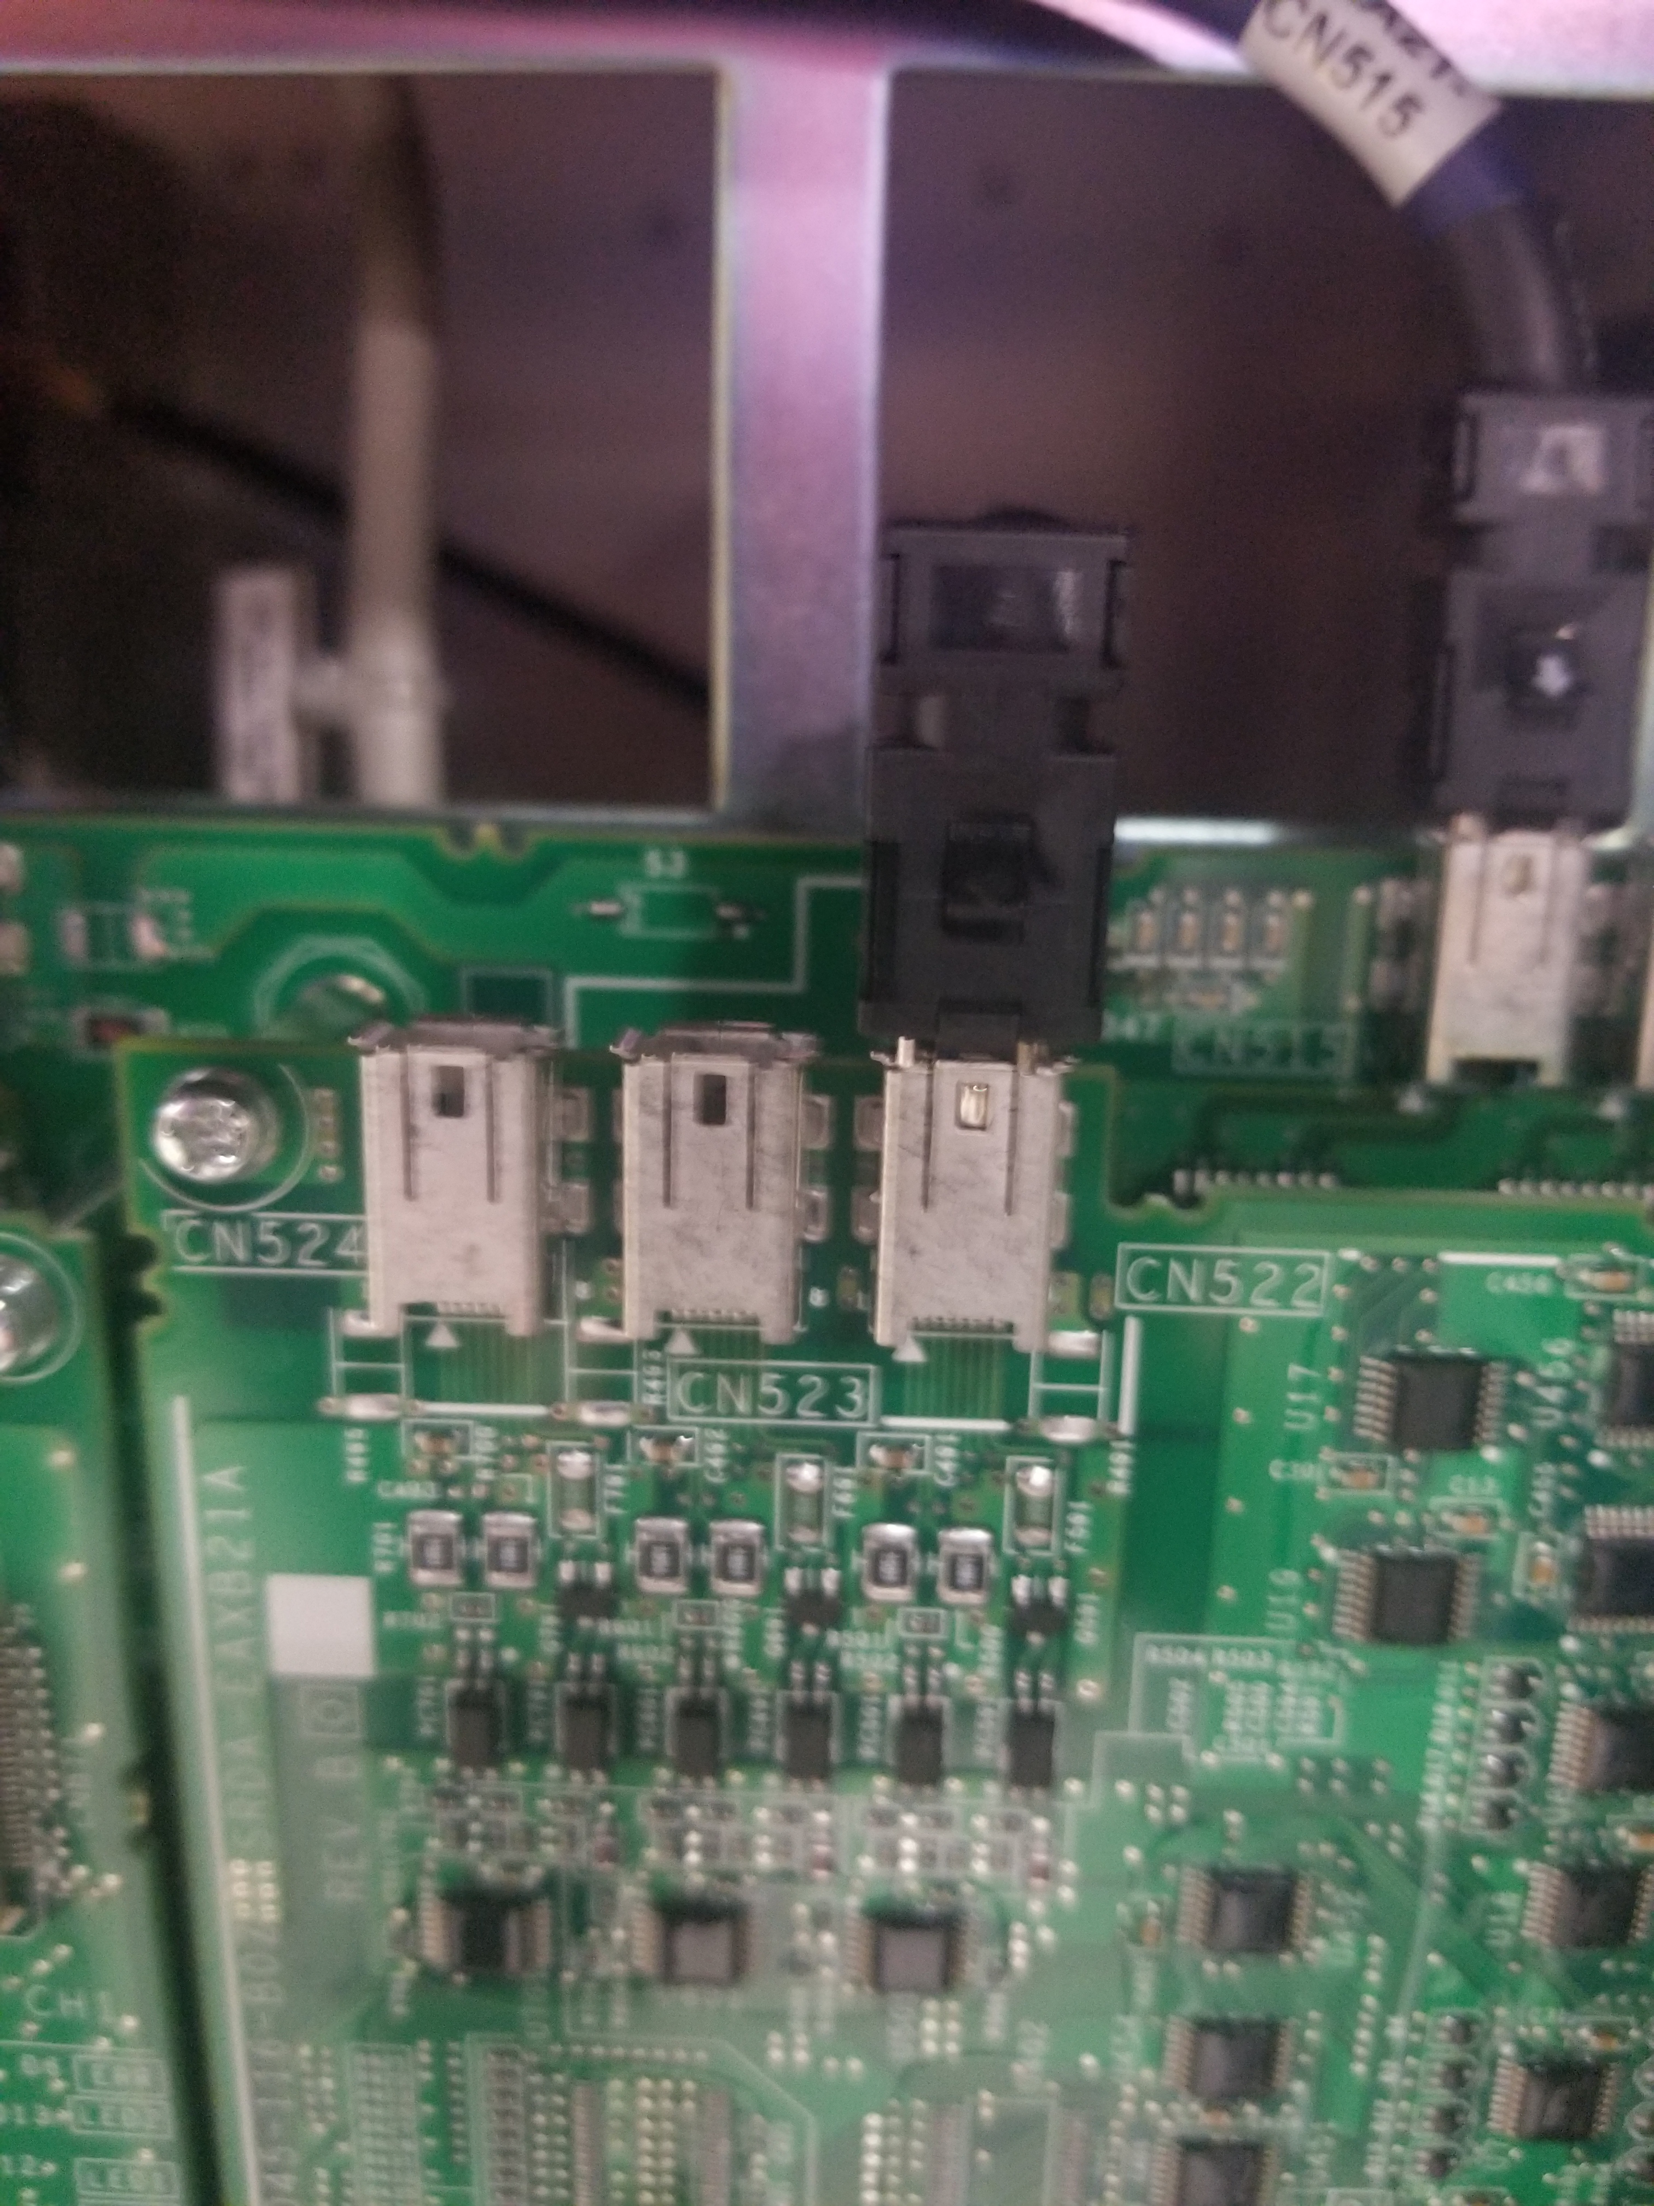
Servo Enable Connector
The final step of the physical set up is the installation of the servo enable connectors.
Plug the connectors in as shown.

Slide 35
External axis set up in the DX200
Now that all of the modules, boards and cables have been installed and connected, the external axis needs to be set up in the DX200 controller.
Hold the “Main Menu” button down on the teach pendant while powering on the controller.
Continue holding the “Main Menu” button down until you hear a beep.
When the controller boots up, you will be in maintenance mode. This is where the set up of the external axis is performed.

Slide 36
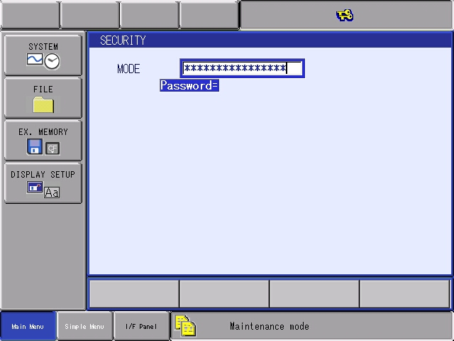
External axis set up in the DX200
After entering “Maintenance Mode”, you will need to enter the “management” level of security.
Select management mode from the drop down menu and enter sixteen “9’s”

Slide 37
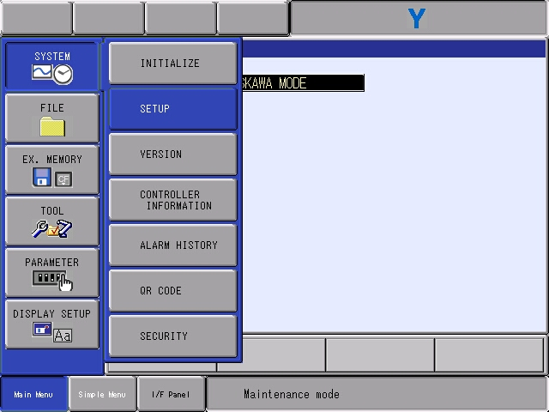
External axis set up in the DX200
After entering “management mode”, select SYSTEM > SETUP from the menu

Slide 38
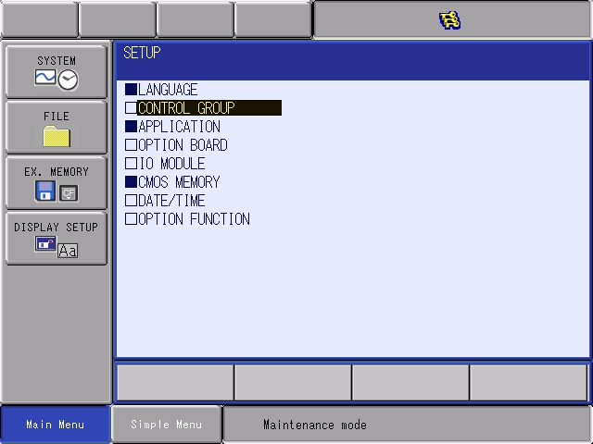
External axis set up in the DX200
The next screen you will see is the SETUP screen.
Cursor down to CONTROL GROUP and select.

Slide 39
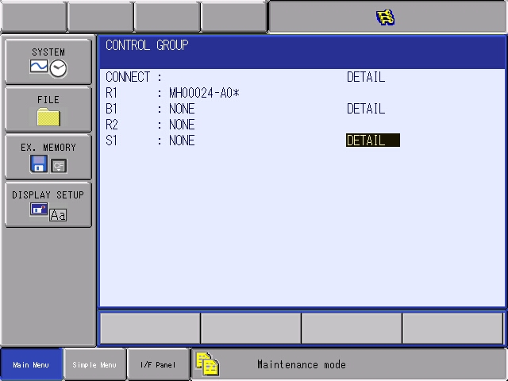
External axis set up in the DX200
The next screen you will see is the CONTROL GROUP screen. From this screen you will select the ROBOT and EXTERNAL AXIS.
Cursor down to the line you want to add the robot and external axis and select on DETAIL.
Once you select on the R1 and S1, as this example will be, a screen with the full machine list will be displayed.

Slide 40
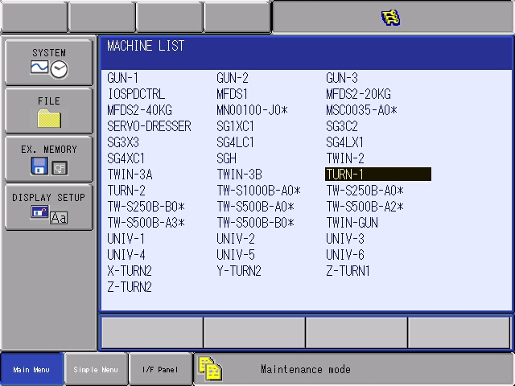
External axis set up in the DX200
From the MACHINE LIST screen, select the correct machine.
The machines listed describe the type of external axis.
For example, a single rotation head stock would be a TURN-1.

Slide 41
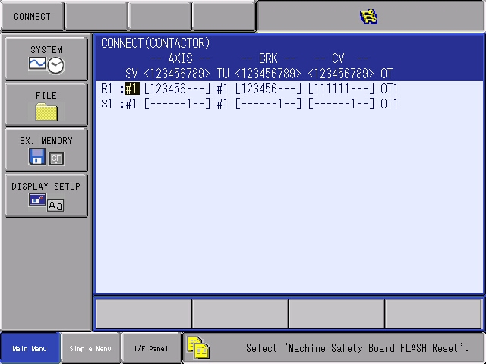
External axis set up in the DX200

Slide 42
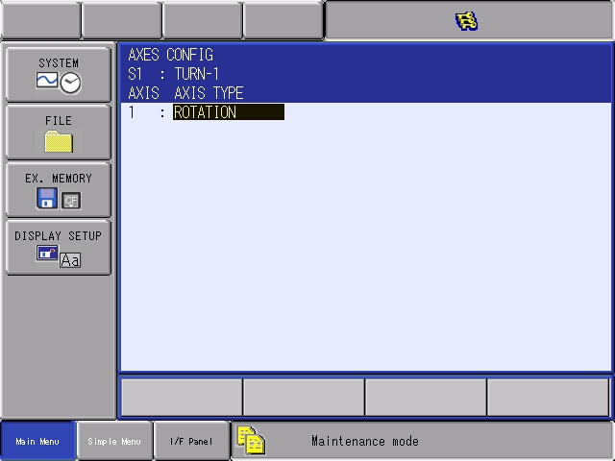
External axis set up in the DX200
After the machine has been selected the following machine set up screens will follow. This information can be found on the machines specification sheet or designated by your engineering group.

Slide 43
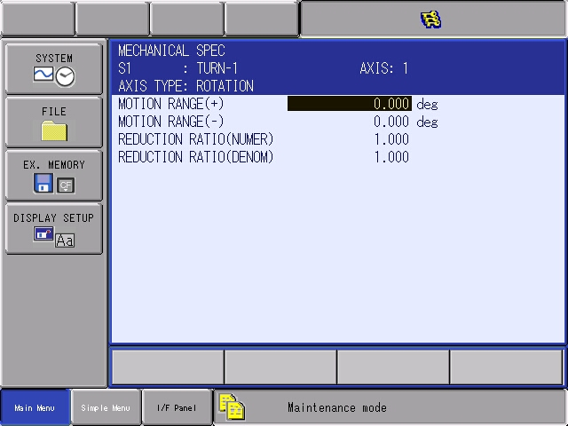
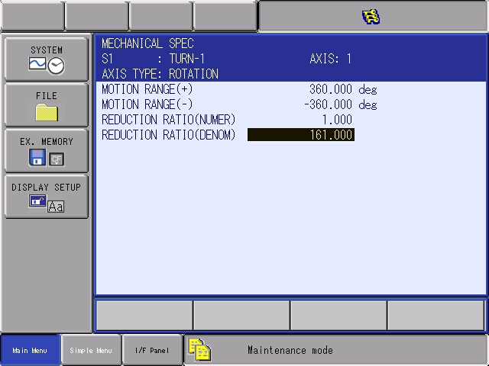
External axis set up in the DX200

Slide 44
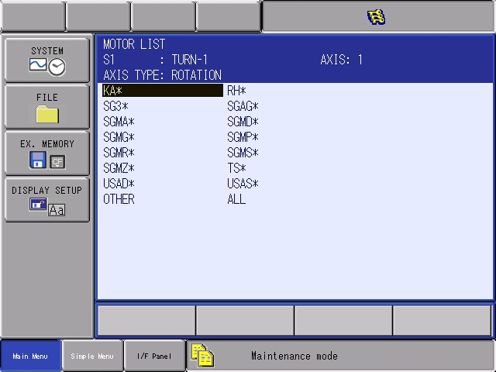
External axis set up in the DX200

Slide 45
External axis set up in the DX200

Slide 46
External axis set up in the DX200

Slide 47
External axis set up in the DX200

Slide 49
Fonts and Primary Colors to use throughout PPT
FONT: Arial Bold and Arial Regular
Headers on content slides
Subheads within body copy
Body copy
RGB 0-0-0
RGB 0-86-185
RGB 100-101-102
These are the secondary colors to use throughout the PPT to add color
RGB 237-195 -27
RGB 243-112-33
RGB 132-177-33
RGB 29-190-235
←preferred
RGB 194-216-54
RGB 0-133-63
RGB 165-51-126
RGB 56-54-135
←add’l if needed

