Slide 2
Introduction to Smart Pendant
Sayre Jeannet

Slide 3
Introduction to Smart Pendant
Overview
Why have a Smart Pendant?
Smart Pendant vs Traditional
Features
Hardware
Pendant Options
Software
Hands On
Restrictions
Functions
Jogging
Smart Frame
Easy INFORM
Visual Limits
Teaching Points
Job Editing
Command Builder
Playback
Variables
IO

Slide 4
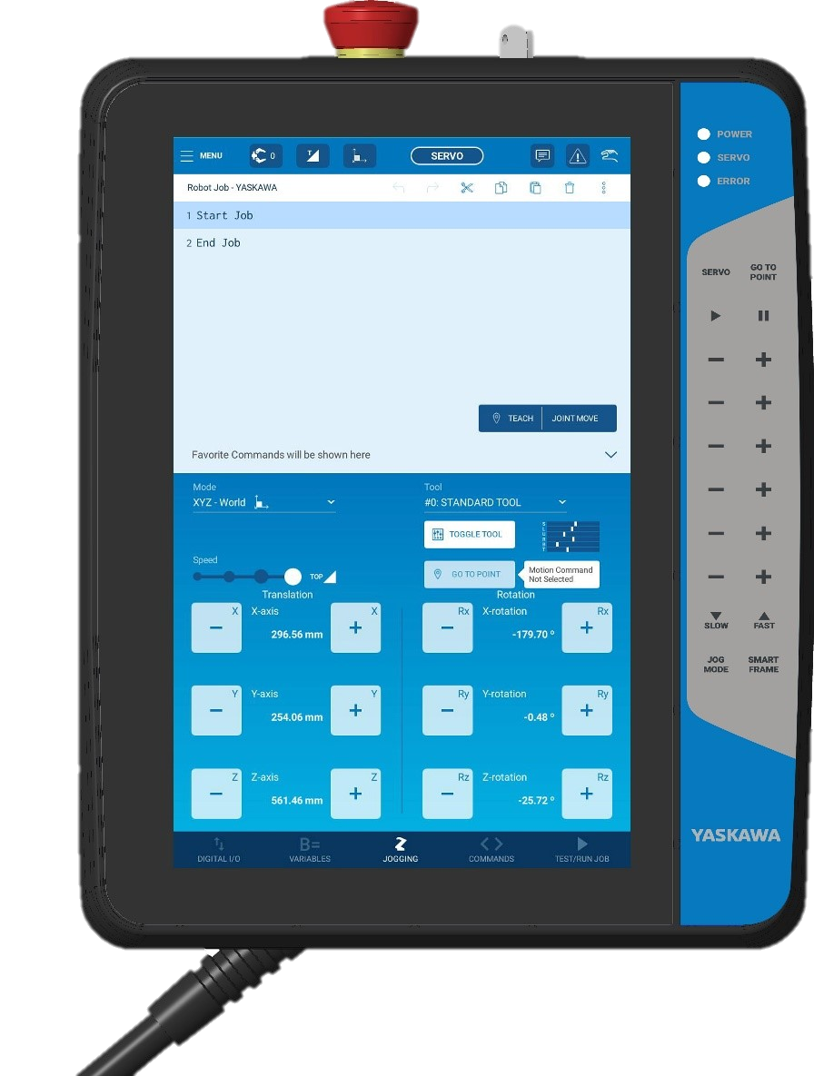
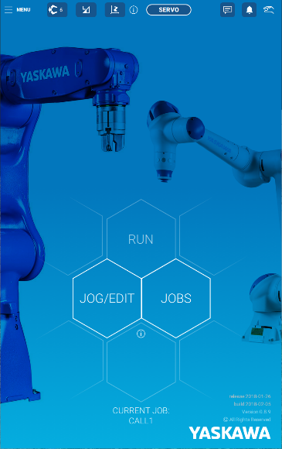
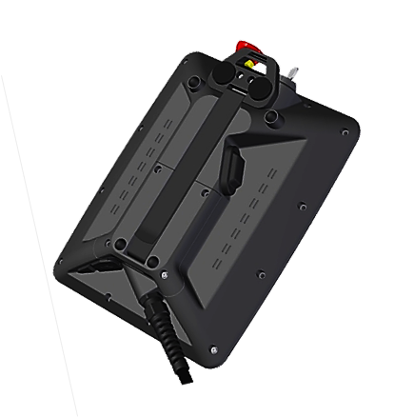
Introduction to Smart Pendant
Why have a Smart Pendant?
EASE OF USE
To offer a pendant to new customers that is both easy to use and encourages customer participation
Simplified “HMI” interface to allow line operators to easily reset and restart the robots
Responsive touch screen interface allows for greater flexibility and comfort for today’s smart phone users

Slide 5
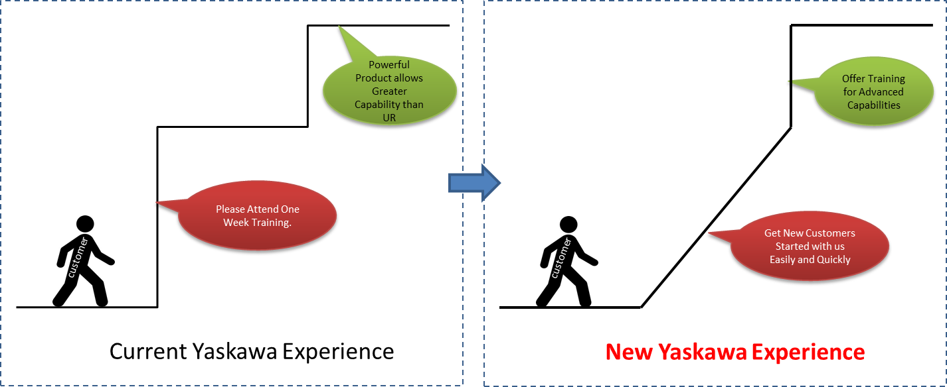
Introduction to Smart Pendant
Smart Pendant vs Traditional
Offers expert functionality that is market leading
Utilizing the latest in modern User Interface design techniques to give users better performance, reduced errors, coherence in information display, action feedback, and assistance with error recovery.

Slide 6
Introduction to Smart Pendant
Smart Pendant vs Traditional
 | YRC Pendant | Smart Pendant
Applications | All | Material Handling, Machine Tending, Injection Molding, Inspection, Assembly
Sale Price | Included with Controller | Same
Platform | Resistive touch screen with many membrane keys | Tablet with Projective Capacitive Touch (PCT) screen that is designed to be hardware independent
Ergonomics | Designed for extended use by a left/right handed person | Designed for shorter duration use by right handed person
Feature Set | All | Limited to meet 80% of handling applications
Customer | Trained robot programmers | Plant engineers and end user operators with limited robotics experience.
Ease of Use | Designed for efficient use by trained programmers | Designed for easy use by novice programmers with little to no training

Slide 7
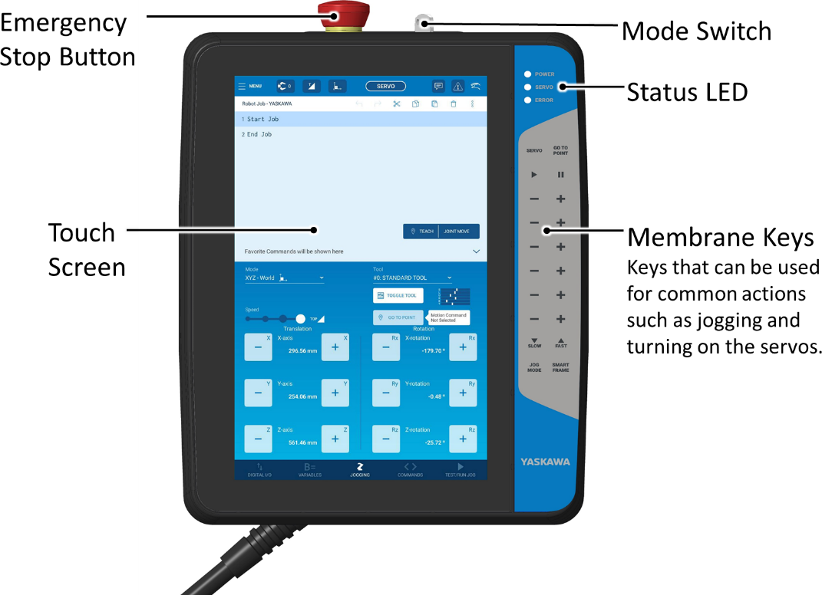
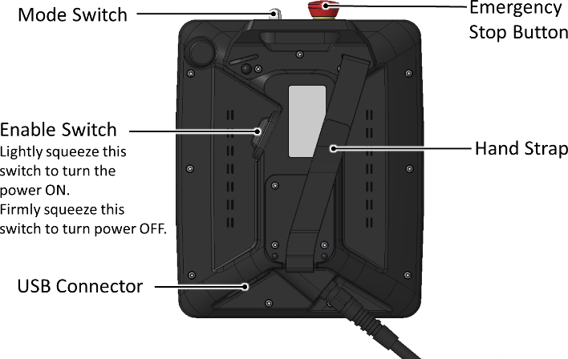
Introduction to Smart Pendant
Features: Hardware
• 10.1” WXGA TFT Display
• 1280 x 800 pixels
• LED back light touch panel
• Capacitive Touchscreen
• 215W x 283.5H x 68.5D mm
• Weight 1.12kg
• Drop Tested: 1m
• External Storage: USB memory

Slide 8
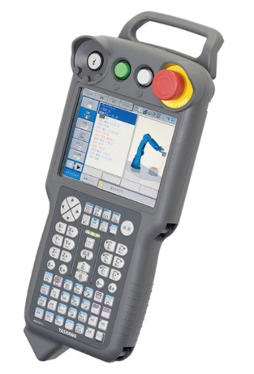
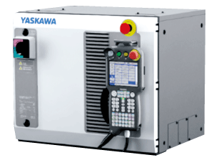
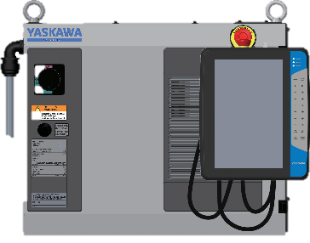
Introduction to Smart Pendant
Pendant Options
OPTION 1
OPTION 2
YRC Controller + YRC Pendant
Full functionality on Pendant
Full configurability of Controller
Targeting existing customers who know Yaskawa products
YRC Controller + Smart Pendant
Subset of functionality on Pendant
Fixed configuration of Controller (with some subset of options)
Targeting new customers with reduced customization needs

Slide 9
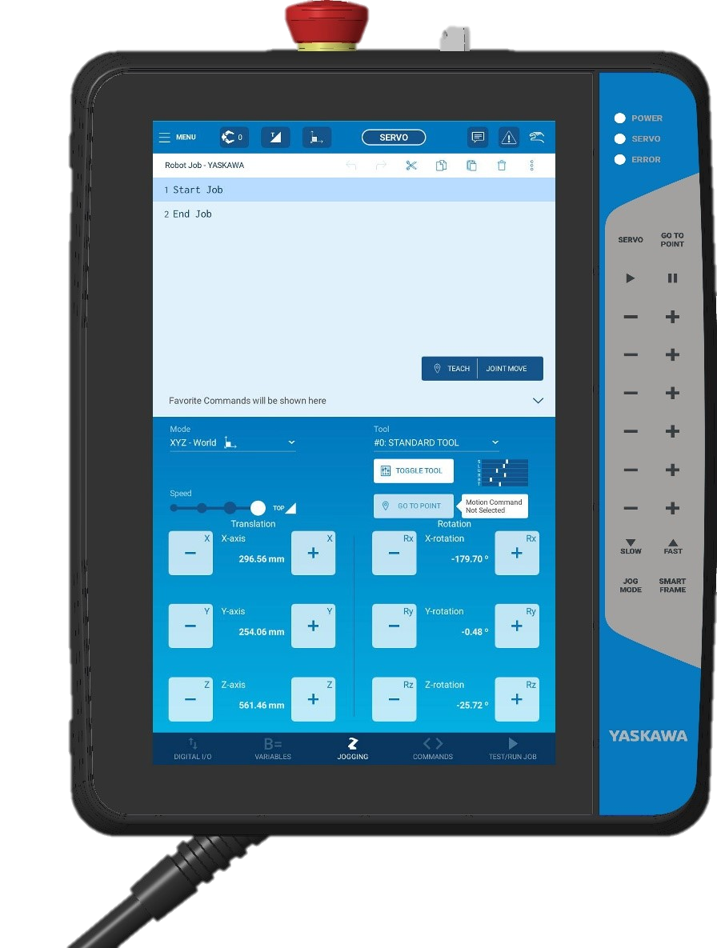
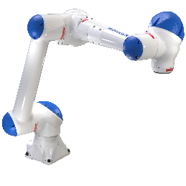
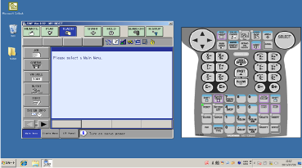
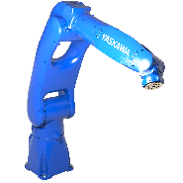
Introduction to Smart Pendant
Smart Pendant Software
The included Software Pendant will be required for Maintenance mode, FSU Settings, and Safety Logic functions

Slide 10
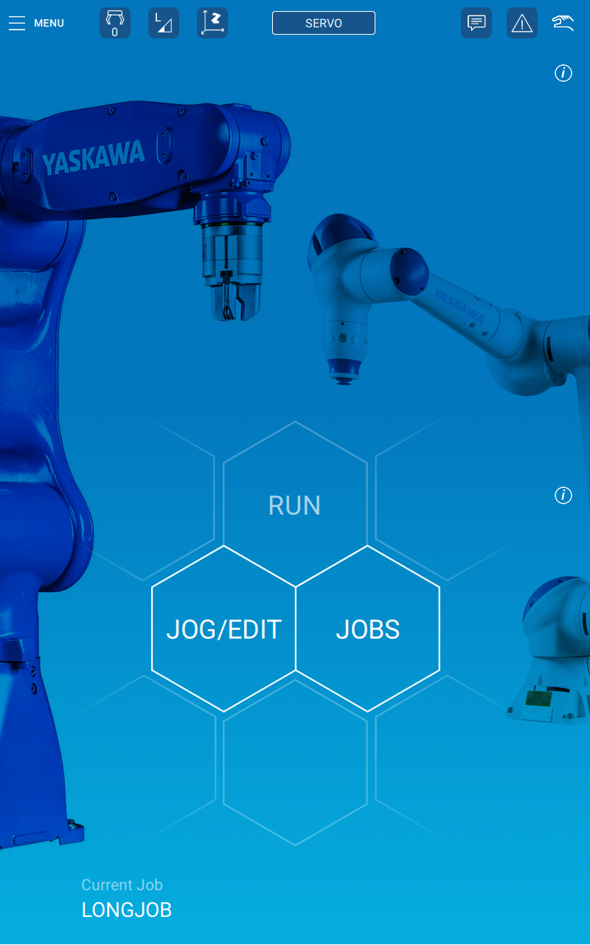
Introduction to Smart Pendant
Smart Pendant Benefits
The main menu makes switching among screens a comfortable experience .
Main menu provides easy access to all functionality.
Smart Pendant reduces the memorization by guiding a user to enter the relevant instructions, values, and/or procedures

Slide 11
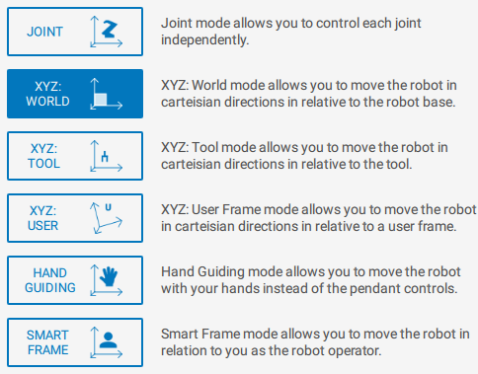
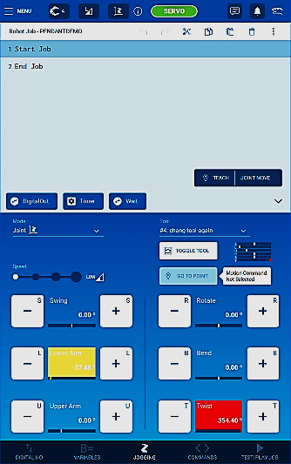
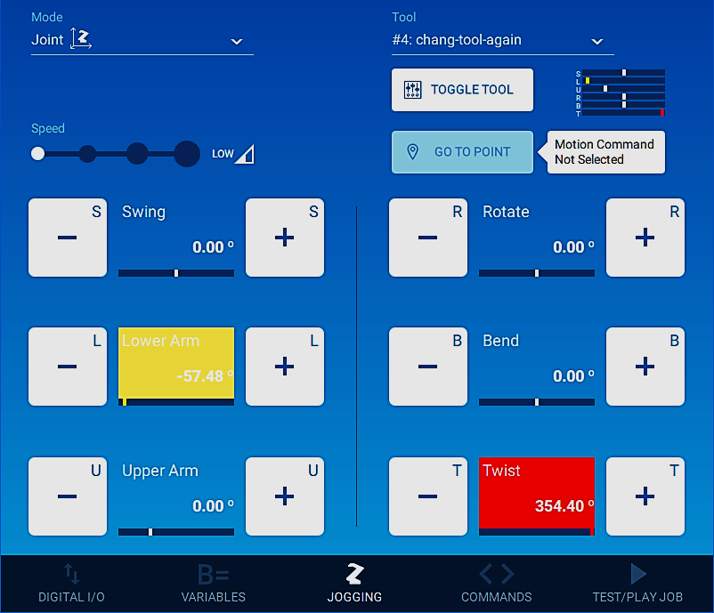
Introduction to Smart Pendant
Robot Jogging
Robot jogging supported from either touchscreen buttons or membrane keys interchangeably
Membrane Keys on the right are dynamically labeled with a black slide out bar

Slide 12
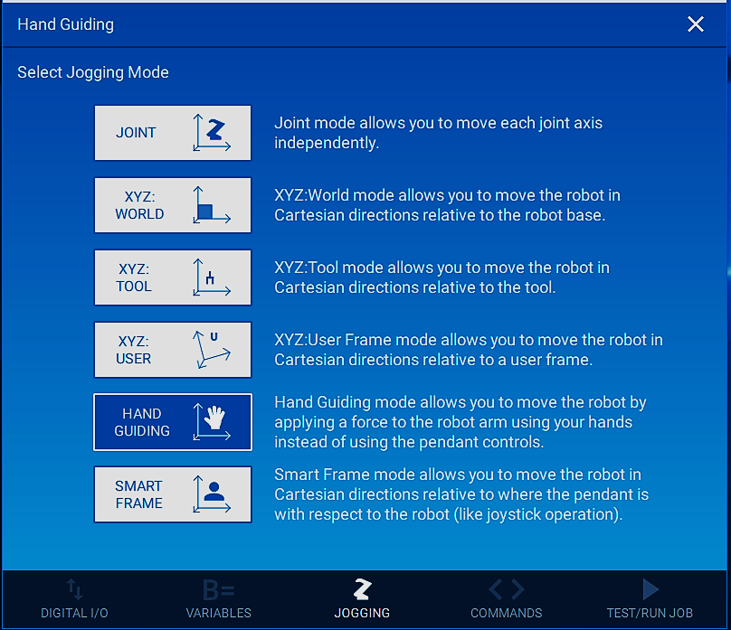
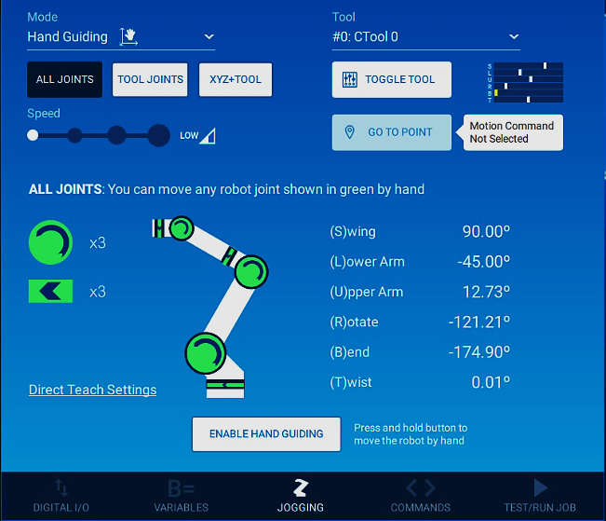
Introduction to Smart Pendant
Supported Jogging Modes
HC10 Exclusive
Smart Pendant Exclusive

Slide 13
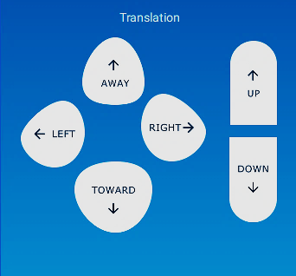
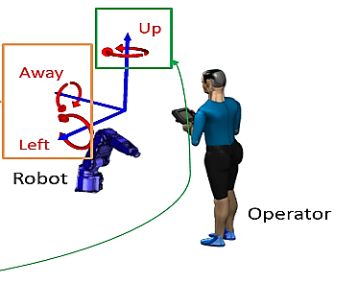
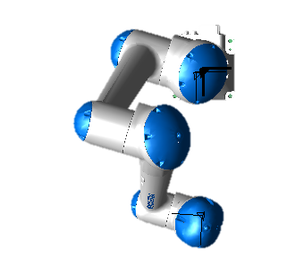
Introduction to Smart Pendant
Smart Frame
PATENTED
Uses the internal Inertial Measurement Unit (IMU) and compass inside the pendant to determine the user’s position relative to the robot.
The system requires initial calibration by standing directly in front of the robot and facing the robot.
Uses intuitive directional buttons to move relative to the operator
Motion is relative to the user
Left
In each of these four examples, the robot will move the same direction
Towards
Away
Right

Slide 14
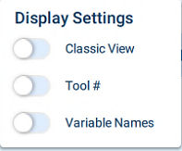
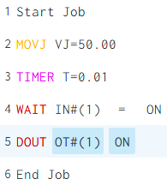
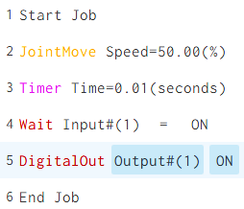
Introduction to Smart Pendant
Easy INFORM
Descriptive commands no longer require users to memorize abbreviations
Classic View
Smart Pendant View
A favorites bar allows for easy access to the most commonly used commands

Slide 15
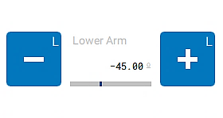
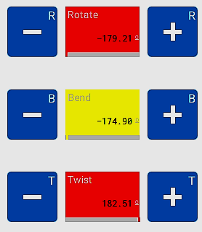
Introduction to Smart Pendant
Visual Limits
Joint Jogging mode
Touch screen jogging buttons show current joint position relative to maximum range below each button.
Yellow – Jogging buttons turn yellow when the joint is close to the maximum limit
Red – Jogging buttons turn red when the axis limit has been reached.
Indicator in the top right corner of the jogging screen shows limits for all axis, regardless of jogging type selected
Axis Range Indication
Axis limits shown via color

Slide 16
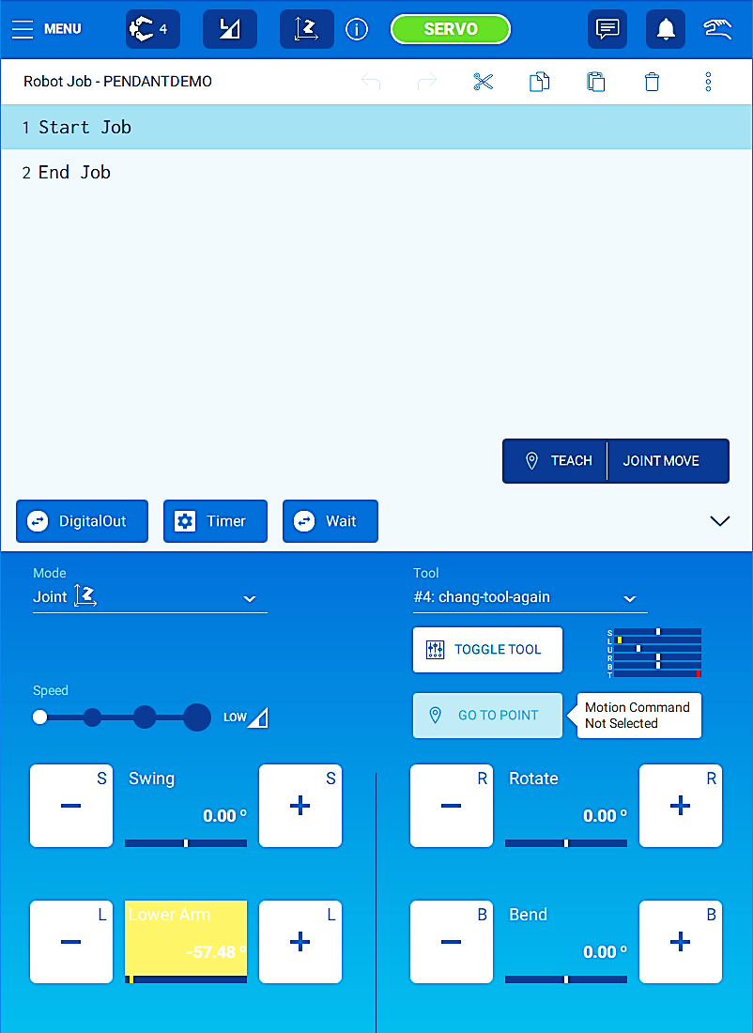
Introduction to Smart Pendant
Teaching Points
Teach button located above jogging keys
The right half of the teach button indicates the taught motion type
Motion type can be cycled through by touching the selected motion type
No longer required to press INSERT
Will insert motion above “End Job” and not produce error if user tries teach a point while “End Job” is selected

Slide 17
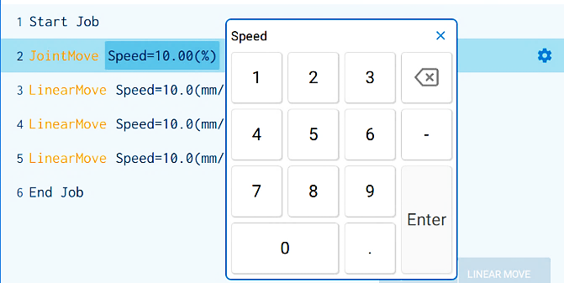
Introduction to Smart Pendant
Job Editing
Easier than ever with touch to edit functionality
Darker Highlighting Indicates Editable Field
Modern gear symbol allows users to “detail edit” any line of code
Copy, Cut, Paste, Undo, and Redo functionality easily accessible in the top right corner of the job edit window

Slide 18
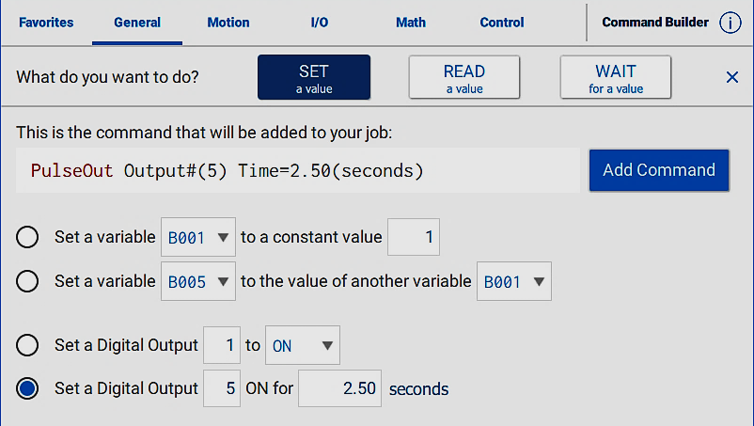
Introduction to Smart Pendant
Command Builder
Guides a user to inserting basic commands
Set a Value
Read a Value
Wait for a Value
Designed for first time users yet to learn command names

Slide 19
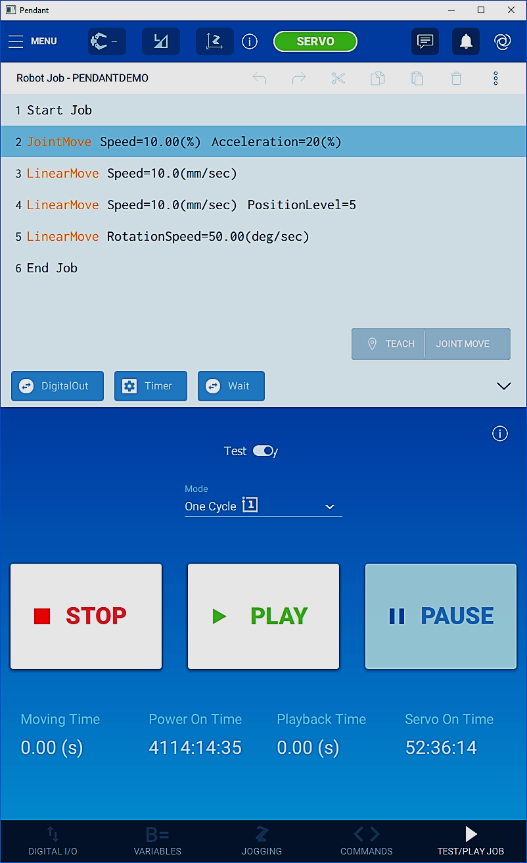
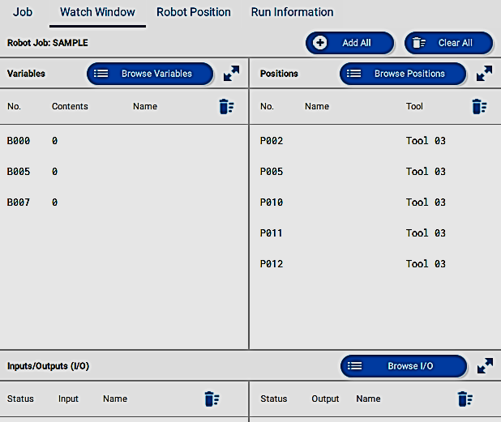
Introduction to Smart Pendant
Playback
Code as it’s run
Robot’s virtual position along the path
Moving, Power On, Playback, and Servo On time information
Interface designed to give relevant information during playback:
Allow users to easily monitor variables, positions, and IO during runtime with Watch Windows

Slide 20
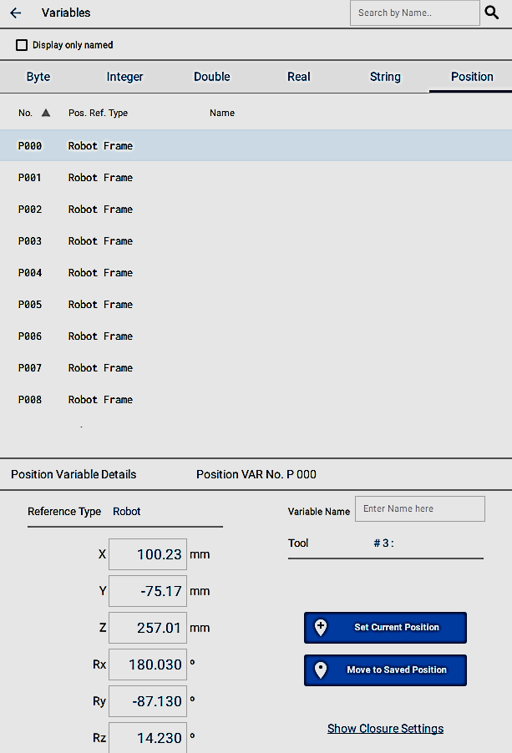
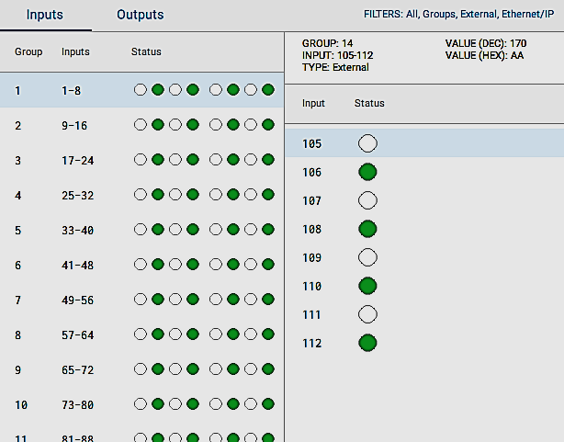
Introduction to Smart Pendant
Variables & IO
Allow easy viewing of multiple fields, naming relevant signals or variables, and easy modification via touch screen interface

Slide 21
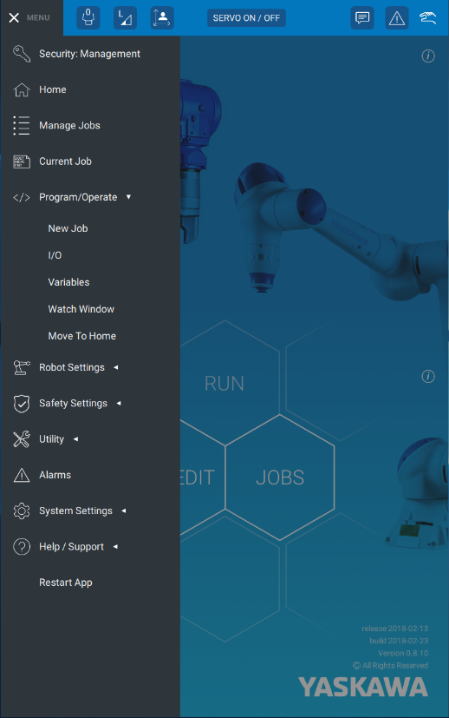
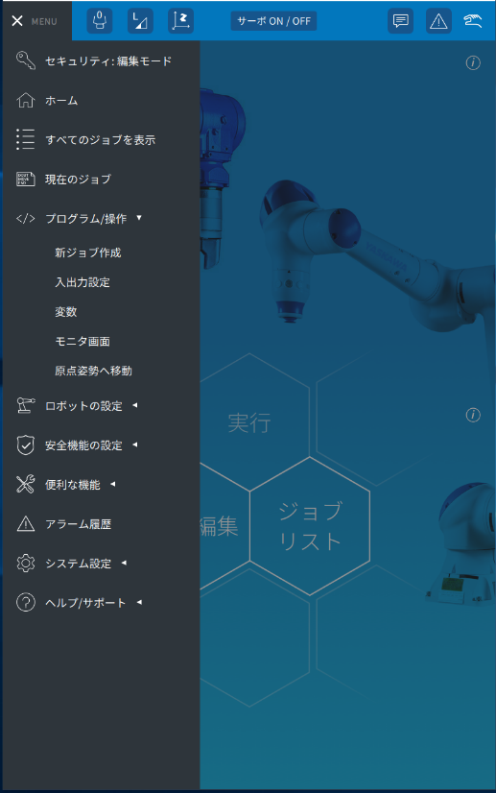
Introduction to Smart Pendant
Multi-Lingual Support
Supports Multiple Languages with more to come

Slide 22
Introduction to Smart Pendant
Conflicts and Restrictions
Smart Pendant is quickly adding functionality but does not yet support all the same features as the standard YRC1000 pendant
MotoSight 2D and other Macro enabled products are not yet supported
Pendant applications are not backwards compatible with older pendants
The software pendant (included at no extra cost) can be run via an ethernet connected laptop.
More Features Coming Soon!
Functionality | Smart Pendant | Software Pendant
Jogging | X
Conveyor Tracking |  | X
IO & Error Handling | X
User Frames / Interference Zones | X
Setting of ABSO Data |  | X
PFL/Tool Setup | X
Functional Safety / Safety Logic Settings |  | X

