Slide 1
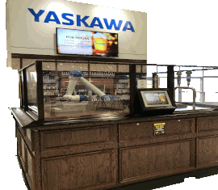
Yaskawa Sales Update
Pub Talk Series
MotoSight 3D BinPick How to Sell
Keith Vozel
Yaskawa Motoman
Tony Kitazawa
Canon U.S.A.

Slide 2
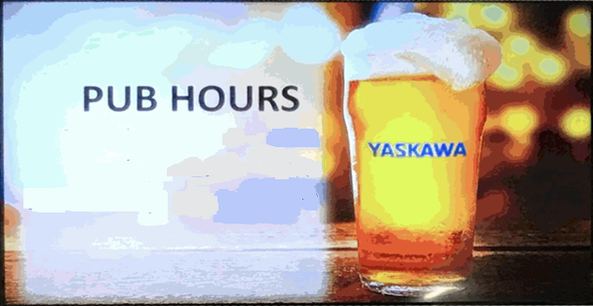
The Pub is Open

Slide 3
MotoSight 3D BinPick Topics
Appropriate types of applications
Sales process
Potential concerns
Good examples

Slide 4
Types of Applications
Almost anything that presents parts randomly in a bin that must then be picked and handled based upon the orientation
Part characteristics
Randomly presented in a bin (or multiple bins)
Distinguishable characteristics of at least 3mm
Parts with high definition
Must Have A CAD Model

Slide 5
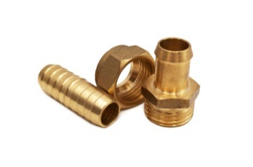
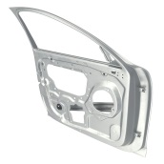
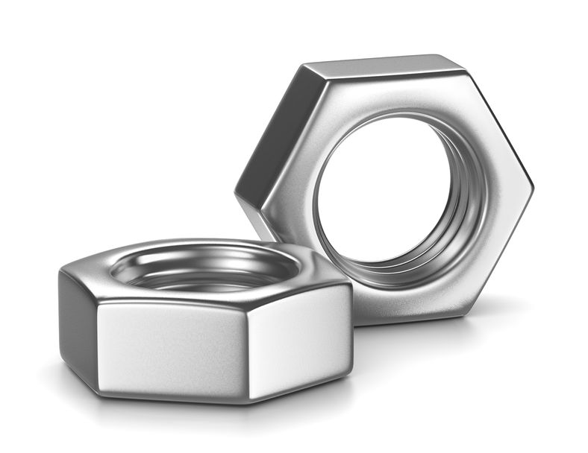
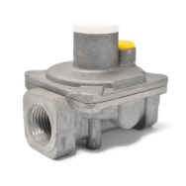
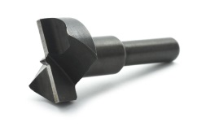
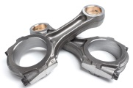
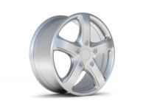
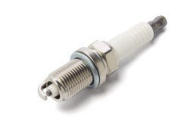
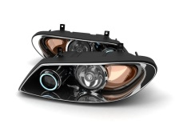
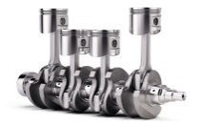
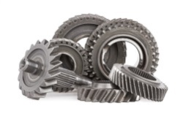
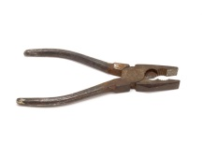
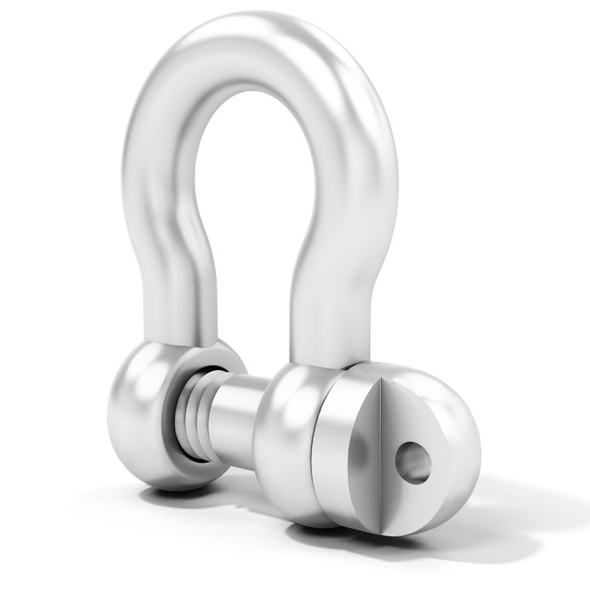
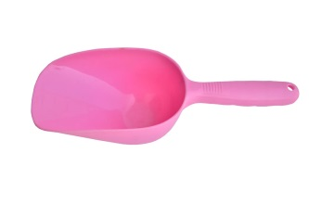
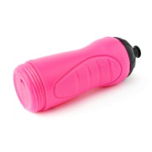
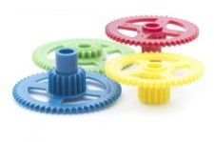
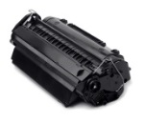
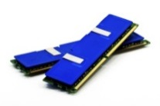
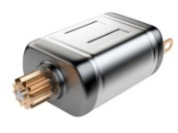
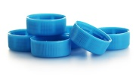
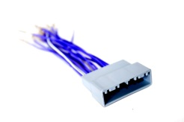
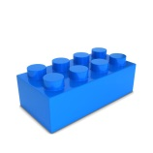
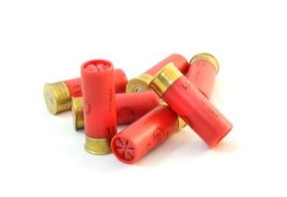
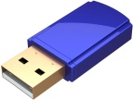
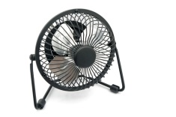
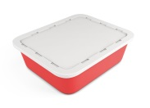
Types of Applications
Automotive
Metals
Electronics
Plastics

Slide 6
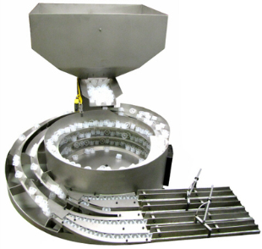
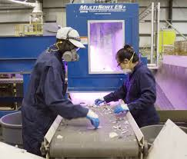
Applications to Target
Bowl Feeder
Human Operators
One device per one part
Huge - takes space
Noisy
Expensive to modify
Not reliable
Expensive
High turnover
Hard to fill the position

Slide 7
Justification
Possible justification – Mechanical Feeder
Eliminates the expense of changeover
More reliable
Possible justification – Human alternative
Redeploy workers to better jobs
More consistent and accurate picking

Slide 8
Sales Process
Understand the application
Understand the part characteristics
Understand the post pick process requirements
Understand the cycle time requirements
Ensure the application is funded and the customer is prepared to make a decision
Submit MotoSight 3D BinPick Part Survey
Schedule a part evaluation test with TAT based upon the evaluation in step #6
Secure the order
Biggest Challenge Affecting Closure. Other priorities or lack of funding occur.
Submit for a cursory review early on as well.

Slide 9
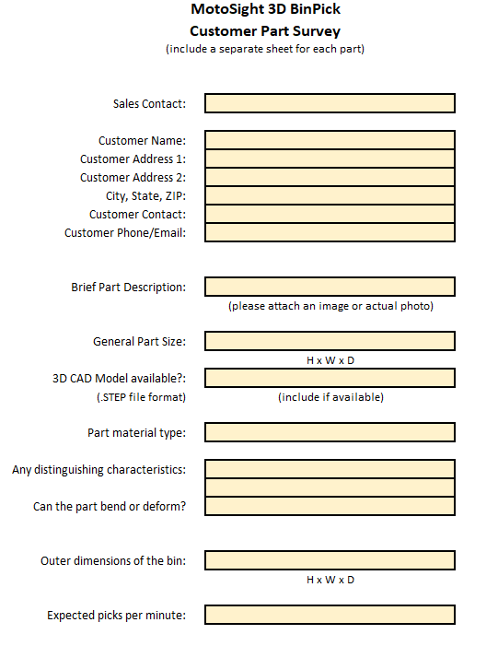
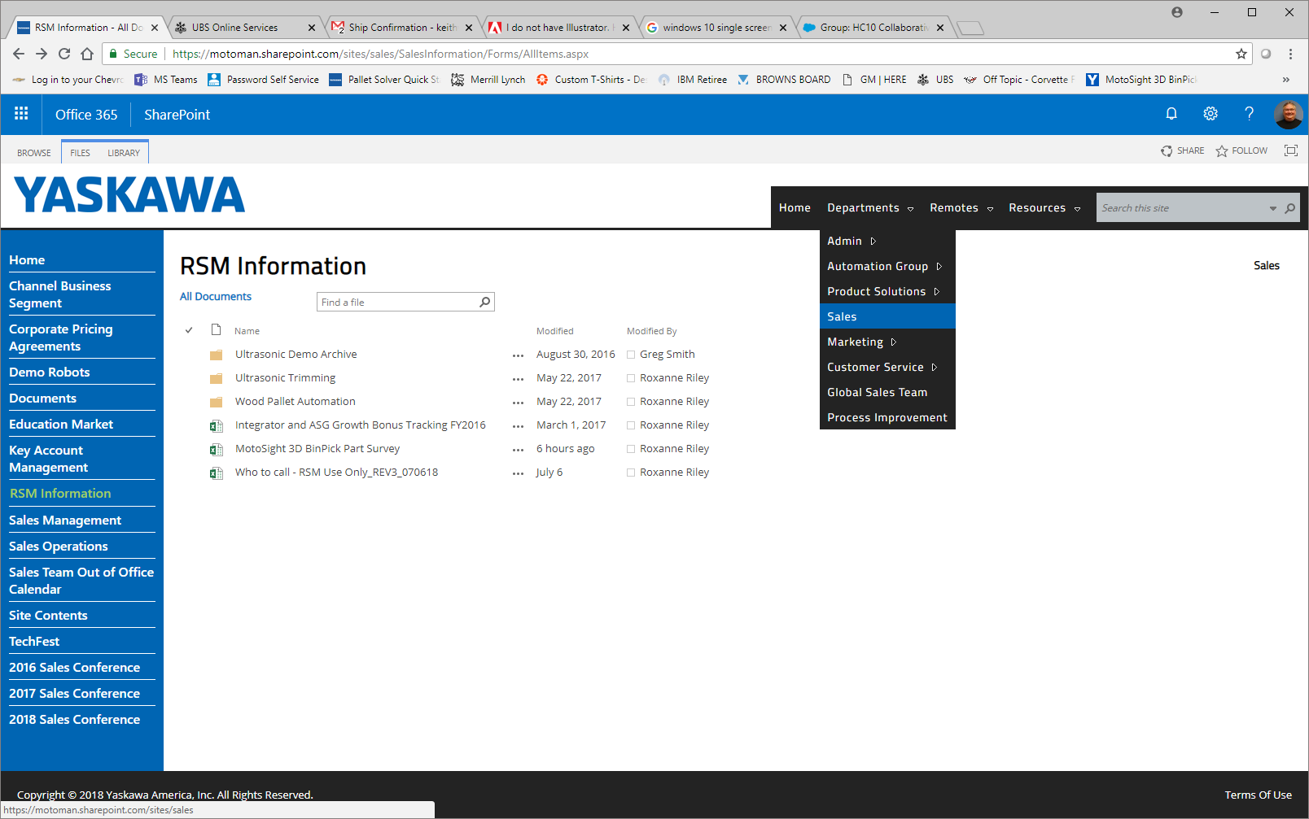
MotoSight 3D BinPick Part Survey
Located on SharePoint….
>Departments>Sales>RSM Information>MotoSight 3D BinPick Part Survey.xlsx

Slide 10
Possible Concerns
3mm x 3mm minimum for RV300
Very small parts

Slide 11
Possible Concerns
Very small parts
Prepackaged parts
Unable to match against the CAD model

Slide 12
Possible Concerns
Very small parts
Prepackaged parts
Soft or deformable parts
Presented differently every time

Slide 13
Possible Concerns
Very small parts
Prepackaged parts
Soft or deformable parts
Translucent parts
Structured light will not reflect

Slide 14
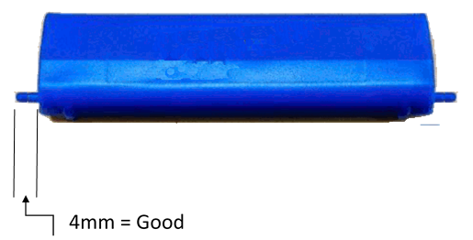
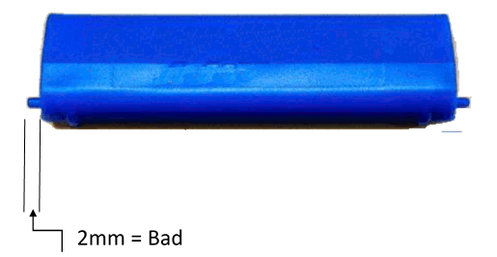
Possible Concerns
Very small parts
Prepackaged parts
Soft or deformable parts
Translucent parts
No significant distinguishable features

Slide 15
Possible Concerns
Very small parts
Prepackaged parts
Soft or deformable parts
Translucent parts
No significant distinguishable features
The need to recognize color
Does not recognize color

Slide 16
Possible Concerns
Very small parts
Prepackaged parts
Soft or deformable parts
Translucent parts
No significant distinguishable features
The need to recognize color
Extremely wide or deep bins
Might need movable camera or software options

Slide 17
Possible Concerns
Very small parts
Prepackaged parts
Soft or deformable parts
Translucent parts
No significant distinguishable features
The need to recognize color
Extremely wide or deep bins
Extremely fast cycle times
Might need multiple robots

Slide 18
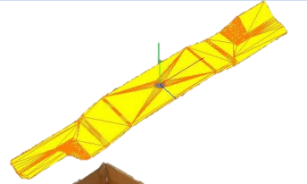
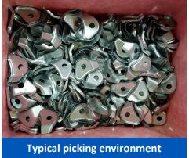
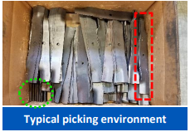
Good Examples

Slide 19
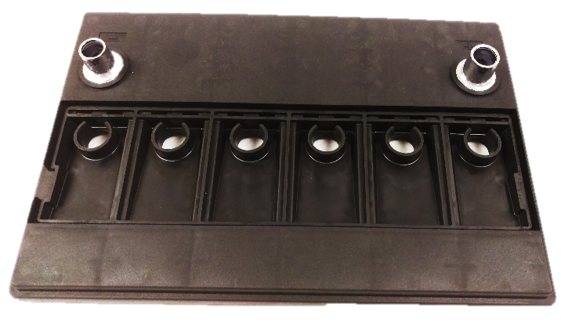
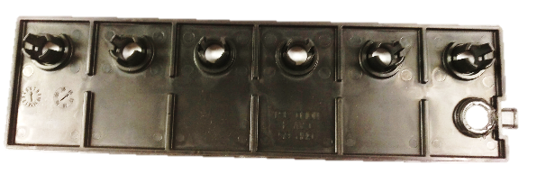
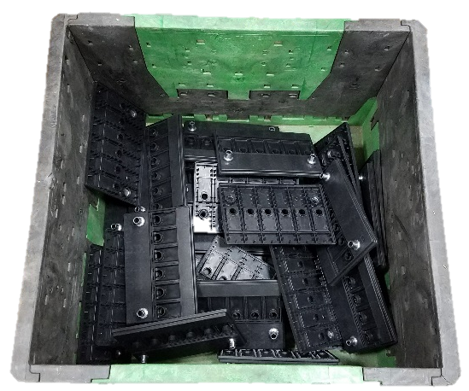
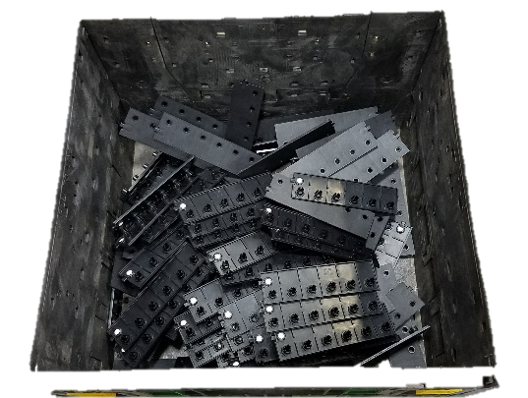
Good Examples
Example of intertwined parts
Typical picking environment
Typical picking environment

Slide 20
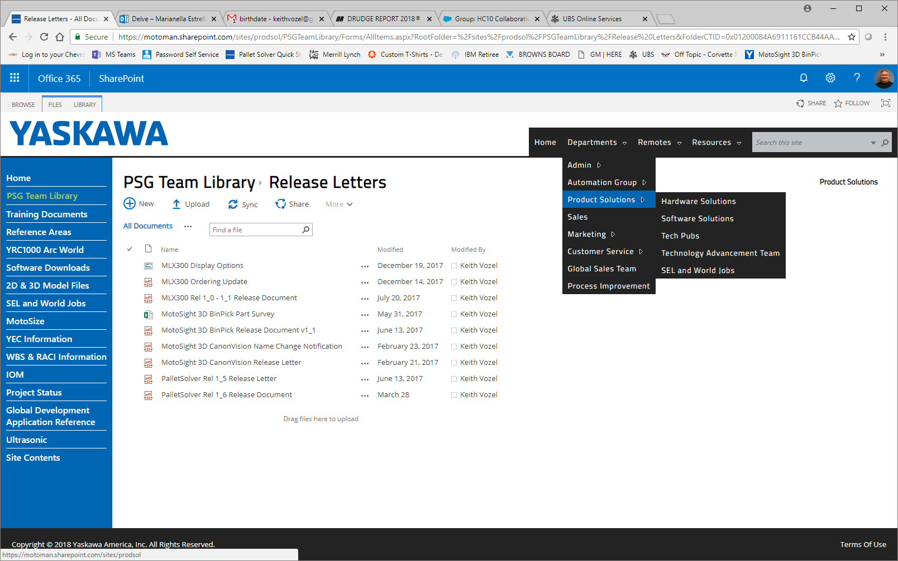
Additional Resources
MotoSight 3D Bin Pick Release Document v1.1
Departments>Product Solutions/PSG Team Library/Release Letters

Slide 21
Coming Attractions
What else is needed to help you sell Yaskawa Vision Solutions?
Email suggestions to keith.vozel@motoman.com
Have any questions?
Email questions to keith.vozel@motoman.com
Questions and answers will be distributed to all attendees

Slide 22
The Pub is CLOSED

